Slide 1
Chrome River:
Expense Reports
DISBURSEMENT SERVICES

Slide 2
Creating an Expense Report
Demonstration

Slide 3
Expense Reports - Tips & Reminders
Expense reports are only done if the traveler (Stockton employee/faculty) is receiving a reimbursement. Travel reimbursements pertaining to students & non-employees are done as direct pays.
If there are P-card transactions related to your trip, check your E-wallet to see if they are there.
If you do not see the Pcard transaction, check WORKS to ensure the transaction has been reconciled and signed off by the BUM.

Slide 4
Tips & Reminders…continued
You should always have a Pre-Approval to reference when completing an Expense Report.
Import the Pre-Approval data only if you are referring to a Pre-Approval that is NOT a blanket. The Import button is on the top of your Expense Report header.
If you are referring to a blanket, complete the report and then when you are ready to submit, click the Pre-Approval button to attach your blanket Pre-Approval.

Slide 5
Tips & Reminders…continued
If you have imported your Pre-Approval data, any line item with , you will need to edit the line item to validate the data.
Any line item with will require you to put in a response to the message in order to submit your report.
Receipts should be attached to each expense line item if required. You can upload an attachment or add from your Receipt Gallery if images were mailed to receipt@chromefile.com
Checking the box next to “Personal Charge” means the traveler will not get reimbursed for the expense.
When inputting Personal Vehicle Mileage, do not type in an amount in the “Spent” field. Click on the “Map” button in the “Miles” field to bring up Googlemaps.
Input your trip information on Googlemaps, click on “Save Trip” and the system will calculate the amount for you. The map showing your trip will also automatically attach to your Personal vehicle Mileage line item.

Slide 6
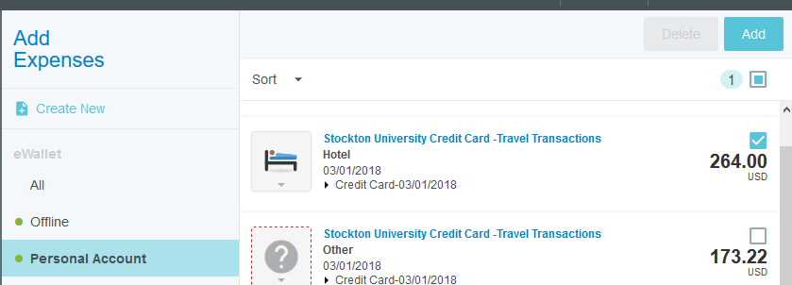
Attaching Pcard Transactions
Reconciled and closed Pcard transactions will be housed in your eWallet under Personal Account.
Click on the box above the amount of the transaction and then click on “Add” to add as a new expense line item.

Slide 7
Attaching Pcard Transactions…continued
Drag & Drop Feature: To add a Pcard transaction to an existing line item, click on the transaction in your Personal Account and while holding down on your mouse, drag the transaction over to the appropriate line item on your report and release from the mouse.
If the Pcard transaction has been reconciled and approved by your BUM, but you do not see it in your Personal Account, when you are in the expense line item, click on the “University Credit Card” box and type in the TXN Number.

Slide 8
Submitting Your Expense Report
If a Proxy completes an expense report on behalf of the traveler, the traveler will receive an email from Chrome River to approve the report first. It will then go to the BUM and then Disbursement Services.
The approved expense report will feed over into Banner as a direct pay with the following information:
Document Number: Will start with a TR (travel reimbursement)
Vendor Invoice Field: First date of travel and the last 4 numbers of the document
Commodity Description: Report Name and the Expense Report ID Number created by CR
To view the direct pay in Banner, go to FAIVNDH (Vendor Detail History) and search by vendor.
Click on “Related” to view the Invoice Information (FAIINVE)

