Slide 1
Increasing Online Survey Response Rates
April 7, 2015
Institute for Faculty Development
Notes:
Flowered lace background
(Basic)
To reproduce the shape effects on this slide, do the following:
On the Home tab, in the Slides group, click Layout and then click Blank.
On the Insert tab, in the Images group, click Clip Art.
In the Clip Art pane, in the Search for box, enter 00435540, select the Include Office.com content check box, and then click Go. Select the clip art file in the pane to insert it into the slide. (Note: If you choose another clip art file, the clip art must be in the Windows Metafile format [.wmf].)
On the slide, select the clip art.
On the Home tab, in the Drawing group, click Arrange, and then click Ungroup.
In the Microsoft Office PowerPoint dialog box, click Yes.
On the slide, select the converted clip art. On the Home tab, in the Editing group, click Select, and then click Selection Pane.
In the Selection and Visibility pane, select the top-level group. On the Home tab, in the Drawing group, click Arrange, and then click Ungroup.
Also in the Selection and Visibility pane, select the Autoshape object, and then press DELETE.
On the Home tab, in the Editing group, click Select, and then click Select All. On the Home tab, in the Drawing group, click Arrange, and then click Regroup.
On the slide, drag the adjustment handles on the group to increase its size so that it extends beyond the edges of the slide.
Select the group. On the Home tab, in the bottom right corner of the Drawing group, click the Format Shape dialog box launcher. In the Format Shape dialog box , click Fill in the left pane, select Solid fill in the Fill pane, and then do the following:
Click the button next to Color, and then under Theme Colors click White, Background 1 (first row, first option from the left).
In the Transparency box, enter 80%.
Also in the Format Shape dialog box , click Line Color in the left pane, select Gradient line in the Line Color pane, and then do the following:
In the Type list, select Linear.
Click the button next to Direction, and then click Linear Down (first row, second option from the left).
In the Angle box, enter 90%.
Under Gradient stops, click Add gradient stop or Remove gradient stop until two stops appear in the slider
Also under Gradient stops, customize the gradient stops that you added as follows:
Select the first stop in the slider, and then do the following:
In the Position box, enter 0%.
Click the button next to Color, and then under Theme Colors click White, Background 1 (first row, first option from the left).
In the Transparency box, enter 100%.
Select the second stop in the slider, and then do the following:
In the Position box, enter 100%.
Click the button next to Color, and then under Theme Colors click White, Background 1 (first row, first option from the left).
In the Transparency box, enter 0%.
To reproduce the background on this slide, do the following:
On the Design tab, in the bottom right corner of the Background group, click the Format Background dialog box launcher. In the Format Background dialog box, click Fill in the left pane, select Gradient fill in the Fill pane, and then do the following:
In the Type list, select Linear.
Click the button next to Direction, and then click Linear Diagonal (first row, first option from the left).
In the Angle box, enter 225⁰.
Under Gradient stops, click Add gradient stop or Remove gradient stop until three stops appear in the slider.
Also under Gradient stops, customize the gradient stops that you added as follows:
Select the first stop in the slider, and then do the following:
In the Position box, enter 0%.
Click the button next to Color, and then under Theme Colors click Tan, Background 2, Darker 10% (second row, third option from the left).
Select the second stop in the slider, and then do the following:
In the Position box, enter 18%.
Click the button next to Color, and then under Theme Colors click White, Background 1 (first row, first option from the left).
Select the third stop in the slider, and then do the following:
In the Stop position box, enter 100%.
Click the button next to Color, click More Colors, and then in the Colors dialog box, on the Custom tab, enter values for Red: 209, Green: 211, Blue: 191.

Slide 2
Students and surveys
MOA creates a moratorium on surveying students during
the official survey period
Students are receiving multiple requests for surveys
Less can be more
Students are e-mailed separate e-mails for IDEA Online and
Small Class Online

Slide 3
How are online surveys administered?
E-mails are sent to students by respective systems
  IDEA Online system (external)
  Small Class Online system (internal)
IDEA Online utilizes students’ Z Numbers to authenticate or link to survey
Small Class Online utilizes students’ portal ID and password to authenticate
IDEA Online sends individual e-mail out for every survey
Small Class Online utilizes multiple e-mails but one site with all survey links

Slide 4
IDEA Online
From Subject
Stockton Student Evaluations End of Semester IDEA Course Survey for GAH 1234 11:27 AM
Please click on the URL below to complete an IDEA Student Ratings of Instruction course survey for
Richard Stockton College of New Jersey
Dennis Fotia
GAH 1234 Introduction to Student Evaluations course.
YOU WILL ONLY BE ABLE TO ACCESS THE URL ONE TIME.
In order to have your responses included, the survey must be completed by 4/27/2015.
All of your responses will be kept confidential and will be submitted directly to the IDEA Center in Manhattan, KS. Your instructor will be provided a report summarizing the responses of your entire class. The written comments given by you and your classmates will also be provided verbatim and will be anonymous unless you supply information that identifies yourself. This information will be most helpful to the instructor and to the institution if you answer thoughtfully and honestly.
If you experience any technical difficulties please contact studentevaluations@stockton.edu. Other questions should be addressed to your instructor.
Thank you for your time and thoughtful responses.
https://theideaonline.org/idea/cs/survey?S=2340411/21052818/F/F/2935493820
If your system is unable to link to the website, please copy the underlined text and paste it into the location field of your web browser.

Slide 5
Small Class Online
Dear Stockton Student,
Please use the following link to provide feedback regarding your Sub Term A course to your professor and the college about the quality of instruction you have received in any of your classes that may be using an online small class form for student evaluations. You should only complete a survey for your Sub Term A course.
http://intraweb.stockton.edu/eyos/page.cfm?siteID=14&pageID=180&action=cas
Note the following important directions:
1) You will have between April 14 and April 27 to complete an evaluation.
2) You must be logged into the Stockton portal for the link to work.
3) Once you have submitted an evaluation for a class, you will not be able to change it.
Your feedback will be most helpful to the instructor and to the institution if you answer thoughtfully and honestly. As student evaluators, you should also know that the results of your evaluations for this class will be included as part of the information used to make decisions about promotion/tenure/salary increases for this instructor. Fairness to both the individual and the institution require accurate and honest answers. The institution guarantees the confidentiality of your responses. Your considered response is important to the college, to the faculty member being evaluated, and to your student colleagues. Please respond accordingly.

Slide 6
Faculty interaction
Alert students ahead of the survey period letting them know to look for survey request
Remind students during survey administration period and prior to survey deadline
  Course e-mail to students’ Stockton e-mail accounts
  Blackboard Announcement (and set to Stockton e-mail)
  Blackboard Message
  Blackboard e-mail
Remind students of course objectives with survey objectives

Slide 7
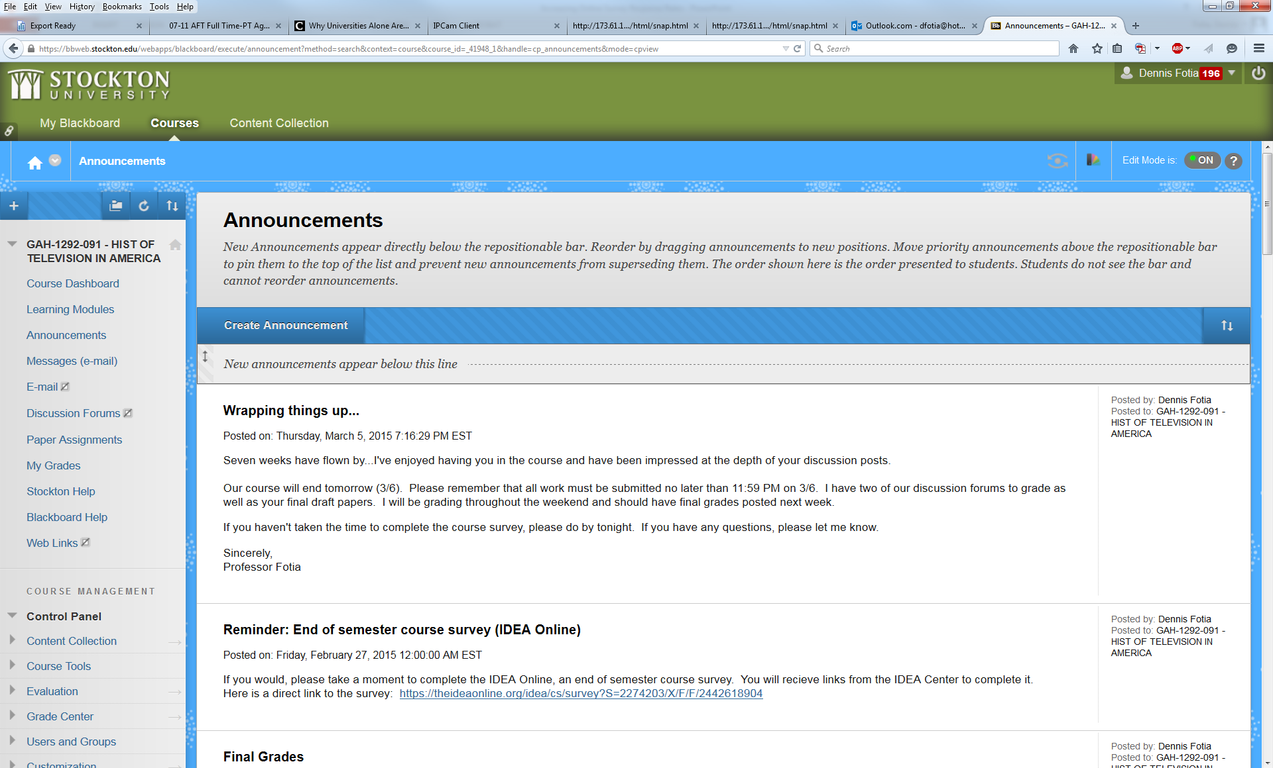
Using URL to post Announcement

Slide 8
Student anonymity and survey enrollment
Student participation and individual responses in online surveys remain anonymous
I can provide current response rate to faculty/instructors but not individual names of respondents who have completed a survey
Students who withdraw from a course are not surveyed
All students officially enrolled are given an opportunity to take survey

Slide 9
Current administrative strategies
Utilization of convenient student interface for completion of IDEA
Email reminders to students and faculty
Regular email updates to faculty on proportion of students that have completed IDEA

Slide 10
Recommendation 1: Create Value for Student Feedback
Beginning of course
  Align IDEA objectives with course objectives (and ELOs) on syllabus
  Tell students how you have used prior student feedback to improve course
Mid-semester: remind students of learning objectives, strategies you’ve utilized to achieve them
End of course
  Remind students that to this point you’ve been giving them feedback, now it’s their chance
  Show them sample score report—emphasize info generated
  Re-emphasize confidentiality (no identifying information; grade cannot be affected)

Slide 11
Recommendation 2: Communicate with students
Use encouraging emails that report proportion of students that have completed survey
Use of social media (more effective if you have utilized SM throughout semester)
If class meets in-person, provide daily updates, reminders

Slide 12
Recommendation 3: Integrate process into campus culture
Introduce online process as part of freshman orientation
Make use of campus-wide information forums
  Ad or article in Argo
  Prominent reminder on students’ Go Portal home page
    Update of campus-wide proportion of completers
    “40 percent of students have completed their online IDEA surveys. Have you?”

Slide 13
Recommendation 4: Use class time
Schedule computer lab
Have students bring laptops

Slide 14
Recommendation 5: Incentives
Course specific
  Points for reaching a set response rate
  Elimination of quiz, homework assignment
Institution-wide
  Lottery for prize
  Early access to grades (probably not viable for us)

Slide 15
Conclusions
Your relationship with students may be the strongest incentive for their participation
  Create “feedback culture” through frequent formative evaluations
  Emphasize desire for feedback about what is and isn’t working
Fostering rapport and a collaborative environment throughout the semester “primes” students for collaboration through IDEA feedback
Over 80 percent participation is a reasonable expectation for online IDEA

