Slide 1
File Construction Workshop NTTP, XIII-D, XIII-O, PT Kerri Sowers Fall 2022

Slide 2
Today’s Session
Important Resources
File Construction
Questions

Slide 3
Important Resources
Locally Negotiated Agreements
Faculty Evaluation Procedure (MoA)
Faculty Evaluation Policy (University Standards – section 6.00 and 10.00)
Program Standards
School Standards
Covid MOA
NTTP MOA
Personnel Actions Calendar
Summary Due Dates

Slide 4
Important Dates
January 4, 2023 - File Closing: NTTP Year 1-4, NTTP Year 5, XIII-D, XIII-O, PT Year 1-4, PT Year 5, and PT After Year 5
January 17 - PRC Letters: NTTP Year 1-4, NTTP Year 5, XIII-O, PT Year 1-4, PT Year 5, and PT After Year 5
January 24
PRC Letters: XIII-D
Dean Letters: NTTP Year 1-4, NTTP Year 5, XIII-O, PT Year 1-4, PT Year 5, and PT After Year 5
January 31
Dean Letters: XIII-D
FRC Letters (only if needed): NTTP Year 1-4, XIII-O, PT Year 1-4, and PT After Year 5
FRC Letters (required): NTTP Year 5, PT Year 5
February 7 - Provost - NTTP Year 5, PT Year 5 required, all others are only if needed
February 14 - President
February 22 - BOT
Rebuttals are due 3 days after each level of review, by 2 PM

Slide 5
NTTP & PT: Review Periods
NTTP
Year 1 through 4 are annual reviews by the PRC and Dean (goes to FRC/Provost only if negative)
Year 5 is a review by the PRC, Dean, FRC, and Provost
If appointed for a sixth year, you are then eligible for two- or three-year contracts
Subsequent reviews go to the PRC and Dean (only negative reviews go to the FRC/Provost)
May apply for promotion to a higher rank (November 1 deadline after 5 years)
Part-Time
Year 1 through 4 are annual reviews by the PRC and Dean (goes to FRC/Provost only if negative)
Year 5 is a review by the PRC, Dean, FRC, and Provost
If appointed for a sixth year, you are then eligible for two-year contracts
Subsequent reviews go to the PRC and Dean (only negative reviews go to the FRC/Provost)
May apply for promotion to a higher rank (during promotion cycle)

Slide 6
XIII-D & XIII-O: Review Periods & Conversion
XIII-D
One-year contract, not permitted to extend beyond three years
XIII-O
May be a two- or three-year contract
XIII-D and XIII-O
Same evaluation process as a first-year tenure track faculty
If converted to a tenure track, the years will count towards the tenure clock
If appointed to a tenure track line for Year 2
One-year contract
Must create a faculty plan in Year 2
Follow the evaluation process for Year 2 faculty
If appointed to a tenure track line for Year 3
Two-year contract
A faculty plan is not required but may be done informally
Year 3 file (feedback evaluation) will follow the MOA procedure for the First Year Feedback review process.

Slide 7
File Construction Approach
NTTP, XIII-D, XIII-O, and PT files are due by 5 PM on January 4th
Review MOA, Policy, & Standards
Consider your audience (PRC, Dean, possibly FRC, Provost, President)
Gather artifacts/evidence of excellence
Engage in thoughtful self-reflection
Utilize FAWN

Slide 8
NTTP File Contents & Promotion
NTTP Files
Evaluated on teaching and service (based on contract terms)
Evidence of teaching excellence and professional development (in subject matter and/or teaching)
Evidence of excellence meeting “specified service responsibilities” (NTTP MOA)
Evidence of scholarly/creative works is not required
NTTP Promotion
Eligible for promotion to higher rank after 5 years of consecutive service
Must meet/exceed the requirements of the higher rank (except in the area of scholarship/creative work)
Promotion will result in advancement of 2 salary ranges
Must submit written application for consideration of promotion on or before November 1 (accompanied by necessary documentation and evidence)
External reviewers are not required for promotion to any level

Slide 9
Required File Content
Background Materials
File cover page & position description/responsibilities (School uploads)
Updated Curriculum Vitae (CV)
Self-Evaluation
Executive Summary (1-2 pages)
NTTP Narrative: self-evaluation of their contributions to teaching, and service
PT, XIII-D, XIII-O Narrative: brief self-evaluation of contributions to teaching, research/creative activity, and service

Slide 10
Required File Content
Teaching Portfolio (REQUIRED CONTENT)
Representative syllabi
IDEA/small class instrument
Optional for spring 2020 – Covid MOA (must cite)
Peer observation(s) – optional (recommended if there is a possibility to convert to tenure track)
Precepting survey – optional (recommended if you had preceptees)
Optional additional materials (sample assignments, lectures, rubrics, class feedback, etc.)
Provide evidence and reflect about how you have met University, School, and Program standards

Slide 11
Required File Content
Scholarship Evidence (OPTIONAL – evidence to support your narrative)
Samples of scholarly or creative work(s)
Evidence of reviews, grants, or awards
Provide evidence and reflect about how you have met University, School, and Program standards
Service Evidence (NTTP REQUIRED)
Evidence of awards
Letters that document impact of service (external and internal)
Notice of committee appointments
Task force/committee reports, meeting notes, other evidence that documents service contributions
Provide evidence and reflect about how you have met University, School, and Program standards

Slide 12
Mistakes to Avoid
Missing or inaccurate CV information
Not considering the readers when writing (consider clarity, brevity, & specificity)
Failing to reference the standards for excellence in teaching, service, and scholarship
Failing to provide evidence
Not connecting your evidence to your self-evaluation
Teaching philosophy not supported by evidence
No examples from IDEAs or overreliance on IDEA scores
Lack of reflection/examination of trends (IDEA & other assessments)

Slide 13
Uploading File Content
Login Instructions
Upload = Slow process

Slide 14
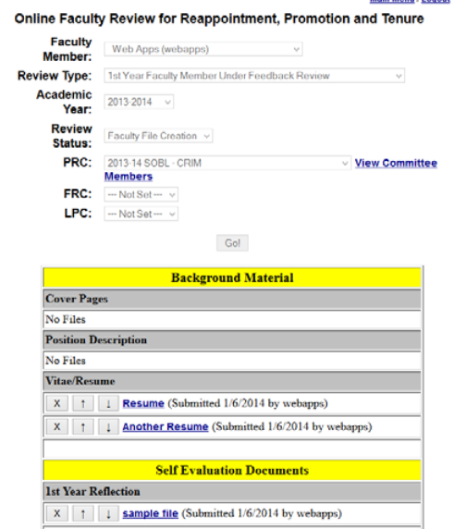
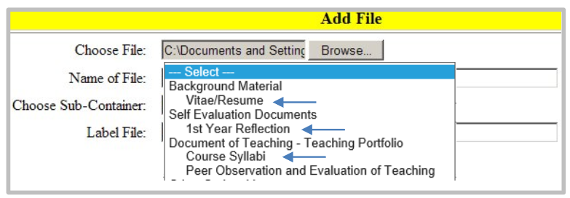
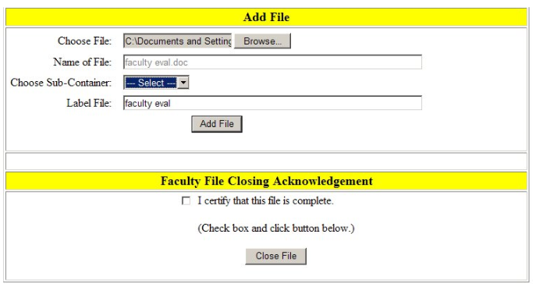

Slide 15
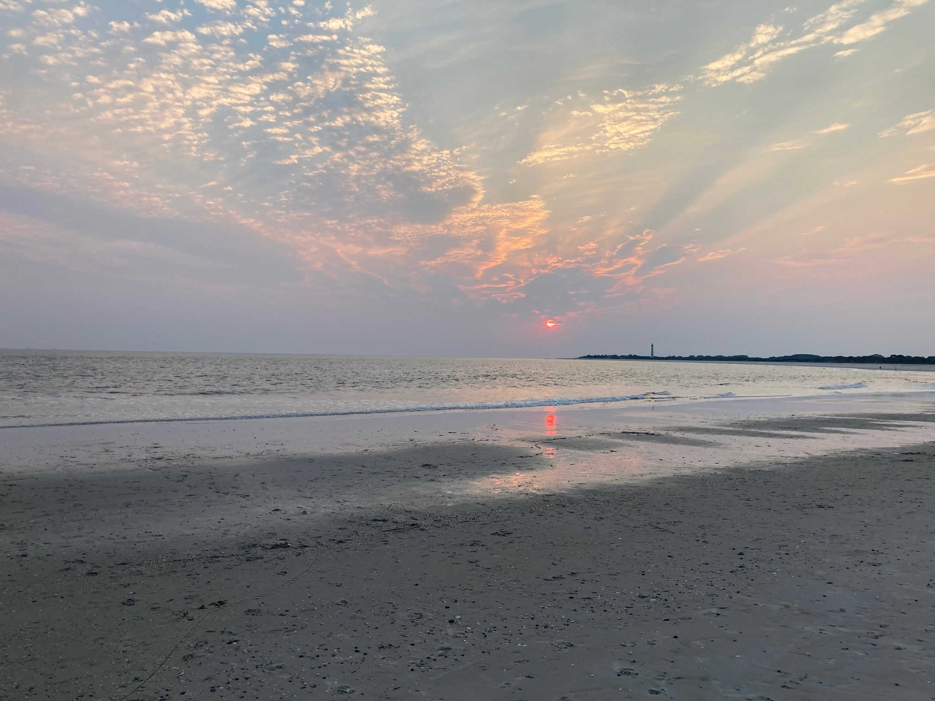
Questions??

