Slide 1

File Construction Workshop
NTTP, XIII-D, XIII-O, PT
Kerri Sowers Fall 2023

Slide 2


Today’s Session
Important Resources
File Construction
Questions

Slide 3

Important Resources
Locally Negotiated Agreements
Faculty Evaluation Procedure MOA
Faculty Evaluation Policy (University Standards – section 6.00 and 10.0)
Program Standards
School Standards
NTTP MOA (2023)
Covid MOA
Online Course MOA
Personnel Actions Calendar
Summary Due Dates

Slide 4
Important Dates
January 3, 2024 - File Closing: NTTP Year 1-4, NTTP Year 5, XIII-D, XIII-O, PT Year 1-4, PT Year 5, and PT After Year 5
January 16 - PRC Letters: NTTP Year 1-4, NTTP Year 5, XIII-O, PT Year 1-4, PT Year 5, and PT After Year 5
January 23
  PRC Letters: XIII-D
  Dean Letters: NTTP Year 1-4, NTTP Year 5, XIII-O, PT Year 1-4, PT Year 5, and PT After Year 5
January 30
  Dean Letters: XIII-D
  FRC Letters (only if needed): NTTP Year 1-4, XIII-O, PT Year 1-4, and PT After Year 5
  FRC Letters (required): NTTP Year 5, PT Year 5
February 6 - Provost - NTTP Year 5, PT Year 5 required, all others are only if needed
February 13 - President
February 21 - BOT
Rebuttals are due 3 days after each level of review, by 2 PM

Slide 5
NTTP & PT: Review Periods
NTTP
  Year 1 through 4 are annual reviews by the PRC and Dean (goes to FRC/Provost only if negative)
  Year 5 is a review by the PRC, Dean, FRC, and Provost
  If appointed for a sixth year, you are then eligible for two- or three-year contracts
  Subsequent reviews go to the PRC and Dean (only negative reviews go to the FRC/Provost)
  May apply for promotion to a higher rank (see section G in the NTTP MOA 2023)
Part-Time
  Year 1 through 4 are annual reviews by the PRC and Dean (goes to FRC/Provost only if negative)
  Year 5 is a review by the PRC, Dean, FRC, and Provost
  If appointed for a sixth year, you are then eligible for two-year contracts
  Subsequent reviews go to the PRC and Dean (only negative reviews go to the FRC/Provost)
  May apply for promotion to a higher rank (during promotion cycle)

Slide 6
XIII-D & XIII-O: Review Periods & Conversion
XIII-D
  One-year contract, not permitted to extend beyond three years
XIII-O
  May be a two- or three-year contract
XIII-D and XIII-O
  Same evaluation process as a first-year tenure track faculty
  If converted to a tenure track, the years will count towards the tenure clock
  If appointed to a tenure track line for Year 2
    One-year contract
    Must create a faculty plan in Year 2
    Follow the evaluation process for Year 2 faculty
  If appointed to a tenure track line for Year 3
    Two-year contract
    A faculty plan is not required but may be done informally
    Year 3 file (feedback evaluation) will follow the MOA procedure for the First Year Feedback review process.

Slide 7

File Construction Approach
NTTP, XIII-D, XIII-O, and PT files are due by 5 PM on January 3rd
Review MOA, Policy, & Standards
Consider your audience (PRC, Dean, possibly FRC, Provost, President)
Gather artifacts/evidence of excellence
Engage in thoughtful self-reflection
Utilize FAWN

Slide 8

NTTP Evaluation
Evaluation based on contract terms and the NTTP MOA
Criteria for Evaluation: The criteria for evaluation of NTTPs will be based on the terms of individual contract(s) and should include but are not limited to:
  1. Evidence of excellence in teaching effectiveness, including professional development to maintain currency in their subject matter as well as their teaching skills/abilities.
  2. Evidence of excellence in meeting service responsibilities
  3. Any additional documentation specified in the University, School, and Program Standards with the exception of those related to scholarship and/or creative activity.

Slide 9
NTTP File Contents
Files of First Year NTTPs
  A short (one-page) reflection on their first semester at Stockton
  Syllabi and student evaluations for first semester courses
  If assigned teaching, NTTPs are expected to have a peer observation in their first semester and include that report in their file
  If assigned other duties, NTTPs are expected to provide relevant documentation of job performance
Files of all other NTTPs
  A self-evaluation of no more than 5-pages (overall assessment of the NTTPs’ achievements in teaching, service, and/or other contractual duties, as assigned)
  If applicable, they should include a Teaching Portfolio with representative syllabi, student evaluations of teaching, two peer-observation reports per year, evaluations of precepting, any optional documentation of teaching excellence, and documentation of service.
  NTTPs are expected to provide relevant documentation of job performance.

Slide 10
NTTP “Advancement” (aka Promotion)
NTTP Advancement
  Eligible for advancement to a higher level after 5 years of consecutive service
  Must meet/exceed the requirements of the higher level (except in the area of scholarship/creative work)
  Promotion will result in advancement of 3 salary ranges
  Must submit written application for consideration of promotion following the normal promotional cycle for full-time faculty, identified in the Personnel Actions Calendar, on or before November 1 (accompanied by necessary documentation and evidence)
  External reviewers are not required for advancement to any level

Slide 11
Required File Content
Background Materials
  File cover page & position description/responsibilities (School uploads)
  Updated Curriculum Vitae (CV)
Self-Evaluation
  Executive Summary (1-2 pages)
  NTTP Narrative: self-evaluation of their contributions to teaching, and service
  PT, XIII-D, XIII-O Narrative: brief self-evaluation of contributions to teaching, research/creative activity, and service

Slide 12
Required File Content
Teaching Portfolio (REQUIRED CONTENT)
  Representative syllabi
  IDEA/small class instrument
    Optional for spring 2020 – Covid MOA (must cite)
  Peer observation(s) – optional PT, XIIIO, XIIID (recommended if there is a possibility to convert to tenure track), required NTTP
  Precepting survey – should include if you have preceptees,
  Optional additional materials (sample assignments, lectures, rubrics, class feedback, etc.)
  Provide evidence and reflect about how you have met University, School, and Program standards

Slide 13
Required File Content
Scholarship Evidence (OPTIONAL – evidence to support your narrative)
  Samples of scholarly or creative work(s)
  Evidence of reviews, grants, or awards
  Provide evidence and reflect about how you have met University, School, and Program standards
Service Evidence (NTTP REQUIRED)
  Evidence of awards
  Letters that document impact of service (external and internal)
  Notice of committee appointments
  Task force/committee reports, meeting notes, other evidence that documents service contributions
  Provide evidence and reflect about how you have met University, School, and Program standards

Slide 14

Mistakes to Avoid
Missing or inaccurate CV information
Not considering the readers when writing (consider clarity, brevity, & specificity)
Failing to reference the standards for excellence in teaching, service, and scholarship
Failing to provide evidence
Not connecting your evidence to your self-evaluation
Teaching philosophy not supported by evidence
  No examples from IDEAs or overreliance on IDEA scores
  Lack of reflection/examination of trends (IDEA & other assessments)

Slide 15

Uploading File Content
Login Instructions
Upload = Slow process

Slide 16
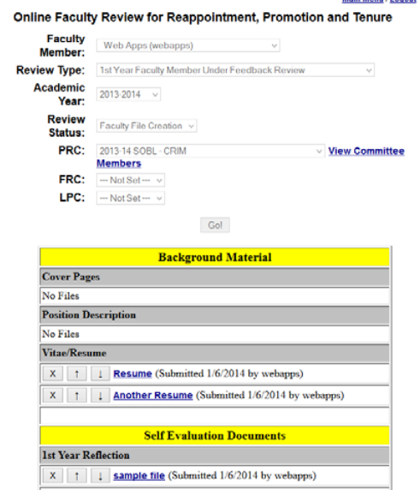
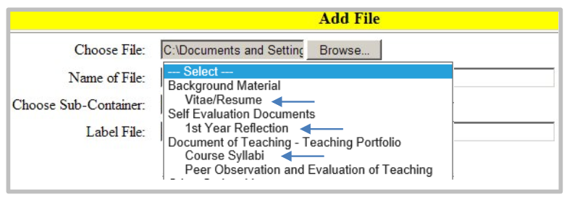
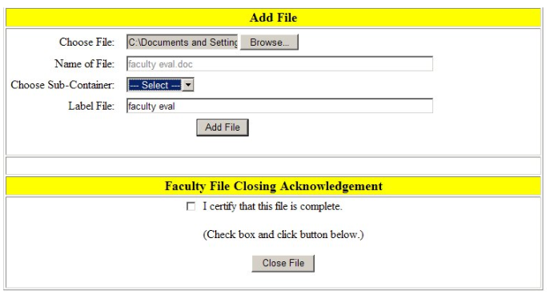

Slide 17
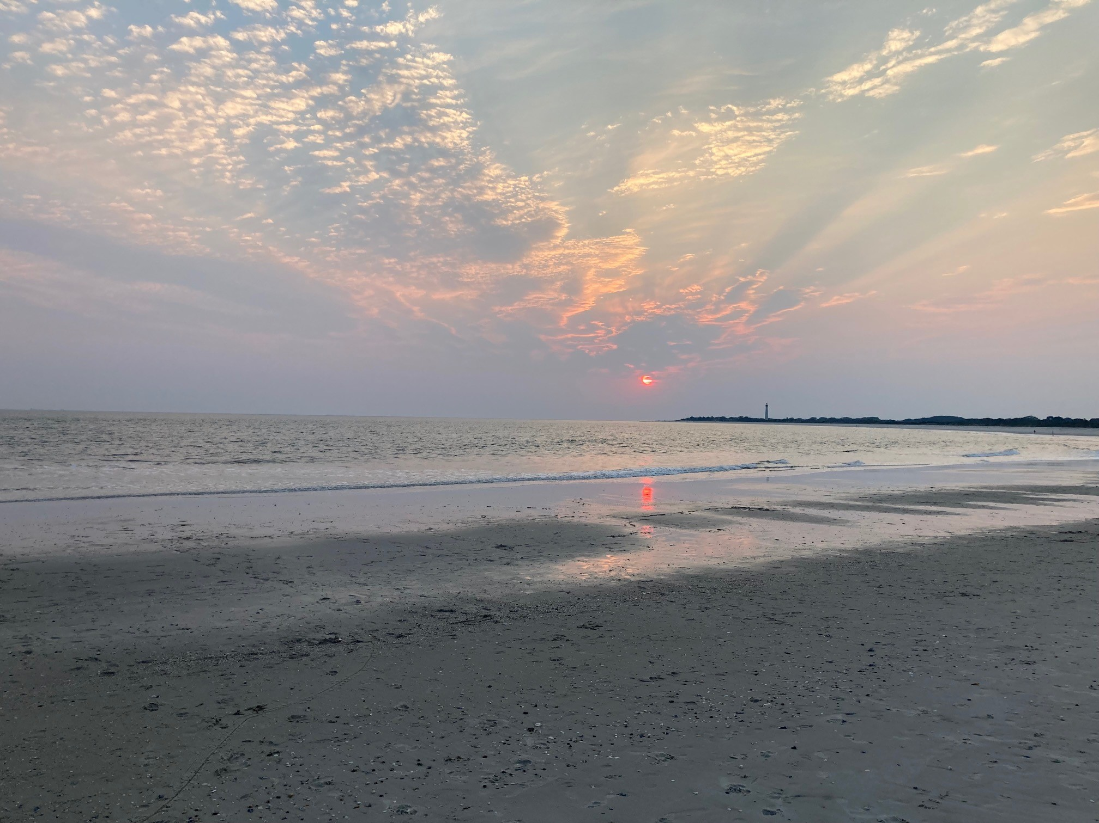
Questions??

