Slide 1
File Construction Workshop Promotion Kerri Sowers Spring 2023

Slide 2
Today’s Session
Important Resources
Promotion File Construction
Questions

Slide 3
Important Resources
Locally Negotiated Agreements
Faculty Evaluation Procedure (MoA)
Faculty Evaluation Policy (University Standards – section 6.00 and 10.00)
Program Standards
School Standards
Covid MOA
Personnel Actions Calendar
Summary Due Dates

Slide 4
Promotion vs. Range Adjustment
Range Adjustment
Based on teaching AND service OR scholarship
You are meeting the standards in your current rank
Files are submitted early spring semester
Promotion
Based on teaching, service, AND scholarship (except Distinguished)
You are meeting the standards for the next highest rank
Files submitted early fall semester
Plan for external review process (depending on rank)
Feedback from PRC/FRC
Program “politics” and other reasons people avoid applying for promotion

Slide 5
Promotion to Assistant
Instructor to Assistant
10.1.1.2.3 (Faculty Evaluation Policy): Only those hired with expectations specified in their contract of earning a terminal degree will automatically receive rank adjustment to Assistant Professor upon documented completion of the terminal degree provided that evaluations to that point are satisfactory.
Have achieved the appropriate terminal degree
Meeting the standards at the rank of Assistant (developing scholarship)
External reviews are not required, but may add support
10.2.2 [Assistant Professors] demonstrate a record of continuous improvement in teaching (in both Program and General Studies courses) toward excellence, a growing record of scope and/or significance of scholarly and creative activity beyond that presented to secure rank, and the capacity to contribute effectively in the use of professional skills in service to the University, discipline, and community.

Slide 6
Promotion to Associate
Assistant to Associate
Normally concurrent with tenure, though there may be exceptions
May apply early (prior to tenure) – those promoted prior to tenure will be judged for tenure at the higher rank
10.3.1 [Associate Professors] must achieve and maintain consistent excellence in teaching (in both Program and General Studies courses) and demonstrate capability in pedagogical leadership, such as the ability to demonstrate pedagogical innovations to others within or outside their program;
10.3.2 [Associate Professors] demonstrate a record of scholarly/creative activity that is recognized by others within their discipline or area of specialization; and
10.3.3 [Associate Professors] document progressively important service roles and demonstrate a capacity for leadership

Slide 7
Promotion to Professor
Associate to Professor
Requires formal solicitation of external reviewers of scholarship, through a process that begins three months prior to the closing of files
Files submitted early fall semester
For faculty hired at the Associate Professor level or above, it is not the norm to be promoted at the time of tenure
10.4.1 [Professors] must achieve a consistent record of excellence in teaching (in both Program and General Studies courses), including curricular contributions, pedagogical leadership, and/or in activities that support the achievement of teaching excellence throughout the University;
10.4.2 [Professors] must achieve and continue to demonstrate a record of scholarly/creative activities that are nationally and/or internationally recognized as outstanding and significant; and
10.4.3 [Professors] must be stewards of service; they must play and continue to play a major role in significant University initiatives, major public initiatives, or hold key positions in their professional organizations. Professors must demonstrate that their service is recognized as outstanding in quality, effectiveness, and scope

Slide 8
Promotion: Distinguished Professor
12.1.1 The title of Distinguished Professor is reserved for those individuals who have exceeded all standards for Professor and have received recognition for their exceptional achievement in teaching and widely recognized achievement in either scholarship/creative activity or service.
Only requires teaching AND service OR scholarship
Minimum 10 years at rank of Professor
Must be nominated by a minimum of three current faculty members who hold the rank of Professor
Requires formal solicitation of external reviewers of scholarship OR service, through a process that begins three months prior to the closing of files
File Requirements:
The standard required background information
A narrative description of the contributions that fulfill the expectations for the next rank
Examples of those contributions that have been regarded as exemplary or significant
External letters evaluating and commenting on the candidate’s meeting all expectations for the rank of Distinguished Professor, elicited through the formal process for eliciting external reviews

Slide 9
Procedure for Promotion
Must notify the Dean of your intent to submit a file for promotion
6/16/2023 Deadline for faculty who plan to apply for promotion to Full Professor or Distinguished Professor in Fall 2023 to notify Dean and meet regarding selection of external reviewers.
6/30/2023 Deadline for faculty who plan to apply for Assistant or Associate. Materials for external reviewers for those applying for Full or Distinguished are due to the deans.
Electronic file organization and submission process (similar to T&P) – files close in early September
Review process for faculty: PRC, Dean, FRC, Provost, President, BOT approval

Slide 10
Promotion: Library Faculty
Promotion of Library Faculty is initiated by an announcement by the President that opportunities are available for growth and/or structural promotions
Once the announcement is made, the Library Faculty member initiates an application for promotion by notifying the Associate Director and Director of his/her intent to apply and by compiling and submitting a file for promotion no later than November 1 for Growth Promotions and by specified deadlines for Structural Promotions

Slide 11
External Review
Three (3) months prior to your file closing date, you must notify your Dean if you plan to use the formal process of External Review
You and your Dean will select a Review Advisor
You and the Review Advisor will select names of people to serve as external reviewers and the Review Advisor will submit those to the Dean within two days of your meeting.
Within two days the Dean will contact those people to see if they agree to review
You will need to submit your scholarly or creative work for review (digitally where possible), and any other materials for review, to the Dean
Letters from external reviewers should be submitted no later than three weeks before the file deadline
Reviewer qualifications
External reviews of scholarship are optional for tenure and for promotion to Associate
External reviews of scholarship are required for promotion to Professor
External reviews of scholarship (OR service) are required for promotion to Distinguished Professor
Details can be found in the Evaluation Procedures, starting on page 10
Includes how to handle “issues” with reviewers

Slide 12
File Construction Approach
Promotion file is due early September 2023
6/16 – Notify Dean for Professor/Distinguished
6/30 – Notify Dean for Assistant/Associate
Review MOA, Policy, & Standards
Consider your audience (PRC, Dean, FRC, Provost, President)
Gather artifacts/evidence of excellence
Engage in thoughtful self-reflection
Utilize FAWN

Slide 13
Promotion File Content
Background Materials
File cover page & position description/responsibilities (School uploads)
Updated Curriculum Vitae (CV)
Self-Evaluation
Executive Summary (1-2 pages)
Narrative - reflect on ACHIEVEMENT of standards based on the next rank:
Teaching
Service
Scholarship
Document and reflect on achievements that have occurred since your last personnel action

Slide 14
Promotion File Content
Teaching Portfolio (since last personnel action)
Representative syllabi
Peer observation(s) – (optional for tenured faculty)
IDEA/small class instrument
All results of past evaluations since the last positive personnel action OR the results from the last 5 years (whichever is shorter)
Tenured faculty are required to evaluate at least half of their course load within an academic year)
Optional for spring 2020 – Covid MOA (must cite)
Precepting survey
Optional additional materials (sample assignments, lectures, rubrics, class feedback, etc.)
Provide evidence and reflect about how you have met the standards

Slide 15
Promotion File Content
Scholarship Evidence (since last personnel action)
Samples of scholarly or creative work(s)
Evidence of reviews, grants, or awards
External Review when required (must obtain reviewers in advance with Dean approval)
Provide evidence and reflect about how you have met the standards
Service Evidence (since last personnel action)
Evidence of awards
Letters that document impact of service (external and internal)
Notice of committee appointments
Task force/committee reports, meeting notes, other evidence that documents service contributions
External Review when required (for Distinguished, if using service)
Provide evidence and reflect about how you have met the standards

Slide 16
Mistakes to Avoid
Missing or inaccurate CV information
Not considering the readers when writing (consider clarity, brevity, & specificity)
Failing to reference the standards for excellence in teaching, service, and scholarship
Failing to provide evidence
Not connecting your evidence to your self-evaluation
Teaching philosophy not supported by evidence
No examples from IDEAs or overreliance on IDEA scores
Lack of reflection/examination of trends (IDEA & other assessments)

Slide 17
Uploading File Content
Login Instructions
Upload = Slow process

Slide 18
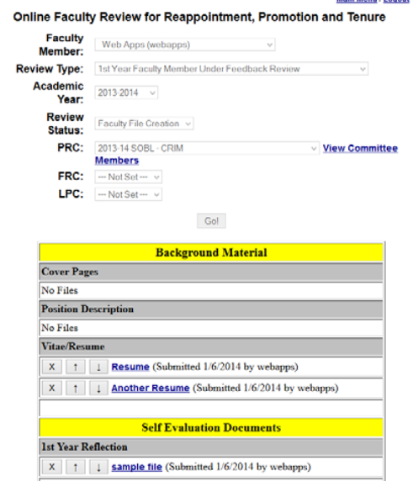
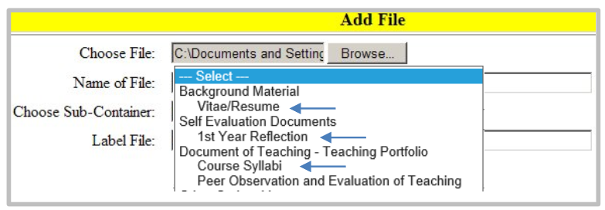
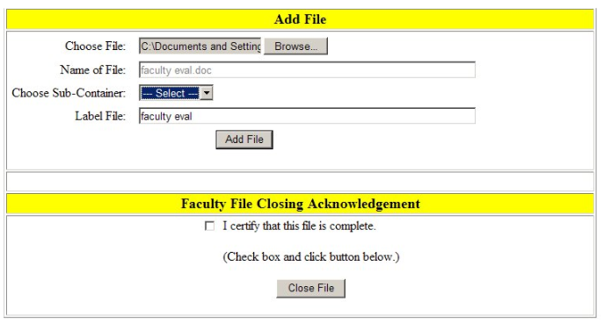

Slide 19
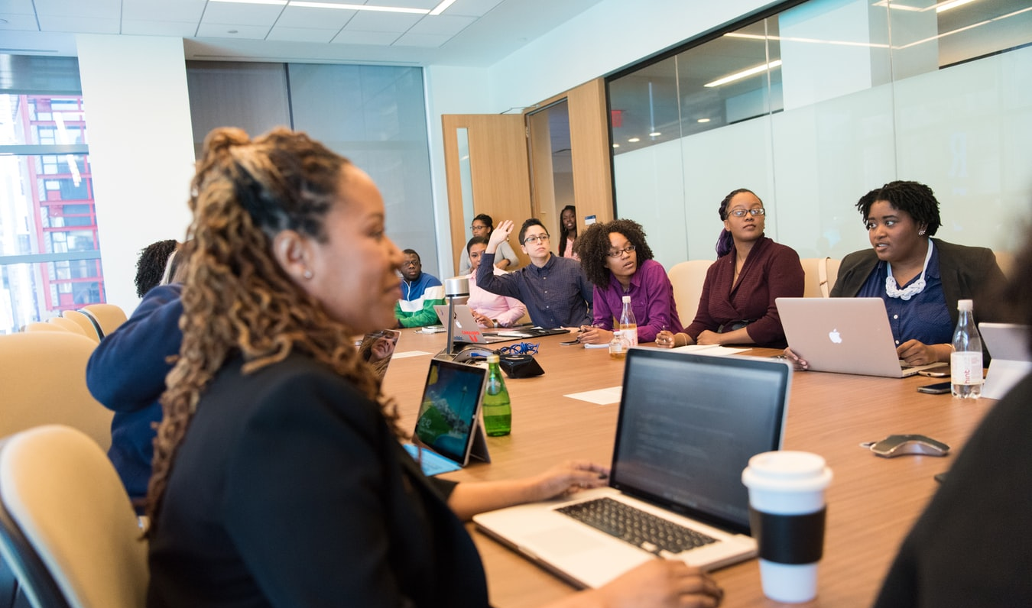
Levels of Review
Faculty decisions go to the PRC, Dean, FRC, Provost, and then President
If you have a PRC member who is serving on the FRC, they will be recused from the discussion and vote at the FRC level
A program member (who was not on your PRC) is allowed to discuss and vote at the FRC level
If you are a PRC member, you will not be involved in other Promotion discussions/decisions
You may write a rebuttal letter (get help from the Union!) after any level (you have 3 days to submit; rebuttals are due by 2 PM)

Slide 20
Successful Promotion
If the President approves the application, a positive recommendation goes to the December meeting of the Board of Trustees
If approved by the Board of Trustees, the promotion to the next rank will be effective at the beginning of the Fall semester following the action by the Board
Faculty members who are promoted shall advance four (4) salary ranges (Article XIV.A of the Master)
Go to the SFT Union Website for Salaries and check out the link for the video “Salary After Promotion” on the right side

Slide 21
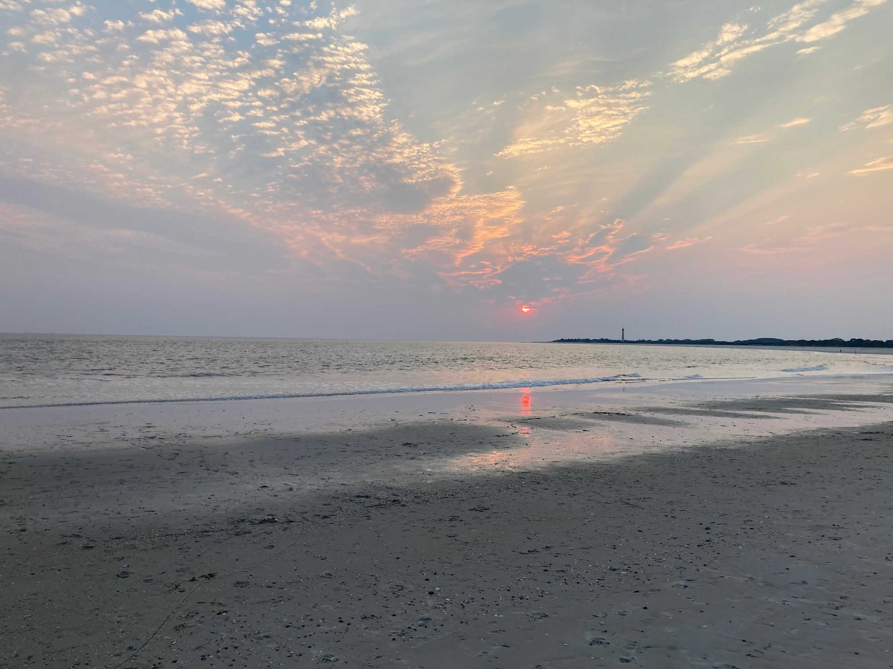
Questions??

