Slide 1

File Construction Workshop
Range Adjustment
Kerri Sowers Fall 2023

Slide 2


Today’s Session
Important Resources
Range Adjustment File Construction
Questions

Slide 3
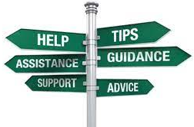
Important Resources
Locally Negotiated Agreements
Faculty Evaluation Procedure MOA
Faculty Evaluation Policy (University Standards – section 6.00)
Program Standards
School Standards
Covid MOA
Online Course MOA
Personnel Actions Calendar
Summary Due Dates

Slide 4
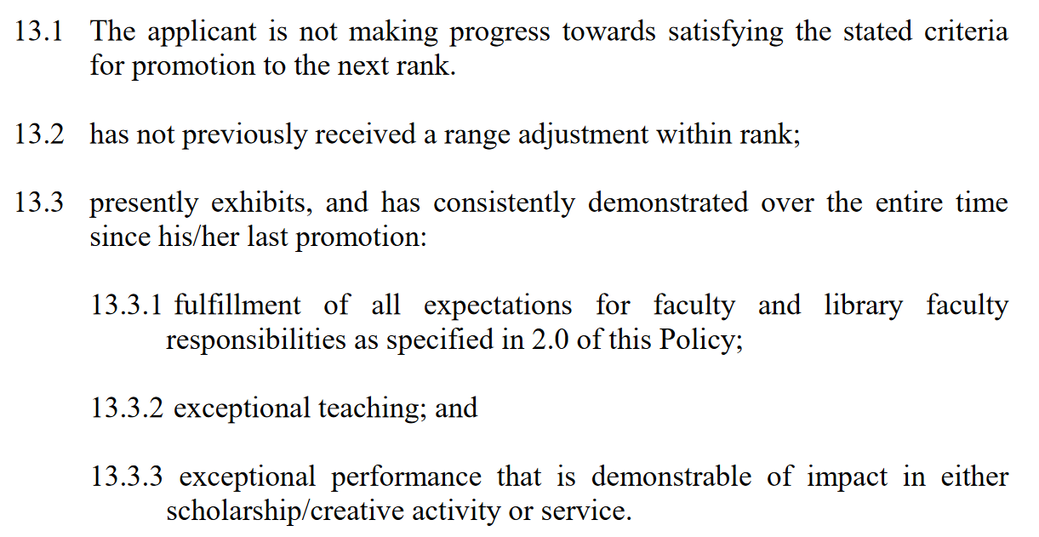
Criteria for Range Adjustment
Stockton University Faculty Evaluation Policy (2016, page 22)

Slide 5
Range Versus Promotion
Range Adjustment
  Based on teaching AND service OR scholarship
  You are meeting the standards in your current rank
  Files are submitted early spring semester
Promotion
  Based on teaching, service, AND scholarship
  You are meeting the standards for the next highest rank
  Files submitted early fall semester
  Plan for external review process
If you can’t decide between service or scholarship for your range file – consider promotion!!
Feedback from PRC/FRC
Distinguished professors are eligible for range adjustment
Professors should consider promotion to Distinguished
  Only requires teaching and service OR scholarship
  Minimum 10 years at rank of Professor
Program “politics” and other reasons people avoid applying for promotion

Slide 6
Procedure for Range Adjustment
Must notify the Dean of your intent to submit a file for range adjustment prior to the last teaching day of the fall semester
  December 8, 2023
Electronic file organization and submission process (similar to T&P or promotion)
Review process
  Faculty: PRC, Dean, FRC, Provost, President, BOT approval
  Librarians: Associate Director, LPC, Director of the Library, Provost, President, BOT approval
Same procedures apply to Faculty Librarians
  Notify the Director/Associate Director in place of the Dean
Faculty Evaluation MOA (2015, page 51)

Slide 7
Important Dates: Range Adjustment
Dean notification and file opening: December 8, 2023
File closing: January 9, 2024
PRC (Associate Director) Review: January 30
Dean (LPC) Review: February 13
FRC (Director) Review: March 5
Provost Review: March 26
President Review: April 18
BOT Approval: May 1
Rebuttals are due 3 days after each level of review, by 2 PM

Slide 8

File Construction Approach
Range Adjustment file is due by 5 PM on January 9th
Review MOA, Policy, & Standards
Consider your audience (PRC, Dean, FRC, Provost, President)
Gather artifacts/evidence of excellence
Engage in thoughtful self-reflection
Utilize FAWN

Slide 9

Required Range Adjustment File Content
Background Materials
  File cover page & position description/responsibilities (School uploads)
  Updated Curriculum Vitae (CV)
Self-Evaluation
  Executive Summary (1-2 pages)
  Narrative - reflect on ACHIEVEMENT of standards in two areas (~15 pages):
    Teaching
    Service or Scholarship
  Document and reflect on achievements that have occurred since your last personnel action

Slide 10
Required Range Adjustment File Content
Teaching Portfolio (since last personnel action)
  Representative syllabi
  Peer observation(s) – optional (not required)
  IDEA/small class instrument
    All results of past evaluations since the last positive personnel action OR the results from the last 5 years (whichever is shorter)
    Tenured faculty are required to evaluate at least half of their course load within an academic year)
    Optional for spring 2020 – Covid MOA (must cite)
  Precepting survey
  Optional additional materials (sample assignments, lectures, rubrics, class feedback, etc.)
  Provide evidence and reflect about how you have met the standards

Slide 11
Required Range Adjustment File Content
Scholarship Evidence (since last personnel action)
  Samples of scholarly or creative work(s)
  Evidence of reviews, grants, or awards
  External Review (optional for range adjustment – need to arrange reviewers in advance)
  Provide evidence and reflect about how you have met the standards
OR
Service Evidence (since last personnel action)
  Evidence of awards
  Letters that document impact of service (external and internal)
  Notice of committee appointments
  Task force/committee reports, meeting notes, other evidence that documents service contributions
  Provide evidence and reflect about how you have met the standards

Slide 12

Mistakes to Avoid
Missing or inaccurate CV information
Not considering the readers when writing (consider clarity, brevity, & specificity)
Failing to reference the standards for excellence in teaching and service OR scholarship
Failing to provide evidence
Not connecting your evidence to your self-evaluation
Teaching philosophy not supported by evidence
No examples from IDEAs or overreliance on IDEA scores
Lack of reflection/examination of trends (IDEA & other assessments)

Slide 13
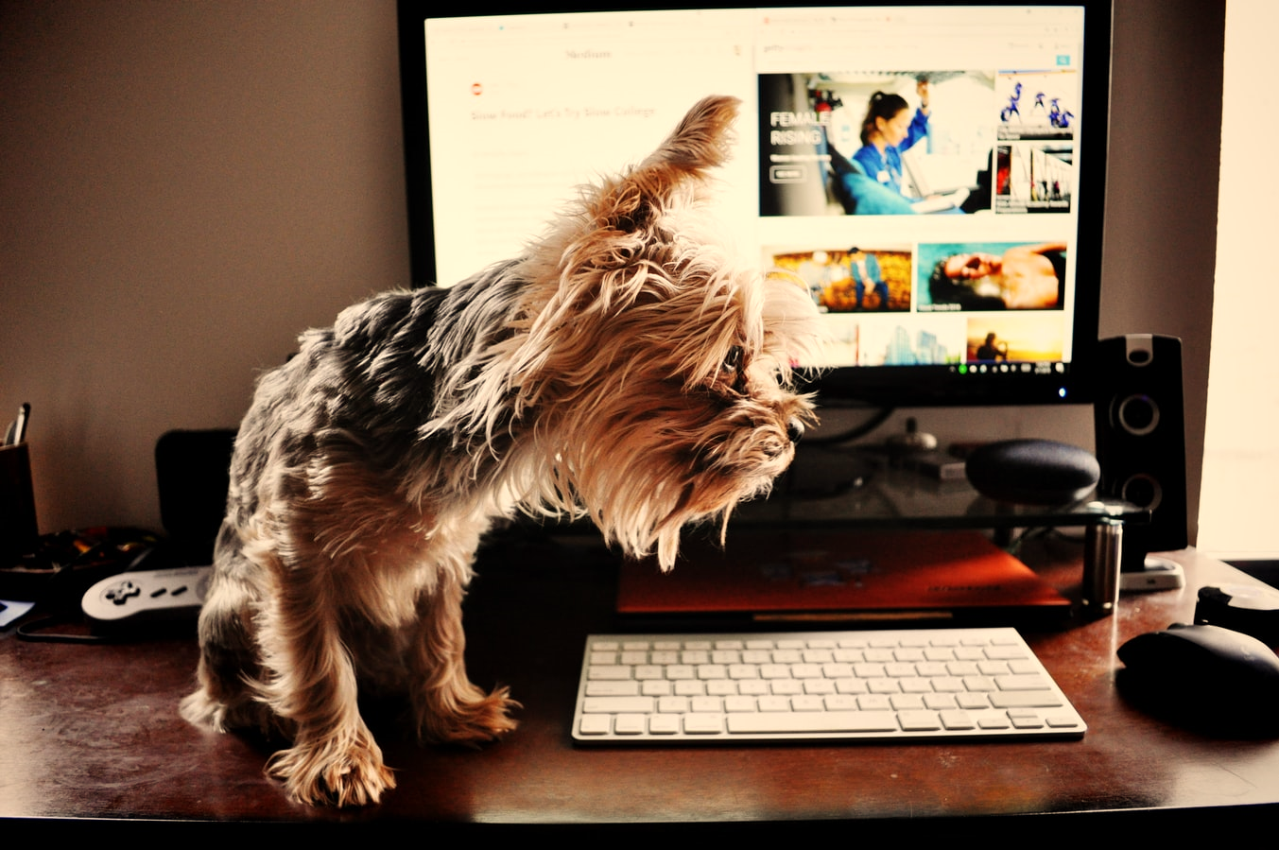
Uploading File Content
Login Instructions
Upload = Slow process

Slide 14
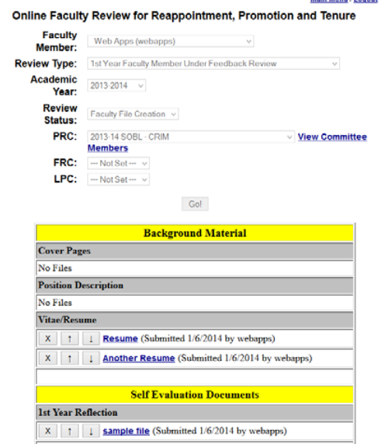
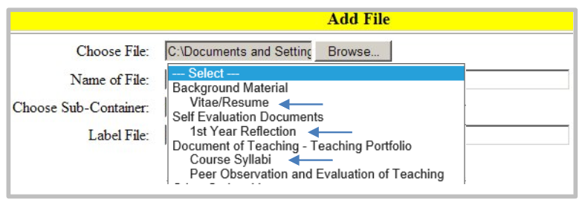
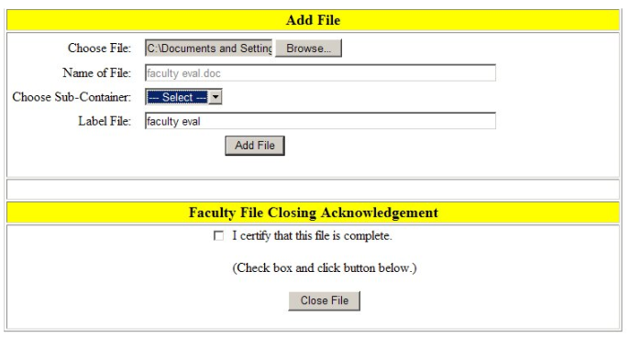

Slide 15
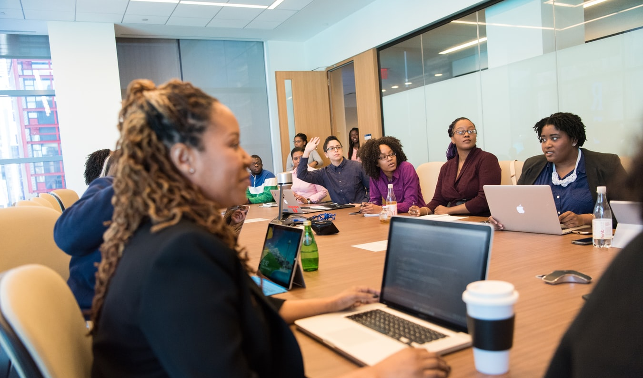
Levels of Review
Faculty decisions go to the PRC, Dean, FRC, Provost, and then President
  If you have a PRC member who is serving on the FRC, they will be recused from the discussion and vote at FRC level
  A program member (who was not on your PRC) is allowed to discuss and vote at the FRC level
  If you are a PRC member, you will not be involved in other Range Adjustment decisions
Librarian decisions got to the Associate Director, LPC, Director of the Library, Provost, President, BOT approval
You may write a rebuttal letter (get help from the Union!) after any level (you have 3 days to submit; rebuttals are due by 2 PM)

Slide 16

Successful Range Adjustment
If the President approves the application, a positive recommendation goes to the Board of Trustees for a two-range adjustment
If approved by the Board of Trustees, the merit-based range adjustment within rank will be effective at the beginning of the Fall semester following the action by the Board

Slide 17
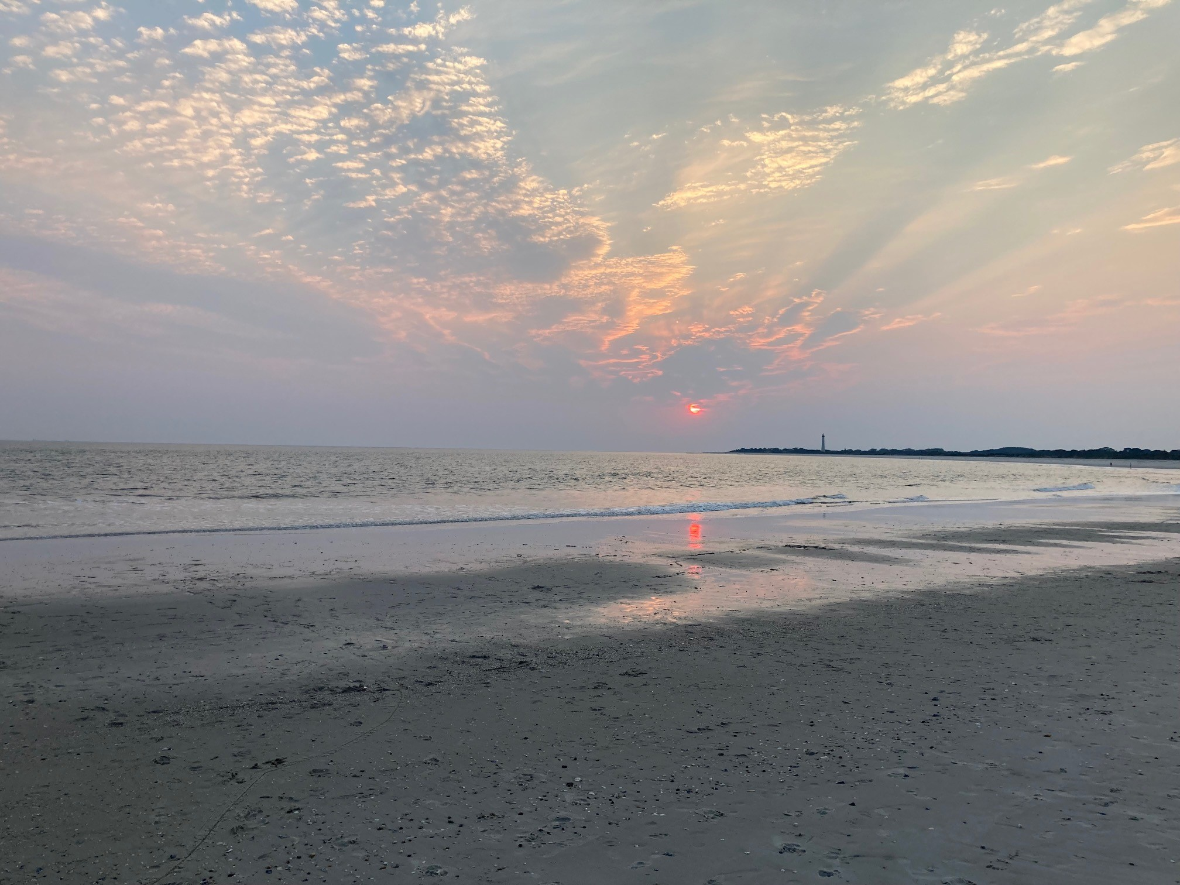
Questions??

