Slide 1

File Construction Workshop
Year 3
Original content: CTLD 2020
Updates: Kerri Sowers Fall 2023

Slide 2


Today’s Session
Important Resources
Year 3 File Construction
Questions

Slide 3

Important Resources
Locally Negotiated Agreements
Faculty Evaluation Procedure MOA
Faculty Evaluation Policy (University Standards – section 6.00 and 10.0)
Program Standards
School Standards
Covid MOA
Online Course MOA
Personnel Actions Calendar
Summary Due Dates

Slide 4

File Construction Approach
YR 3 file is due by 5pm on January 30th
Review MOA, Policy, & Standards
Ask mentor/colleagues for samples & advice
Consider your audience (PRC, Dean)
Gather artifacts/evidence of excellence
Engage in thoughtful self-reflection
Utilize FAWN

Slide 5

Purpose of Feedback File
Procedure required by MOA
Self-reflect on performance
Receive feedback from PRC and Dean about your progress towards tenure and promotion
Add new evidence and narrative for future files

Slide 6
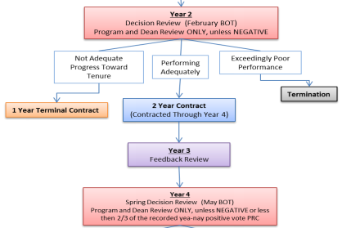
Stockton University MoA: Procedure for the Evaluation of Faculty & Library Faculty (2015)

Slide 7

Required Third Year File Content
Background Materials
  File cover page & position description/responsibilities (School uploads)
  Updated Curriculum Vitae (CV)
Self-Evaluation
  Executive Summary
  Narrative - reflect on progress towards standards
Consider potential need for decoupling of tenure & promotion in this file (Covid or other reason)

Slide 8
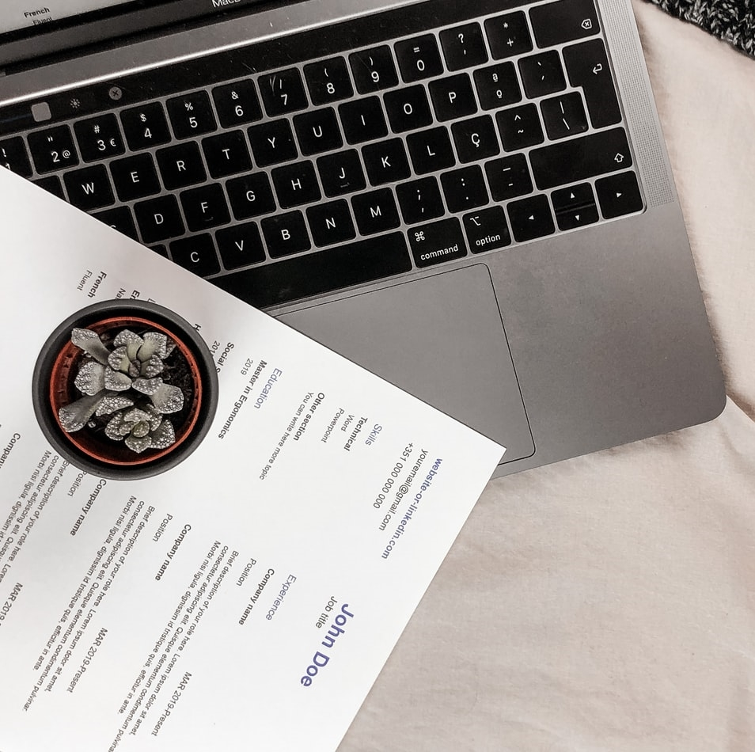
Self-Evaluation
Executive summary
  1-2 page overall summary
Narrative
  Teaching section
  Service section
  Scholarship section

Slide 9
Required Third Year File Content
Teaching Portfolio
  Representative syllabi
  Peer observation(s) - 2 per year
    SIPET trained and/or tenured faculty
    G course observation required before tenure year
  IDEA/small class instrument
  Precepting survey
  Optional additional materials (sample assignments, lectures, rubrics, class feedback, etc.)

Slide 10
Required Third Year File Content
Scholarship Evidence
  Samples of scholarly or creative work(s)
  Evidence of reviews, grants, or awards
  External Review (for early promotion to Associate Professor)
Service Evidence
  Evidence of awards
  Letters that document impact of service (external and internal)
  Notice of committee appointments
  Task force/committee reports, meeting notes, other evidence that documents service contributions

Slide 11

Mistakes to Avoid
Missing or inaccurate CV information
Not considering the readers when writing (consider clarity, brevity, & specificity)
Failing to reference the standards for excellence in teaching, service and scholarship (& promotion)
Failing to provide evidence
Not connecting your evidence to your self-evaluation

Slide 12
More Mistakes to Avoid
Teaching philosophy not supported by evidence (or missing)
  No examples from IDEAs
  Overreliance on IDEA scores
  Lack of reflection/examination of trends (IDEA & other assessments)
Not addressing feedback from previous file letters
Not addressing precepting as teaching
Blaming students for issues
Failing to provide referenced document (or not referencing document used as evidence)

Slide 13
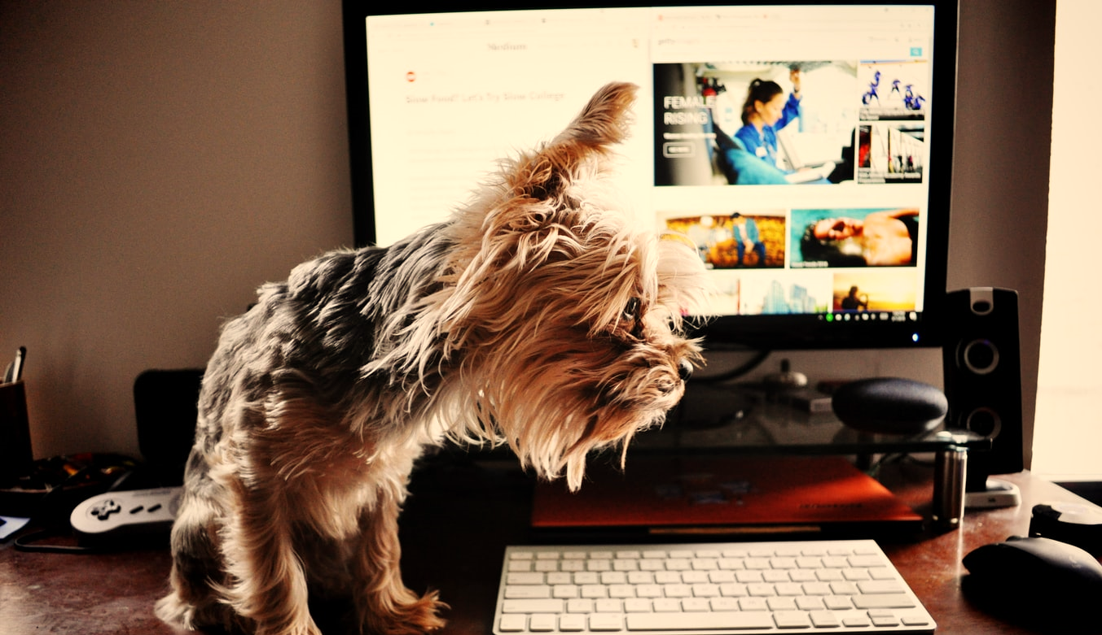
Uploading File Content
Login Instructions
Upload = Slow process

Slide 14
Next Step: YR 3 Feedback Year
Program Review Committee (PRC)
PRC consists of either all or most of the tenured members of your program
  Minimum of 3 tenured faculty members
  Large programs (>10 tenured faculty members) the PRC will consist of at least 7 members, elected by simple majority
Feedback year (YR 1 and 3)
  PRC will meet to discuss file and progress towards standards
  A letter summarizing the meeting and discussion will be signed by the PRC and faculty member
The PRC can only consider the information in the file when providing feedback or decisions
You are allowed to write rebuttal letters at each stage of the process (PRC, Dean, etc.)
  You have 3 days (letters are usually due by 2 PM)
  Reach out to the Union and CTLD for assistance

Slide 15

Next Step: Dean Review
Dean will review your file, including the PRC feedback letter and submit their own letter
You have 3 days to submit a rebuttal letter

Slide 16

What’s Next?
Faculty Plan
  Year 3 revisions allowed (need to resubmit to PRC)
  Not a contract
Peer Observations
  2 per year
  Hybrid/online courses if part of normal load
  G course
YR 4 File Prep
  Collect evidence
  Decision Year

Slide 17
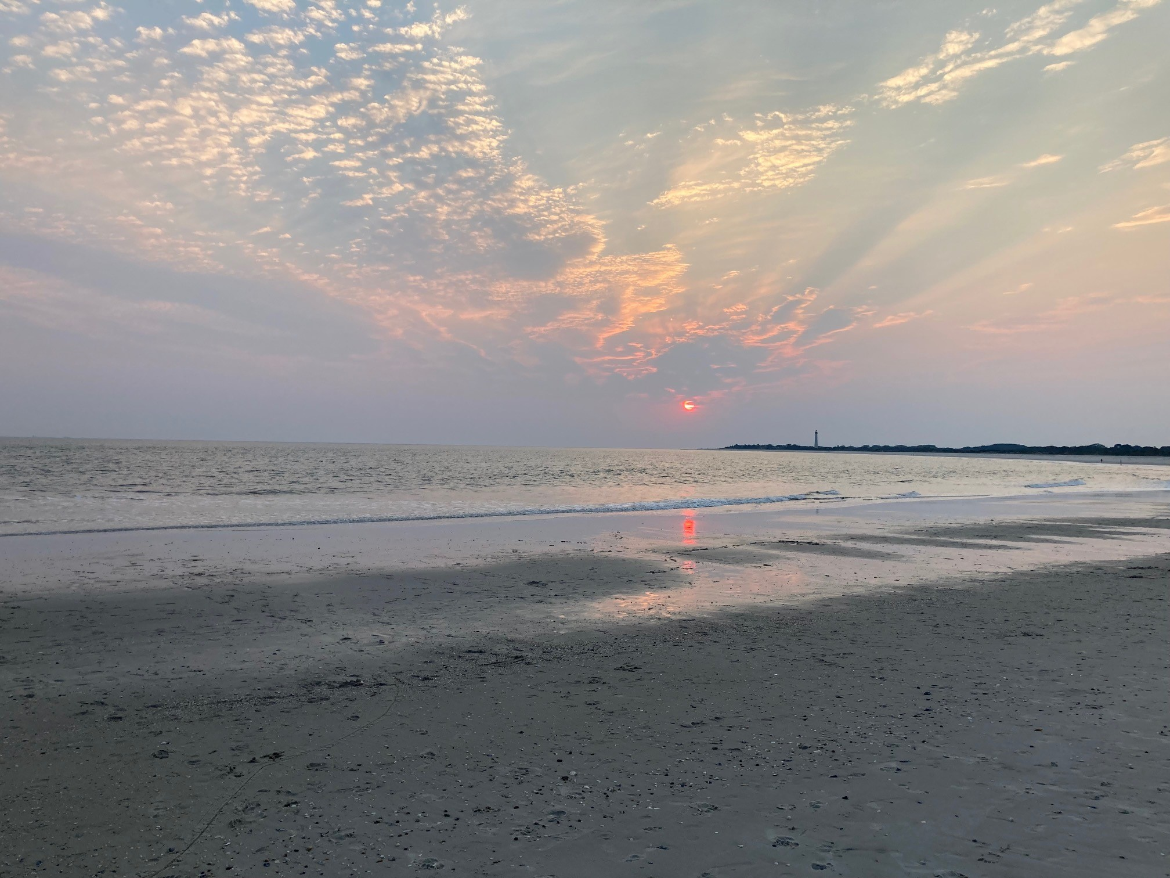
Questions??

