Slide 1
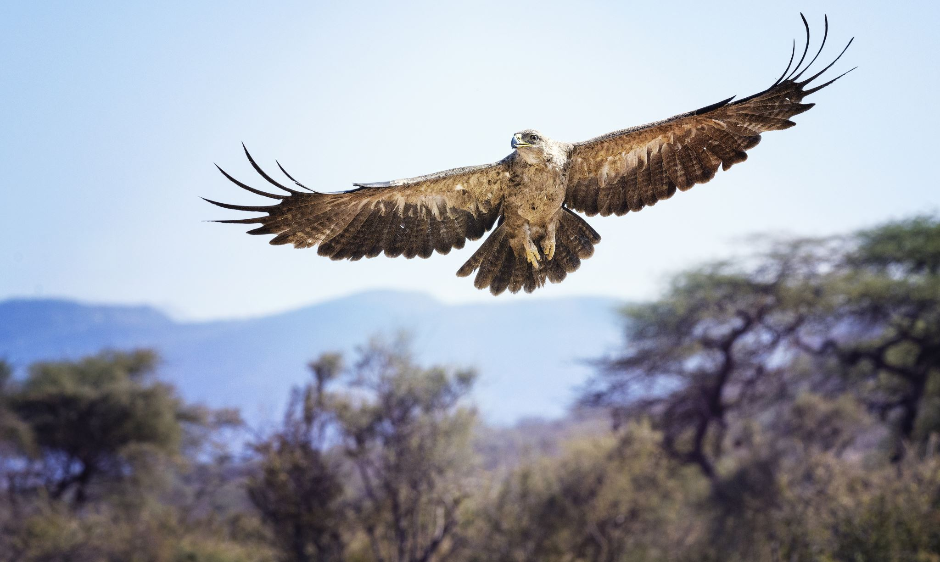
Ospreys Navigate Call for volunteers

Slide 2
What is ‘Ospreys Navigate’?
Ospreys Navigate is a digital platform that is designed to support student success in college
Utilizes data and user feedback to help staff, faculty, and students communicate about student interests and concerns efficiently
Notes:
Navigate was purchased and work was proceeding on the project in AY23-24. Faculty working on the project relayed concerns to me, which I then discussed with the Provost. He decided that it would be best to press pause on the project and have a complete re-set. Our plan has shifted based on faculty input.
New plan is to have a small pilot launch in the Fall with ~10-15 faculty volunteers.

Slide 3
Expectations for Ospreys Navigate Pilot
Pilot volunteers can expect to use Ospreys Navigate to:
Submit and receive early alerts
Provide mid-semester progress checks
View student academic progress
Contribute to a communication system
Help develop a student support response network
Schedule appointments with students
Add and view precepting notes

Slide 4
Why volunteer?
It is important and valuable
Faculty input is needed as we develop this tool
Gradual rollout of software will help with wider adoption
It is low stakes
Need to push the software and the system to its limits
Find bugs or issues before wider deployment
Engage with software and share feedback iteratively
Training and support will be provided
Help us develop best practices for all stakeholders
Volunteering does not ensure selection
Small (10-15 faculty) pilot in Fall 24; Larger pilot in Spring 25

Slide 5
I’m interested! How can I learn more?
Drop-in information session during Welcome Day
F-222 from 12-2
Zoom link will be provided
Contact faculty/staff working group member
Heather McGovern
Mariana Smith
Kerri Sowers
Lauren Fonseca
Ariane Newman
Interested volunteers- fill out form on website

