Slide 1
Strategic Planning
2024 Fall Faculty Conference
Stockton University

Slide 2
What is strategy?
The link between mission and the realities of the external, competitive marketplace
Need to define the current mission, vision, and values for the university
Strategy should have an external focus
Strategy is about choices associated with organizational direction
Important to articulate what our choices are
Strategic plan cannot include all choices that we have as a university
Strategy differs from operations
Strategy is the purpose for taking operational steps
Peter Eckel and Cathy Trower, “Stop Planning!”. Inside Higher Ed. Feb 13, 2019
Notes:
Before we start our discussion of strategic planning, it would first be important to identify what we mean when we say ‘strategy’.
When we think of strategy we should first consider how our mission, vision and values connect to the realities of the external marketplace.
A first step in this is identifying how we view our current mission, vision and values. Have these shifted over the course of the last five years? The external market certainly has with the decrease in students. How do we, as a university, find our niche in the context of the external pressures?
Defining a strategy requires us to make choices. We cannot be all things to all people as a university. We need to focus on a limited set of priorities that are achievable in the timeline of a strategic plan. We have a set of choices that we can make to define our direction. The first step is to define what those choices are and then to determine which of these we want to prioritize.
We also need to think about how strategy and operations are distinct,yet intertwined. Frequently, strategic plans become very good operational plans but have no strategy to back them up. We can think of strategy as the purpose to take operational steps.

Slide 3
Strategy = choices and vision
Operations = infrastructure
Strategy
Operations
Intricate balance between strategy and operations
Notes:
In this framework, we might consider strategy to include our choices and our vision, while operations are the infrastructure that can support strategy. Obviously, these two are interrelated and need to exist in a balance between one another.

Slide 4
Strategy = choices and vision
Operations = infrastructure
Strategy
Operations
Strategy
An operational plan will build infrastructure with no clear goals for that infrastructure
Does not articulate rationale for resource allocation
Operations
Notes:
A plan that is operational will have a great infrastructure, but the infrastructure exists in a vacuum. What is the purpose of investing resources into university operations if they are not aligned with a main goal. The operational costs should help to support different arms of a strategic plan.

Slide 5
Strategy = choices and vision
Operations = infrastructure
Strategy
Operations
Operations
Strategy relies on operations to be in place
Strategy could include building
infrastructure for support
Strategy
Notes:
In contrast, we could develop a strategy that we do not have the infrastructure to support. If this is the case, we might say we want to become the leading regional center for a topic that we do not have the capabilities to support. So, when thinking of strategy, it is important to consider what we are capable of achieving. Note that part of a strategy might include building infrastructure to support it.

Slide 6
Strategy = choices and vision
Operations = infrastructure
Strategy
Operations
Operations address how to do things right
Strategy is about the right things to do
Notes:
A conceptual schema to think about this is that operations address how to do things right, while strategy is about the right things to do.
We, as a university community, are at a point where it will be critically important to define the right things to do. In a changing market, with a changing student population and view of secondary education, it will be more important than every to be forward thinking about how the university can develop a plan that helps guide our decisions for the next few years

Slide 7
Strategic Planning Discussion prompts
What should be the mission, vision, and values of Stockton University?
What distinguishes Stockton from other universities?
What does it mean for us to be an anchor institution?
What is our role in supporting the community?
In what ways have we been successful in community engagement?
In what ways could we support the community better?
What is our role in preparing students for the future?
How should we be preparing students for future careers?
Should we focus more on interdisciplinary education? Why?
What do you see as Stockton's strengths?
Are there any areas that we could grow?
What strengths have we 'lost along the way'?
Notes:
With this in mind, we have worked to develop the following five discussion topics. Please select one of the topics from above for discussion after the break. If your first choice is not available, please move to a second or third choice.When you return from the break, you will find your number topic on one of the round tables. From my left to right, the topcis will be 1-5 and are color coded for your convenience. We will provide ~20 minutes to discuss your topic in small groups. Each group will need someone designated as a notetaker, and will share the group notes on a central Excel document. The Excel document is divided by table number, so please be sure you are writing in the correct tab. After the time is up, you will have an opportunity to share one central idea or theme that came out of your discussions for the larger group.

Slide 8
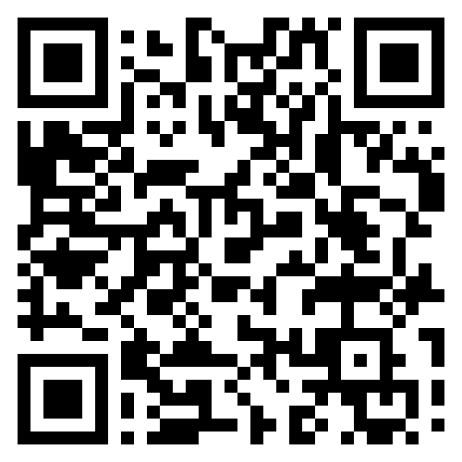
Strategic planning discussion notes
Please designate a notetaker at your table to take notes about your strategic planning topic.
The notetaker can scan the QR code or go to the weblink below to access the Sharepoint Excel document. (*You will need to be logged in to your Stockton.edu account.) Please type your responses in the designated tab at the bottom of the spreadsheet!
https://tinyurl.com/StratPlanDiscussionFFC
See tab at bottom of spreadsheet for your table #

Slide 9
Discussion summary
Share one key idea or theme that came out of your small group discussion

Slide 10
Why contribute to strategic planning?
Faculty input will be integral in determining university choices and direction of the plan
Strategic plan will direct the allocation of university resources
Plan will not be exhaustive of all ideas
Will be narrowed and focused on how to move the university forward
There will be contributors and decision-makers
Clear priority in the plan is supporting the people in the university community
This is the first of multiple opportunities to contribute

Slide 11
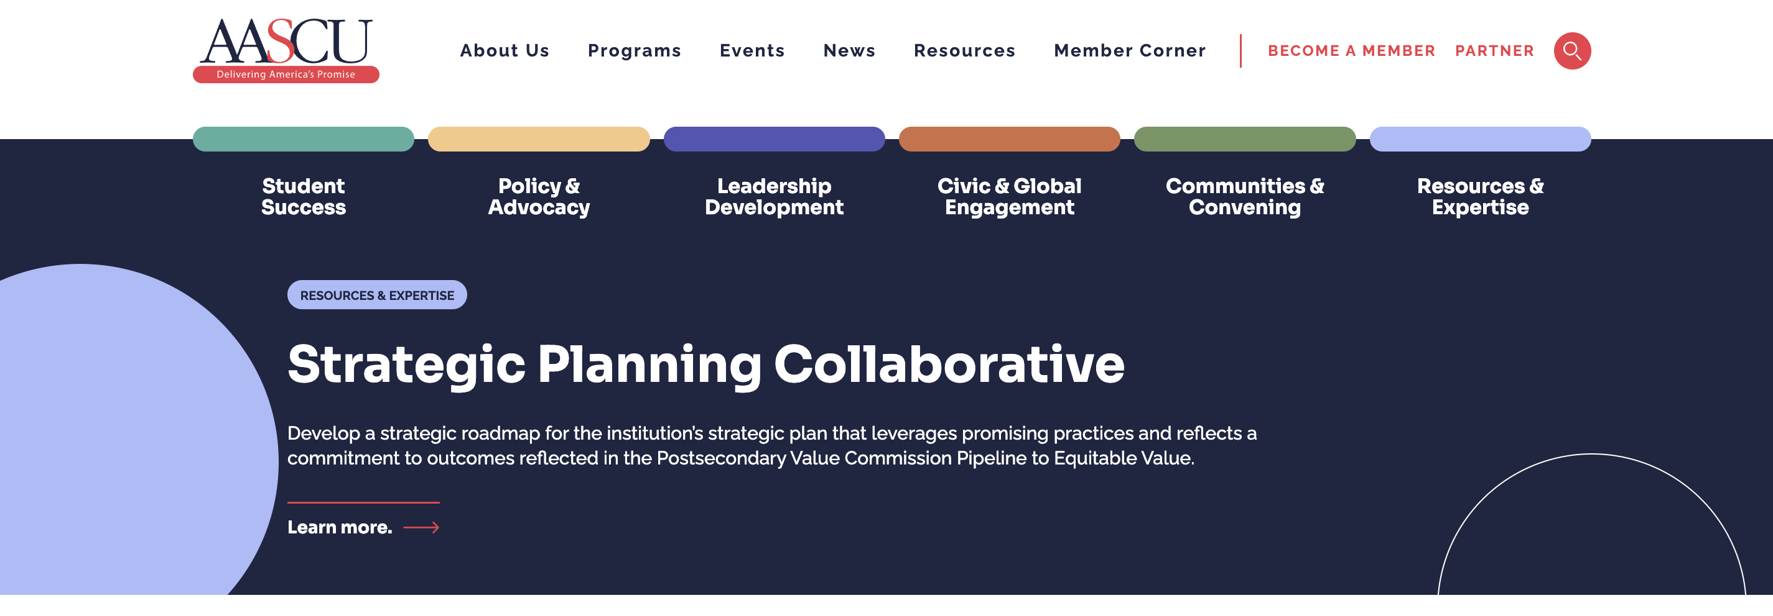
AASCU strategic planning collaborative
Stockton is a member of the American Association for State Colleges and Universities strategic planning collaborative
California State University, Los Angeles
State University of New York, Oswego
Slippery Rock University of Pennsylvania
Montclair State University
AASCU follows a postsecondary value initiative

Slide 12
Postsecondary value initiative
Equalize access to increase postsecondary value
Remove affordability as an impediment to postsecondary value
Eliminate completion gaps and strengthen post-college outcomes to ensure postsecondary value
Improve data to expose and address inequitable postsecondary value
Promote social justice by providing equitable postsecondary value

Slide 13
Strategic Planning Steering Committee
Committee has been working over the summer
Committed to a transparent, collaborative, and relationship-focused process
Committee subgroups have been formed and will begin work
Get involved!

