Slide 1
Stockton University
Welcomes
New Faculty

Slide 2
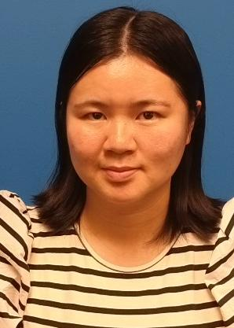
ARHU
Huixin Deng
Assistant Professor of Communication Studies, Digital Journalism
ARHU

Slide 3
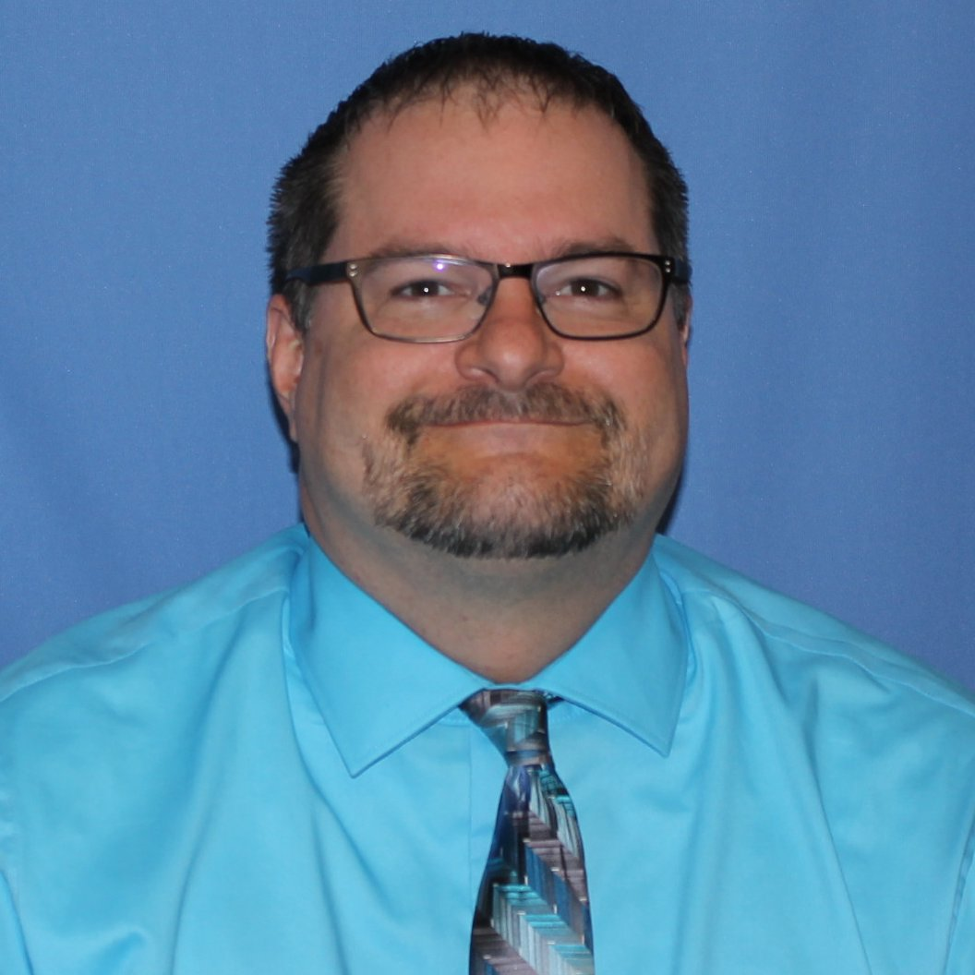
ARHU
Chad Roberts
Teaching Specialist, Communication Studies,
Media Production
ARHU

Slide 4
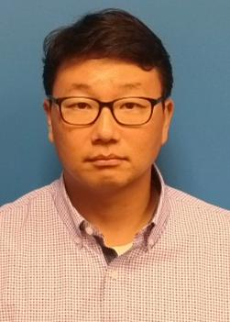
ARHU
Dong Jo Shin
Assistant Professor of History, World History
ARHU

Slide 5
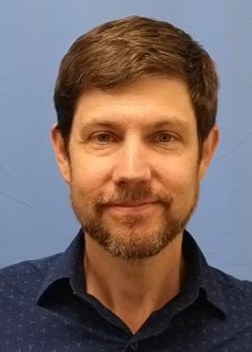
ARHU
Derek Wright
Assistant Professor of Theatre, Production Management
ARHU

Slide 6
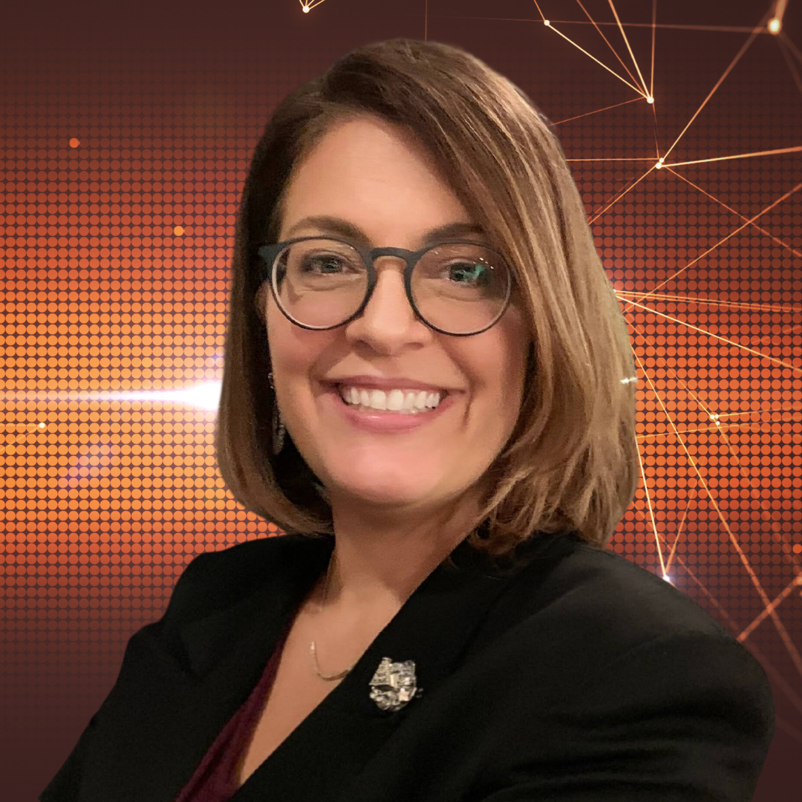
BUSN
Monica Amadio
Assistant Professor of Business Administration, Management
BUSN

Slide 7
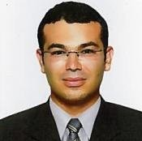
BUSN
Mehmet Akgul
Assistant Professor of Computer Information Systems
BUSN

Slide 8
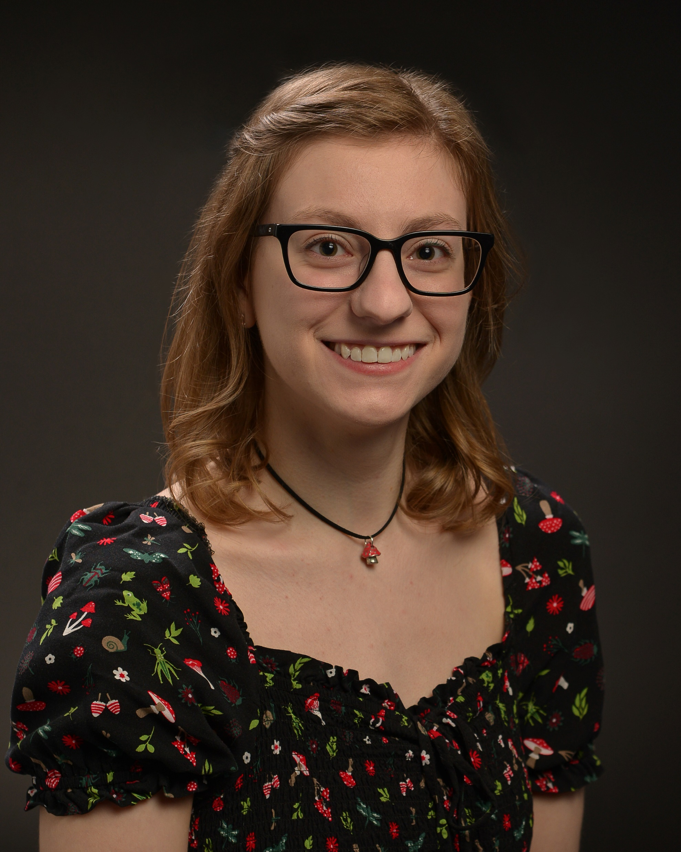
BUSN
Emily Kaplitz
Assistant Professor of Computer Science
BUSN

Slide 9
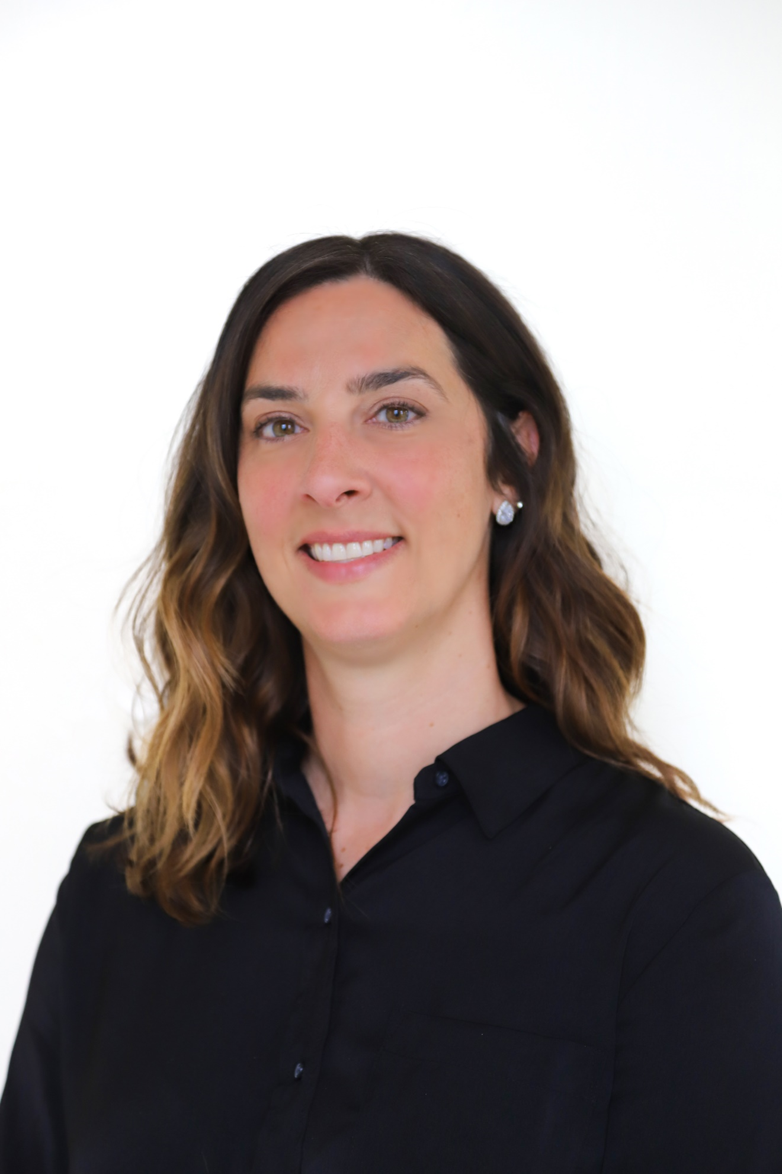
BUSN
Elaine Perignat
Assistant Professor of Business Administration, Management
BUSN

Slide 10

BUSN
Ralph Courtland
Instructor of Finance
BUSN

Slide 11
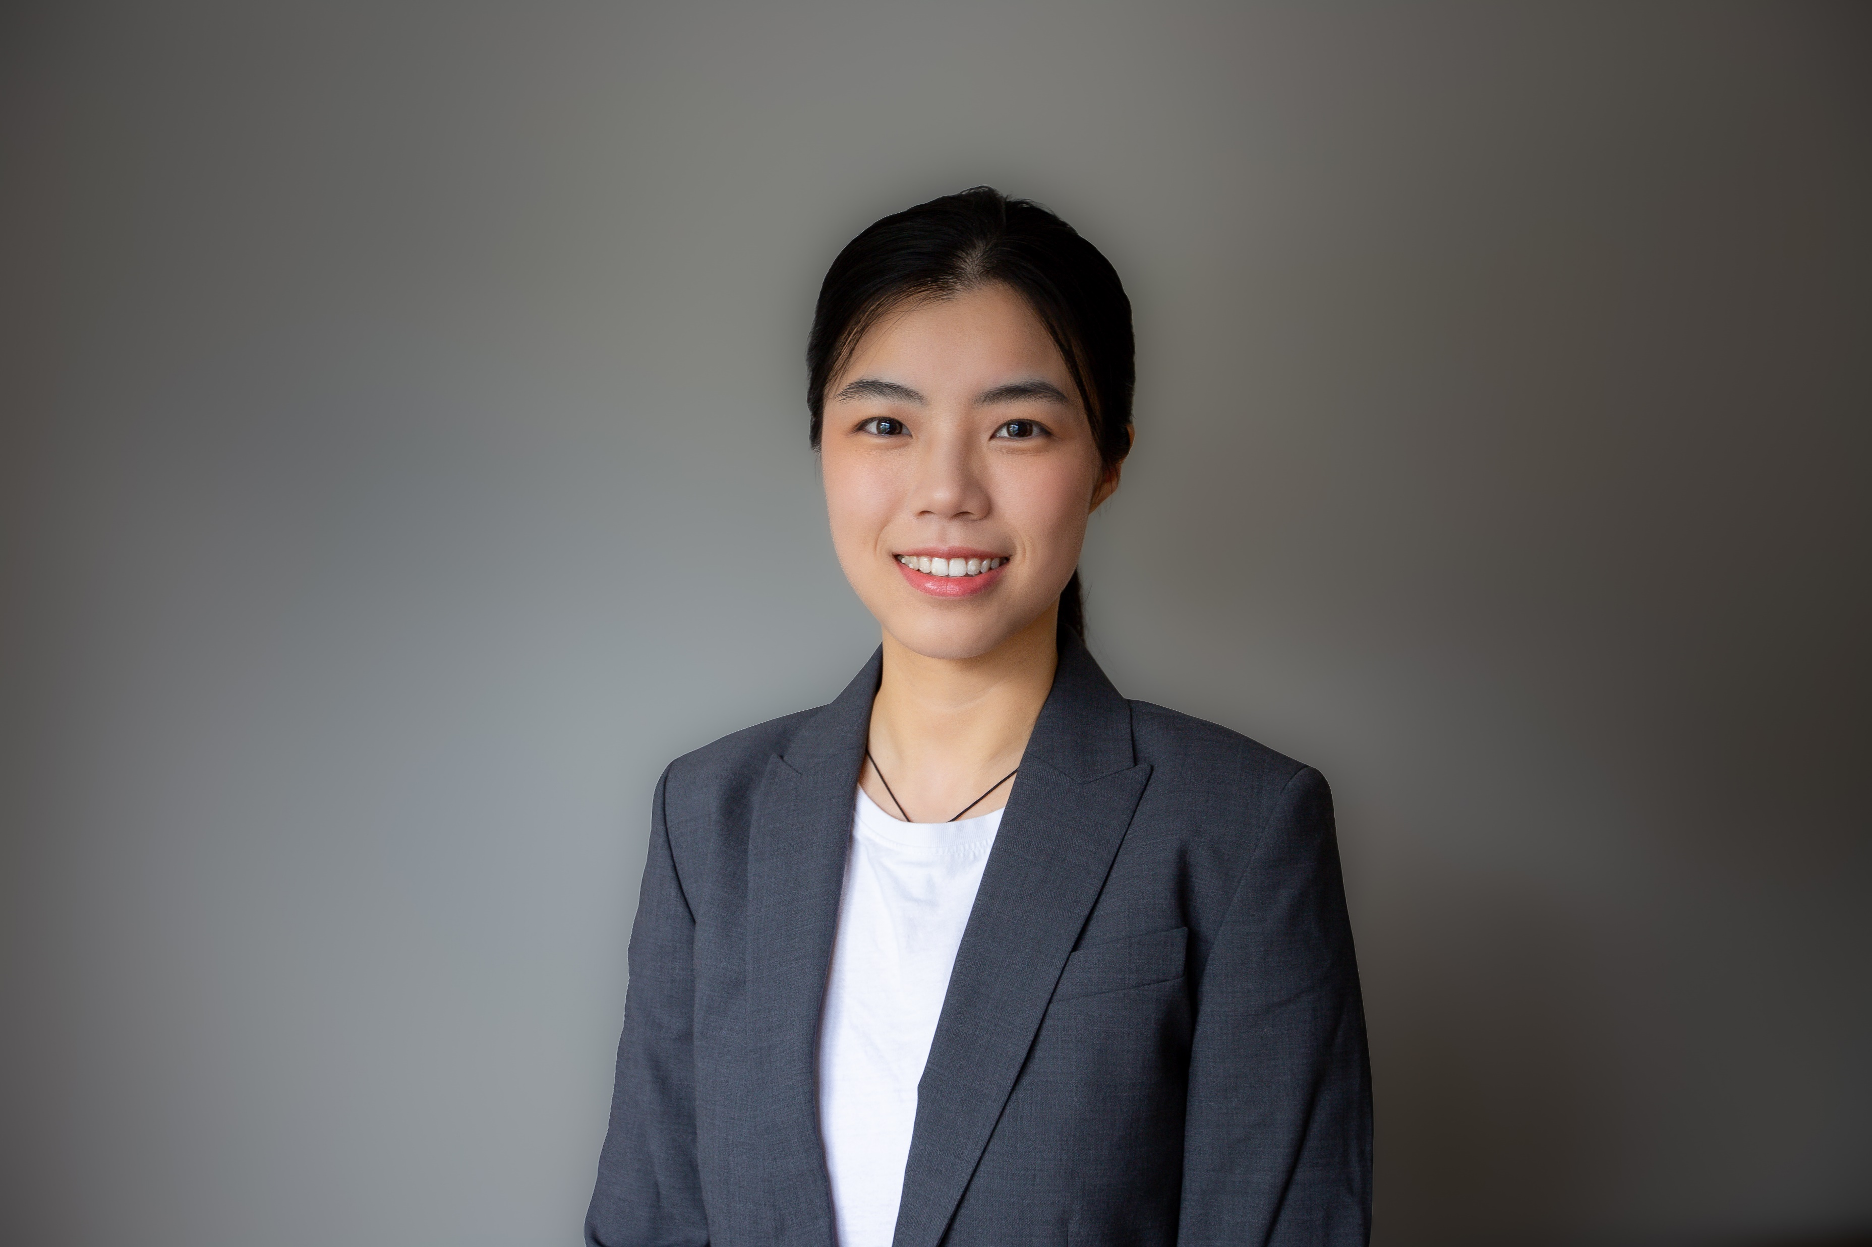
BUSN
Yuqiao Cen
Instructor of Business Analytics
BUSN

Slide 12
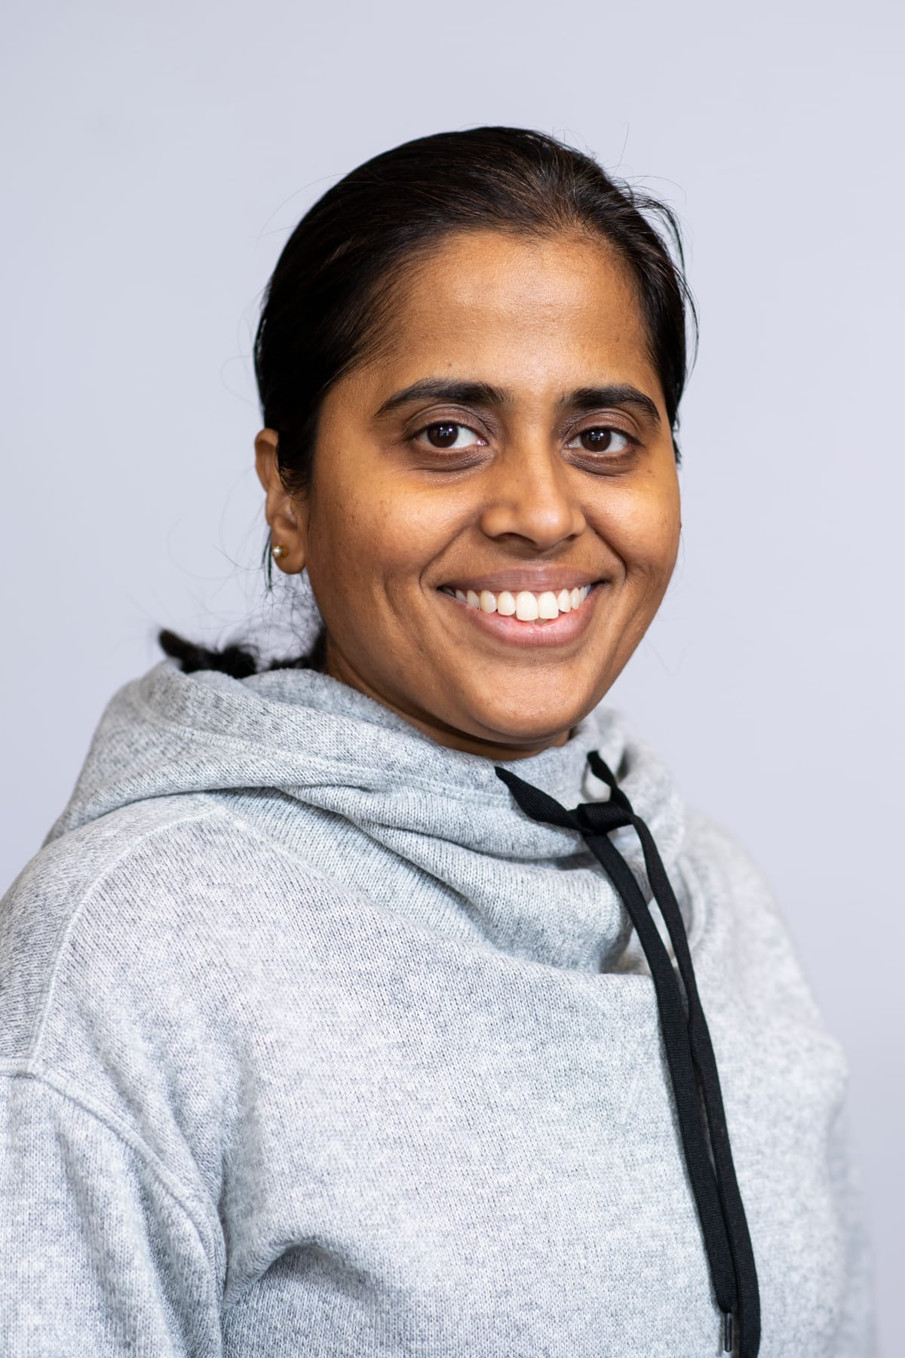
BUSN
Hima Bindu Sadashiva Reddy
Assistant Professor of Computer Information Systems
BUSN

Slide 13
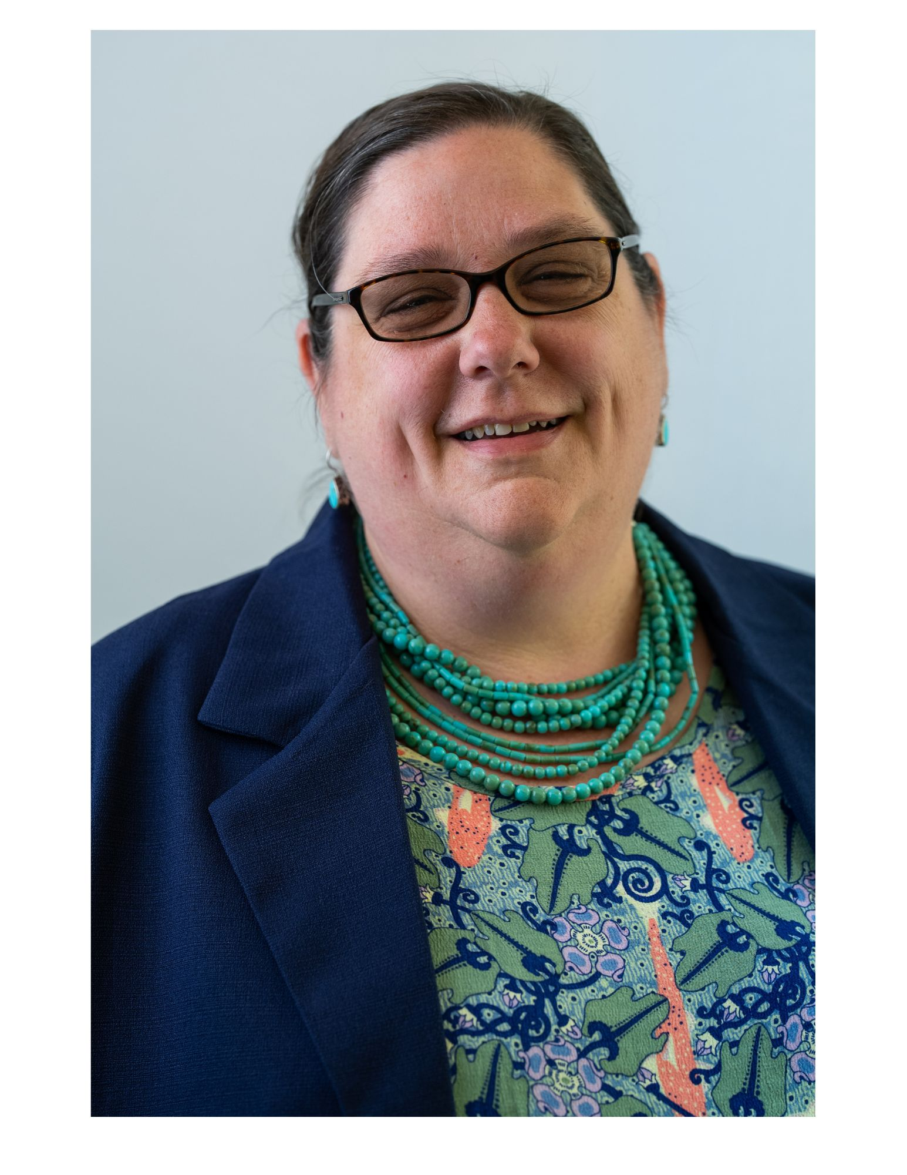
EDUC
Erin O’Hanlon-Keys
Teaching Specialist, Education and Human Development
EDUC

Slide 14
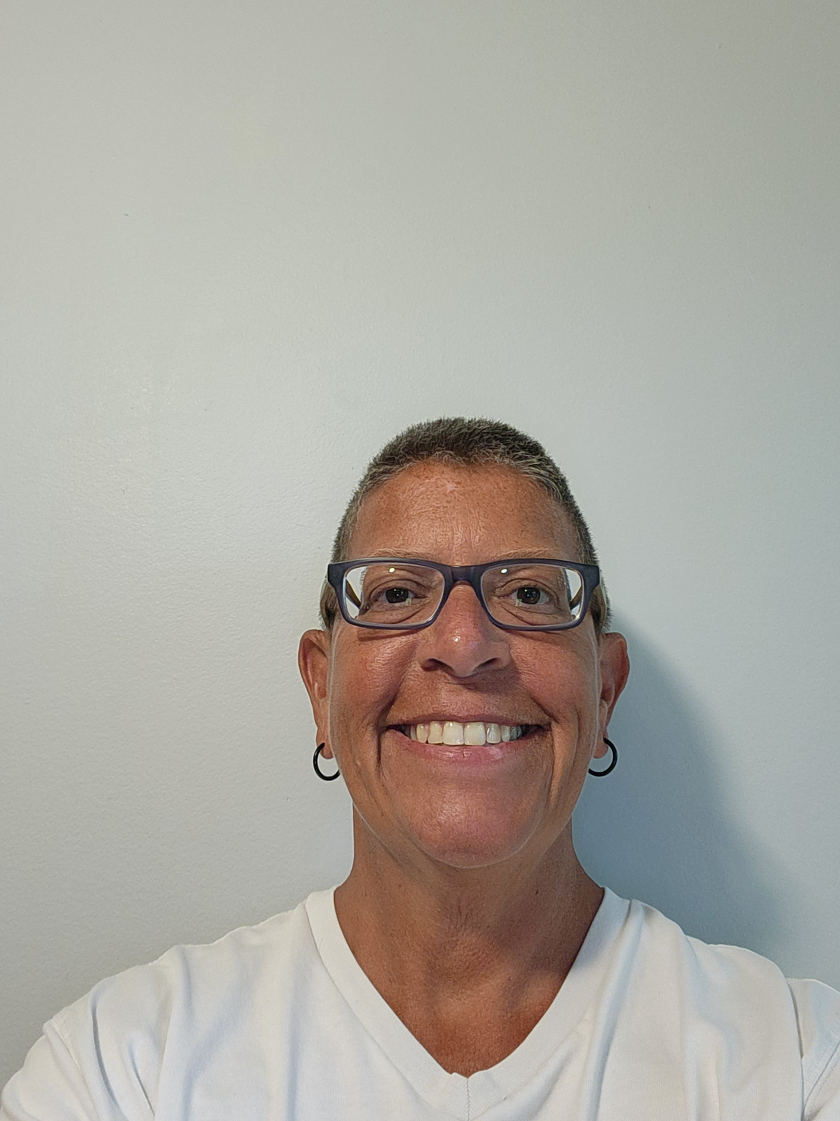
EDUC
Jennifer Tartaro
Teaching Specialist, Education and Human Development
EDUC

Slide 15
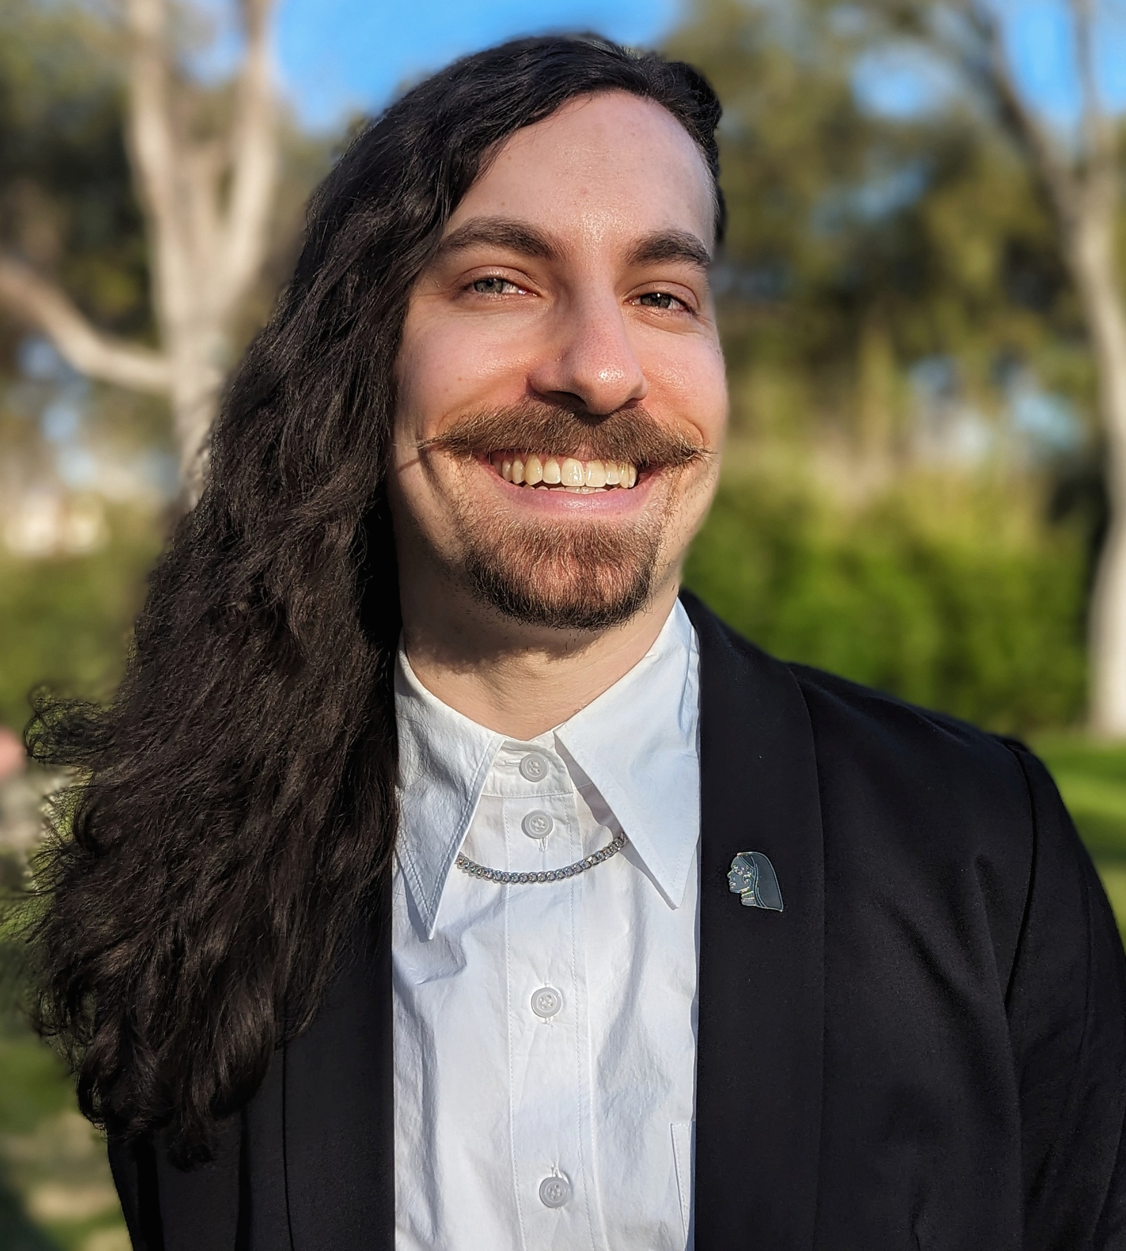
EDUC
Joseph Giunta
Visiting Instructor of Education and Human Development
EDUC

Slide 16
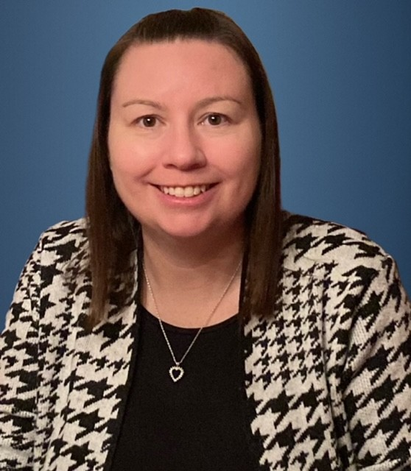
EDUC
Karen McLaughlin
Assistant Professor of Education
EDUC

Slide 17
GENS
Lidia Zessin-Jurek
Assistant Professor, Postdoctoral Fellow, Holocaust & Genocide Studies
GENS

Slide 18
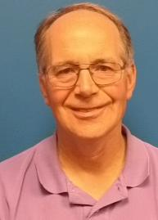
HSCI
Fred Schuster
Teaching Specialist, Exercise Science
HSCI

Slide 19
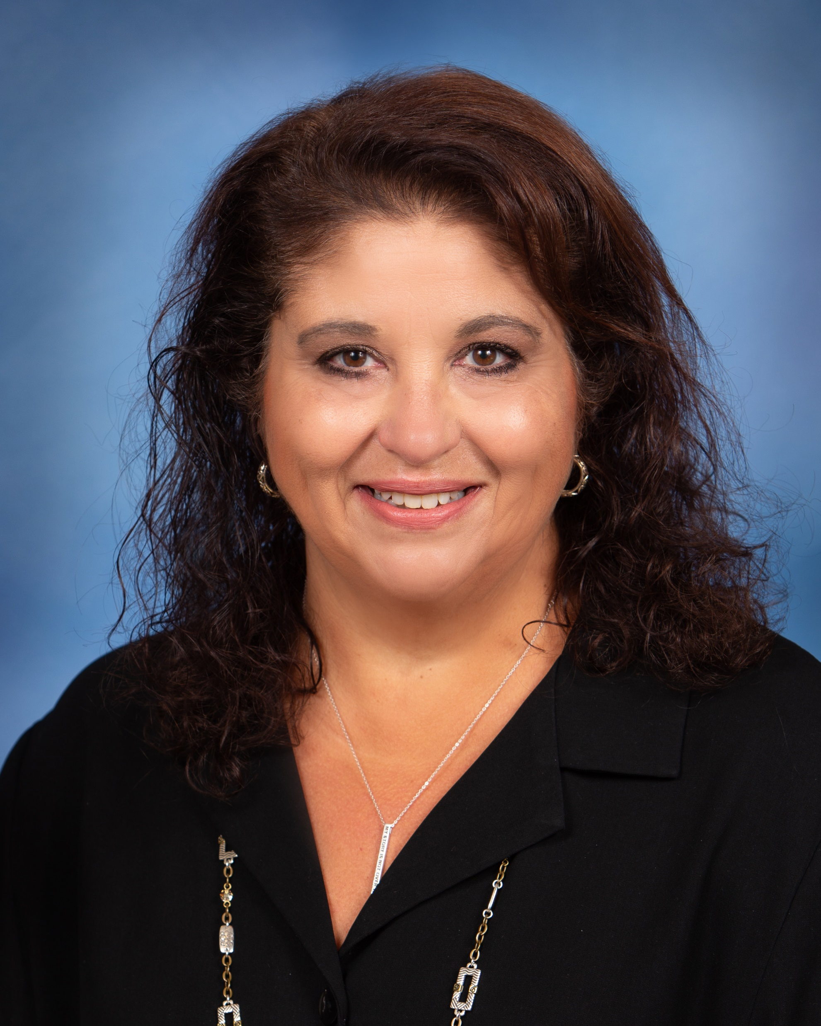
HSCI
Felicia Chew
Instructor of Occupational Therapy
HSCI

Slide 20
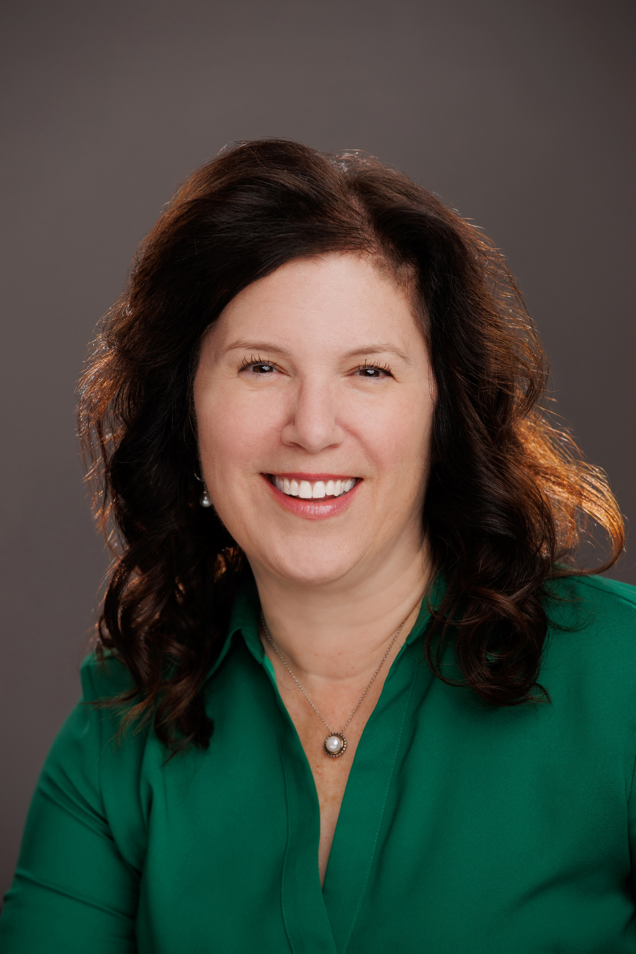
HSCI
Michele Gaguski
Assistant Professor of Nursing
HSCI

Slide 21
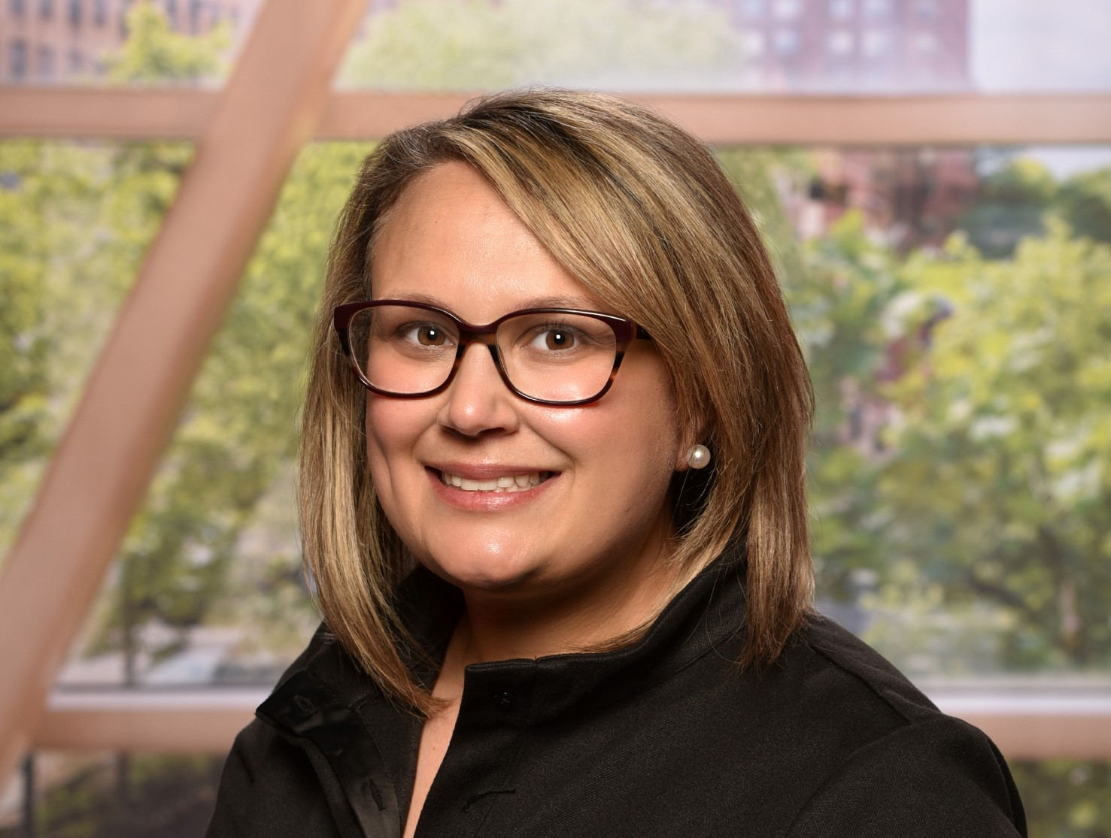
HSCI
Michelle Turner Swartz
Assistant Professor of Communication Sciences & Disorders
HSCI

Slide 22

HSCI
William Buchala
Assistant Professor of Physical Therapy
HSCI

Slide 23
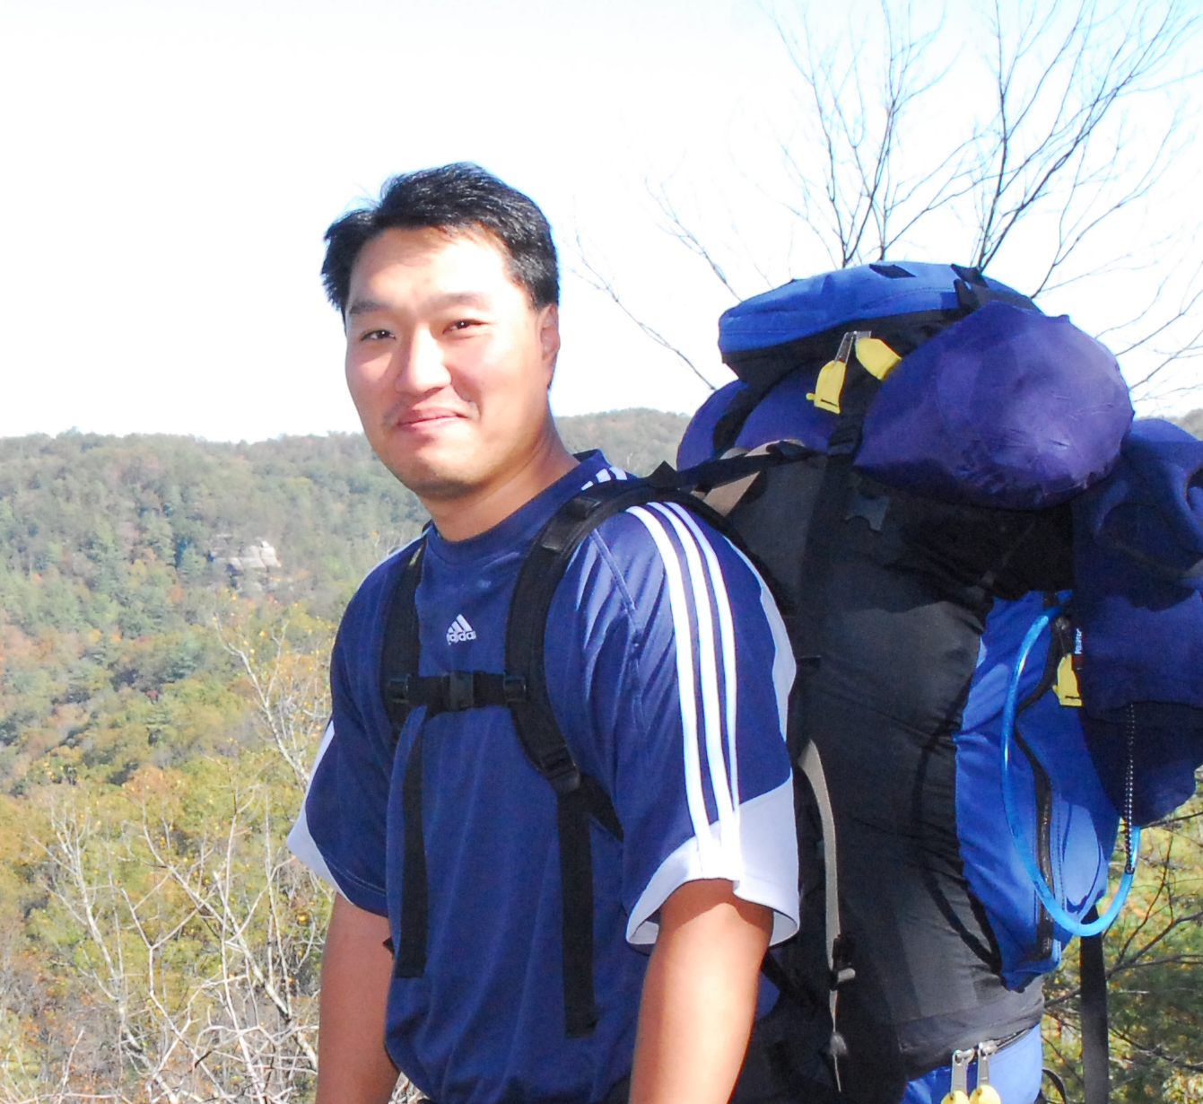
NAMS
Min Kook Kim
Assistant Professor of Environmental Science
NAMS

Slide 24
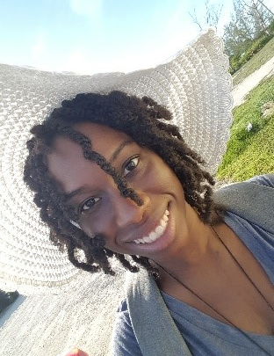
NAMS
Kayla Pennerman
Assistant Professor of Biology
NAMS

Slide 25
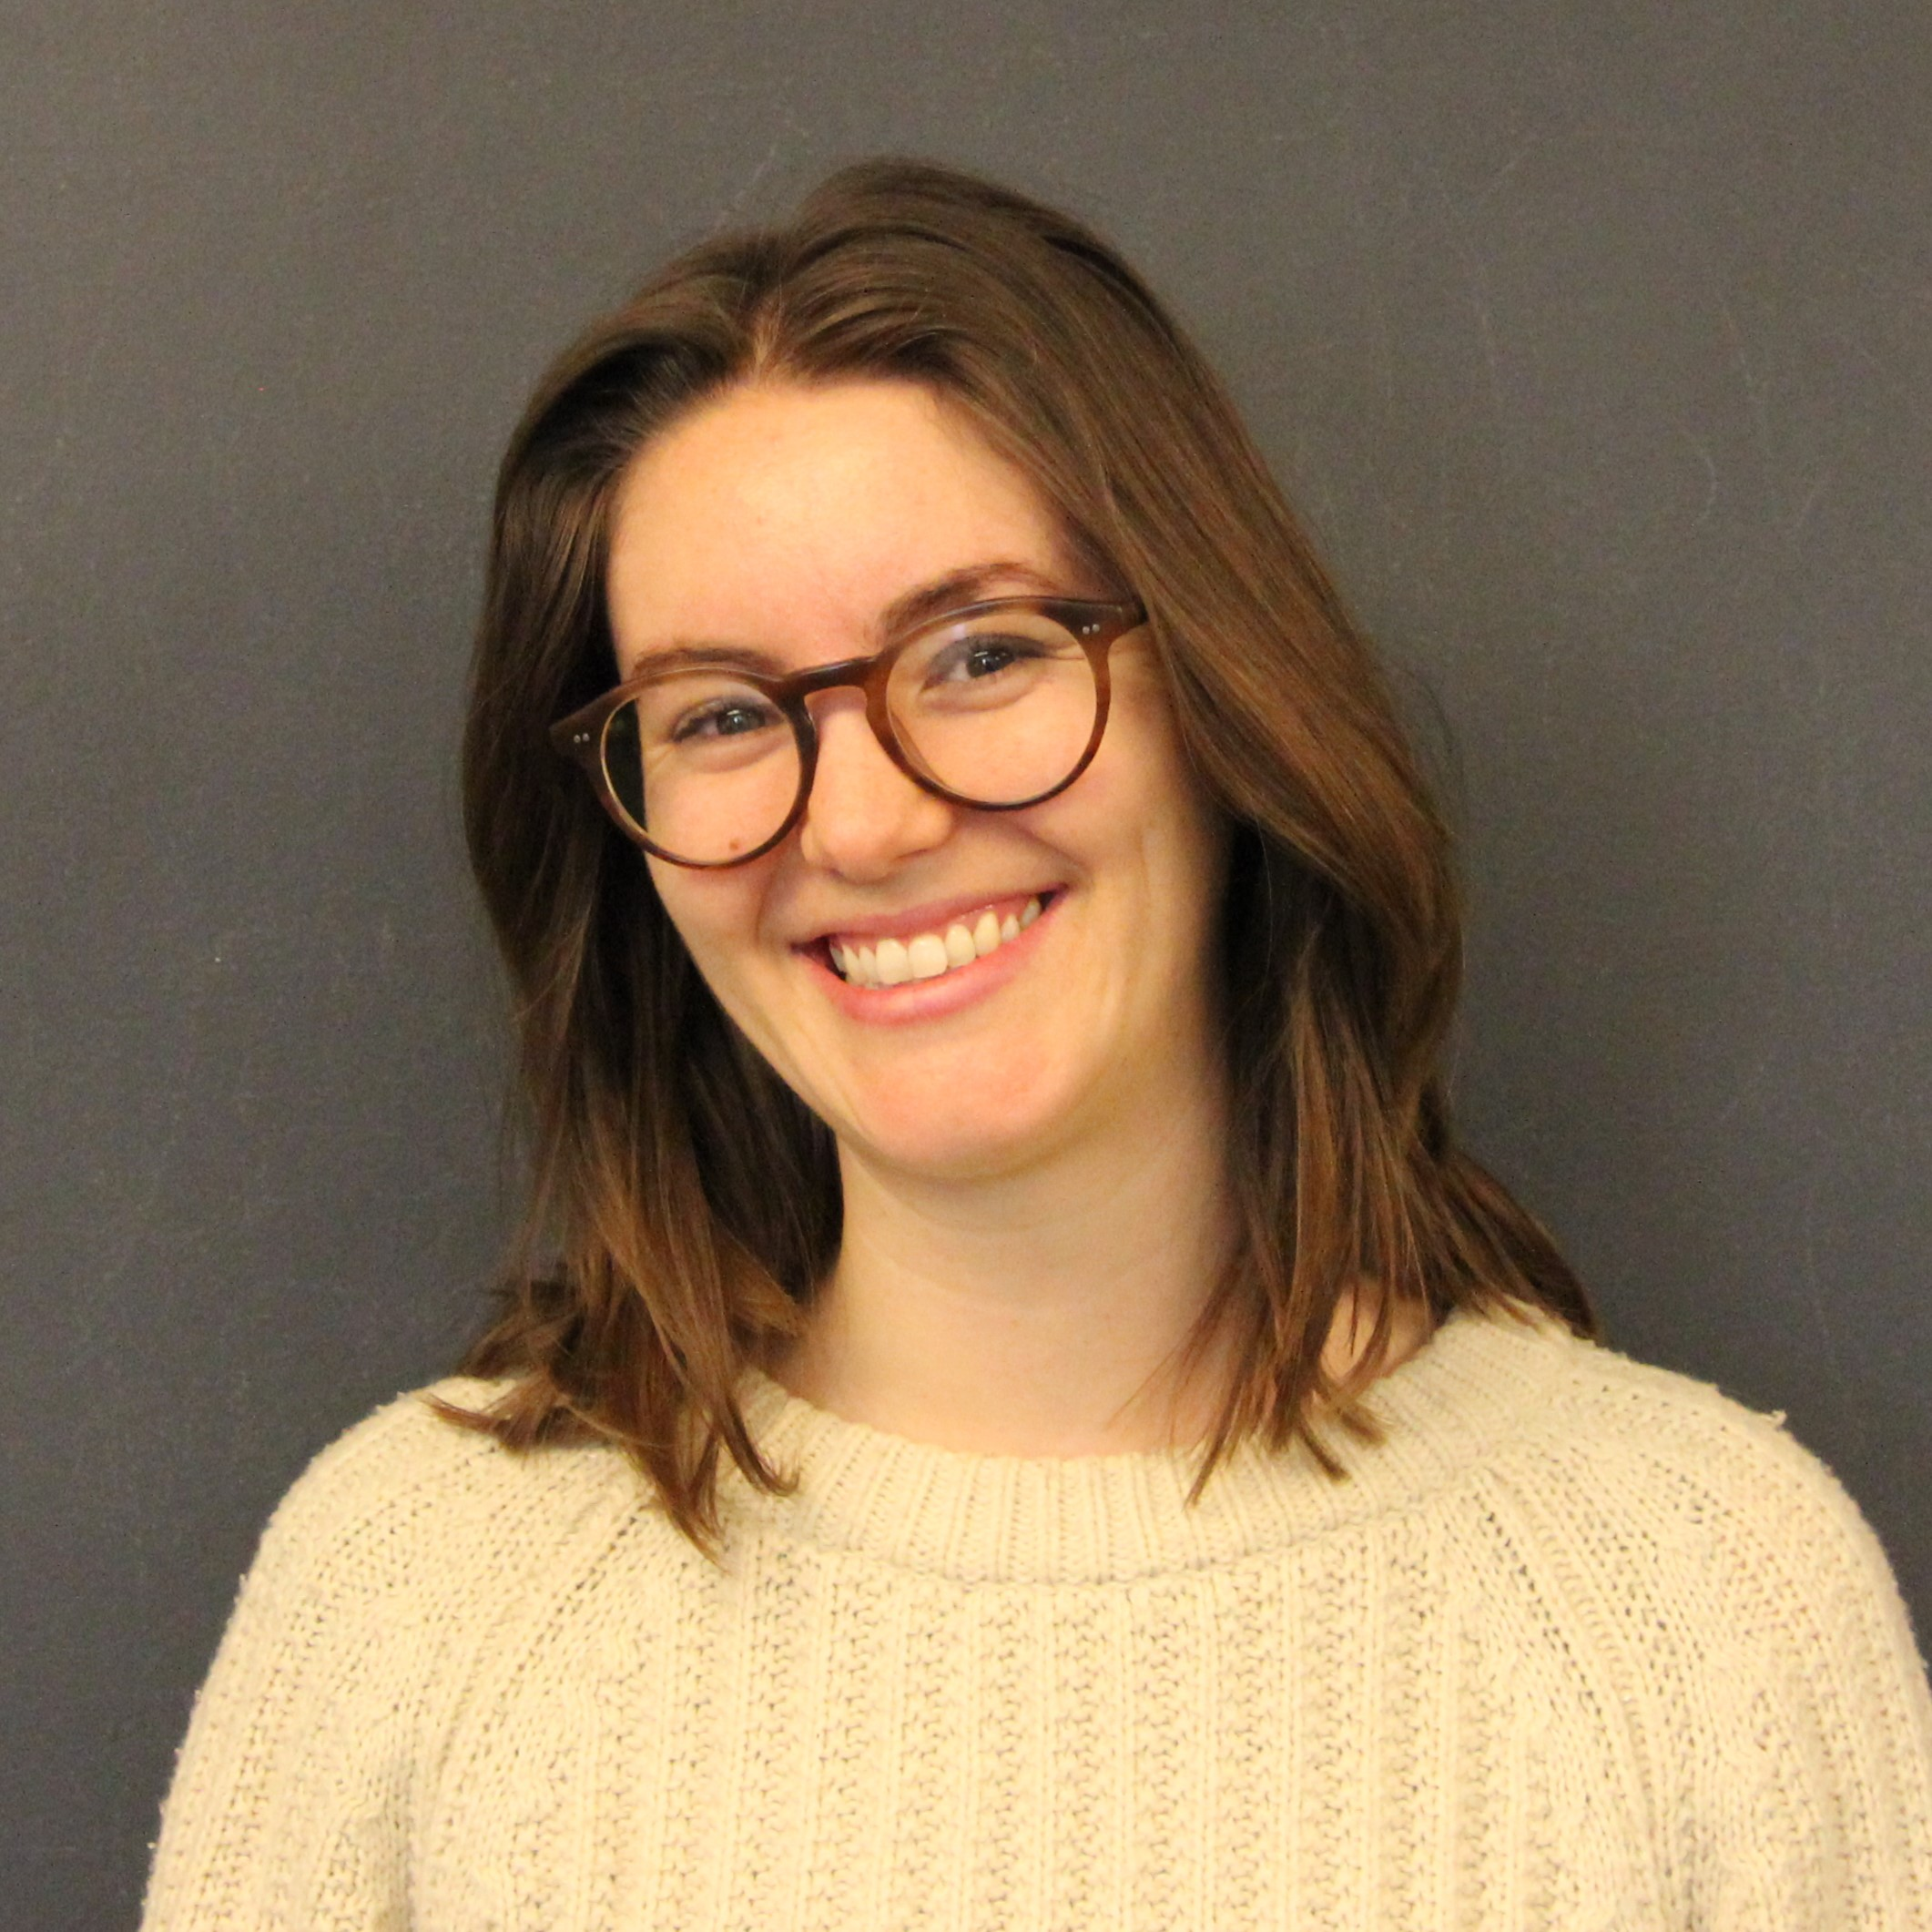
NAMS
Hannah Turner
Assistant Professor of Mathematics
NAMS

Slide 26
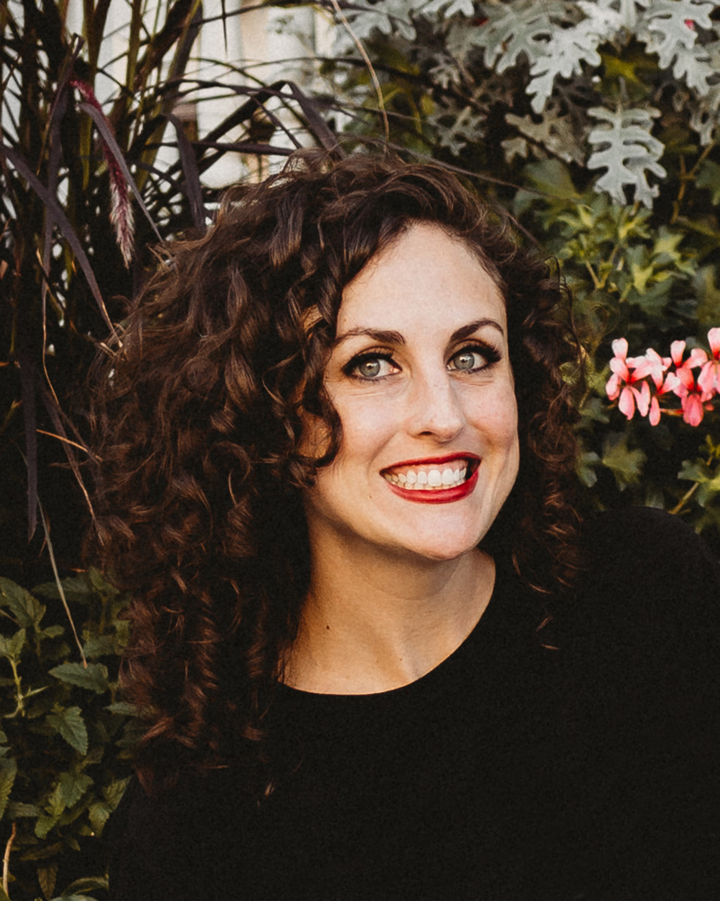
SOBL
Bobbi Hornbeck
Assistant Professor of Archaeology
SOBL

Slide 27
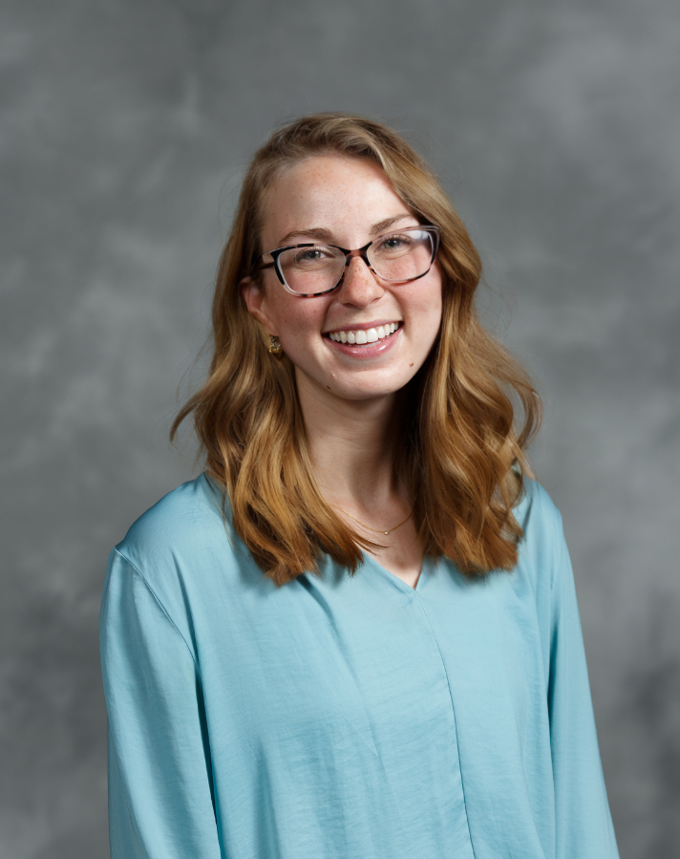
SOBL
Hannah Wolfe
Assistant Professor of Psychology/Gerontology
SOBL

Slide 28
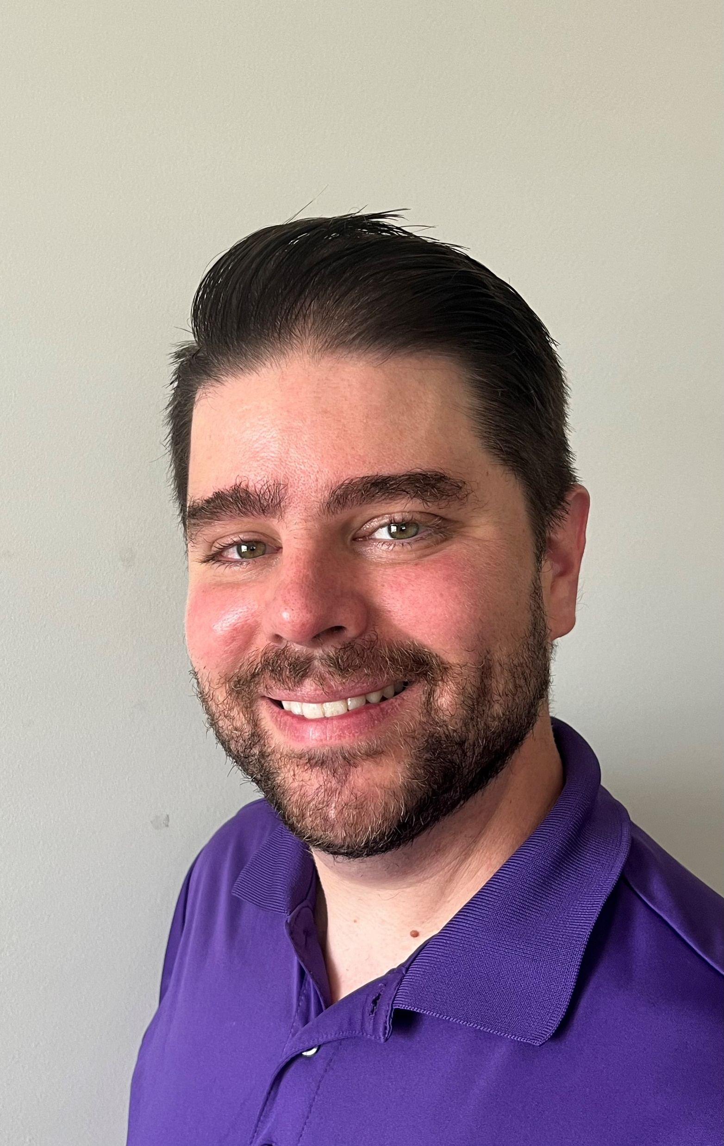
SOBL
Ian Zapcic
Assistant Professor of Social Work
SOBL

Slide 29
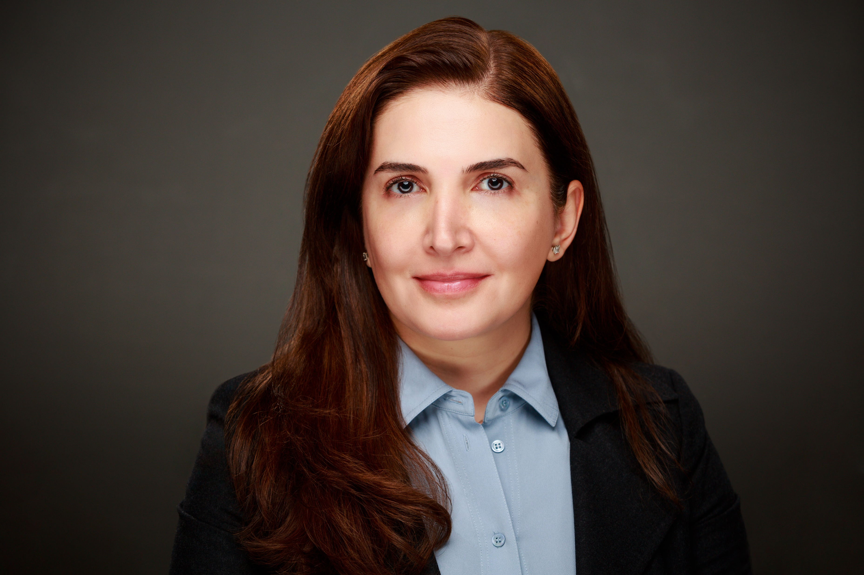
SOBL
Ghaidaa Hetou
Teaching Specialist, Political Science & Economics
SOBL

