Slide 1
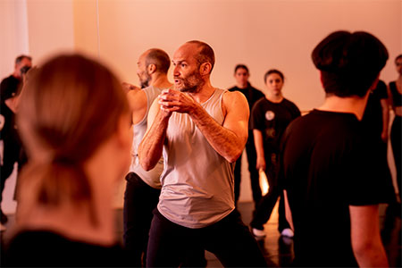
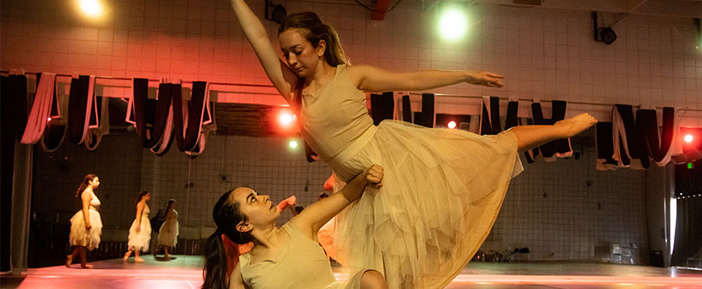

SCHOOL OF ARTS AND HUMANITIES
Stockton Dance Program at the Palm Springs International Dance Festival
This past semester, Dance faculty Caitlin Pittenger and Beau Hancock, along with seven students of the Stockton Dance Company, were invited to attend the Palm Springs International Dance Festival in Palm Springs, California. As performers, Pittenger and Hancock had shared the stage in the past. Still, the Palm Spring International Dance Festival was the first time they collaborated as choreographers as they set a piece on the Nickerson-Rossi Dance Company.
Notes:
Applaud leadership deans and Centers & Department Managers and Likewise the faculty and staff. The accomplishments last year during transition from COVID model to F2F with students and the
Been a pleasure to work with administrative, faculty leadership and faculty and staff. Continue positive work in efforts to benefit our students.
Had an aggressive agenda last year that included digitizing for efficiencies, Beginning ELO process, RISE initiative, LWL, review policies and procedures, Updating compliance items, - work that will continue into the next year. On top of those items faculty have demonstrated talent in educating our student in addition to exceptional service and scholarship – Library centers and departments too have amazing outcomes – all of which I will share some highlights – too many to review everything in 10 minutes so please note that if you or your accomplishment is not present it doesn't mean I didn't read it in the annual report, scholarship report etc... but I tried to provide a diverse array of items to share.
So.... I'll start with some of the accomplishments from last year in aggregate. This Power Point will be viewable on the Provost Archive off of the Stockton Portal under Faculty tab. So... if I move to fast, you have the option of going back to review.

Slide 2
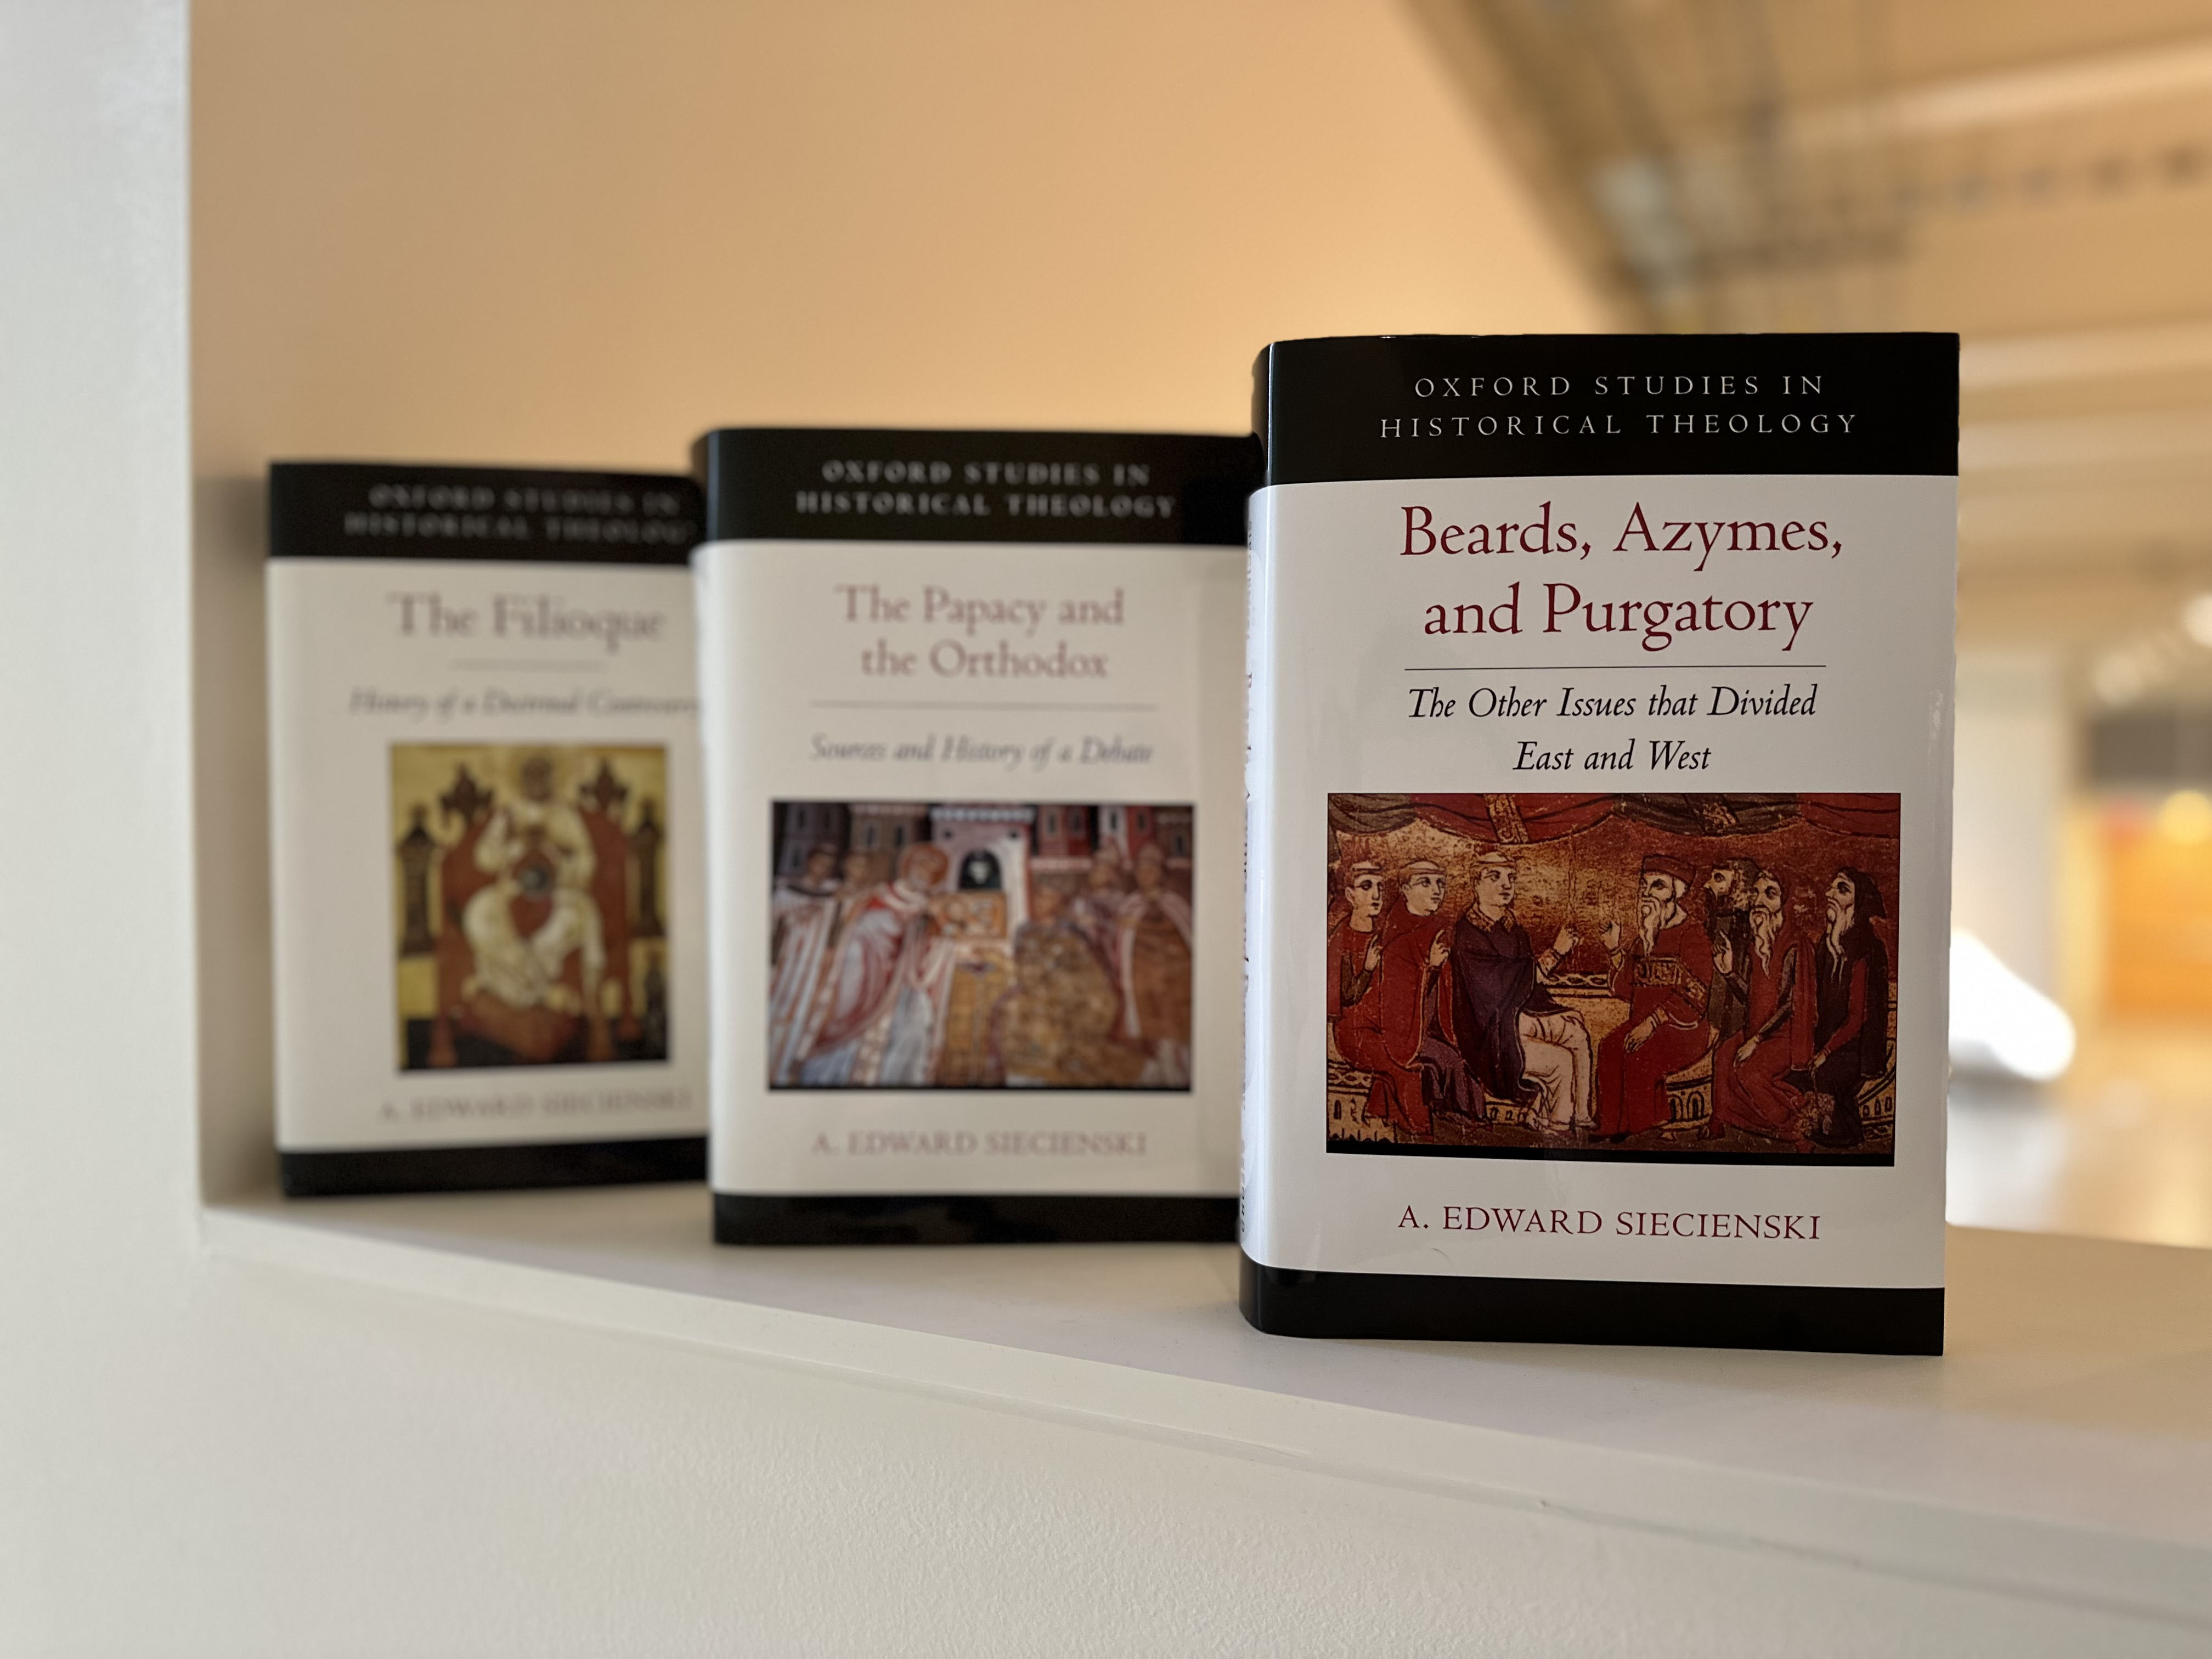
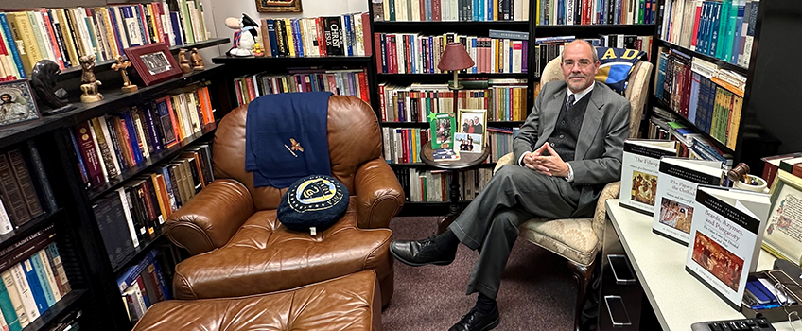
SCHOOL OF ARTS AND HUMANITIES
Faculty Highlight: Edward Siecienski
The Professor of Religion and Clement and Helen Pappas Professor of Byzantine Civilization and Religion, in his 16th year teaching at Stockton, has written a trilogy of books which he sees as comprising a trilogy of East-West issues that explain why the Catholic and Orthodox Churches are not part of the same Church today.
Notes:
Applaud leadership deans and Centers & Department Managers and Likewise the faculty and staff. The accomplishments last year during transition from COVID model to F2F with students and the
Been a pleasure to work with administrative, faculty leadership and faculty and staff. Continue positive work in efforts to benefit our students.
Had an aggressive agenda last year that included digitizing for efficiencies, Beginning ELO process, RISE initiative, LWL, review policies and procedures, Updating compliance items, - work that will continue into the next year. On top of those items faculty have demonstrated talent in educating our student in addition to exceptional service and scholarship – Library centers and departments too have amazing outcomes – all of which I will share some highlights – too many to review everything in 10 minutes so please note that if you or your accomplishment is not present it doesn't mean I didn't read it in the annual report, scholarship report etc... but I tried to provide a diverse array of items to share.
So.... I'll start with some of the accomplishments from last year in aggregate. This Power Point will be viewable on the Provost Archive off of the Stockton Portal under Faculty tab. So... if I move to fast, you have the option of going back to review.

Slide 3
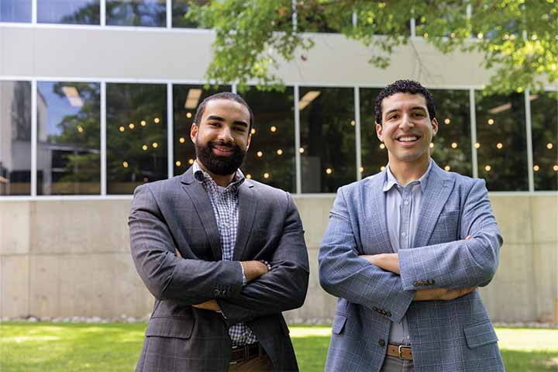
School of business
Feature Story: Computer Science major Francisco Vizcaino-Martinez '20 and Business Administration major Sage Del Valle ‘20
In the fall of 2018, Sage Del Valle and Francisco Vizcaino-Martinez found themselves taking “The History of Christian Thought I” to fulfill a general education requirement. And as the saying goes, the rest was history.
By April 2019, they launched their business, F & S Digital, working from dorm rooms and the N Wing cafeteria on the Galloway campus.
While they completed their Stockton degrees, they steadily grew their business, providing digital solutions for their clients. The pair specialize in bridging technology gaps for both established and startup organizations, including custom software, automations and cloud infrastructures.
They never imagined within five years they would be hiring over 50 employees and contractors and preparing to expand outside of Atlantic City.

Slide 4
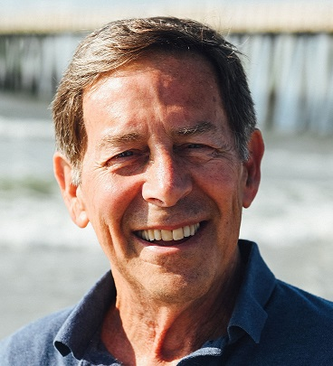
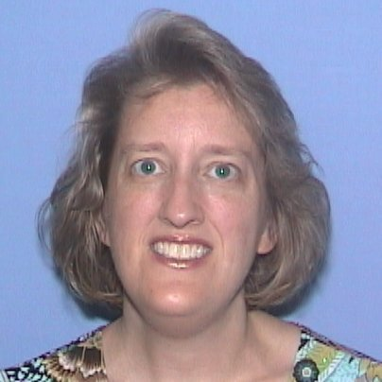
Did you know?
Finance Professor, Dr. Michael Busler, was recently featured in WalletHub's piece about the Cheapest Cars to Insure.
Business Analytics Professor, Dr. Ellen Kraft, was recently featured in WalletHub's piece about Cheap Car Insurance in New Jersey.

Slide 5
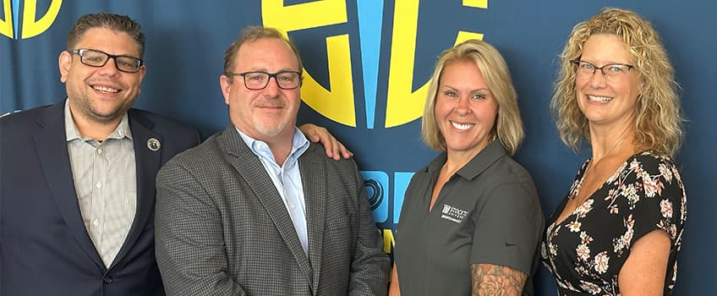
School of BUSINESS
Faculty Focus on EIC in Esports
The Esports Innovation Center (EIC) at Stockton University announced four new board members at its annual meeting on 15th July 2024.
Congratulations to Associate Professor Noel Criscione-Naylor, Assistant Professor Jennifer Aarons, Information Security Officer Demetrios Roubos and David Weinstein on becoming new members of the Esports Innovation Center's Advisory Board!

Slide 6
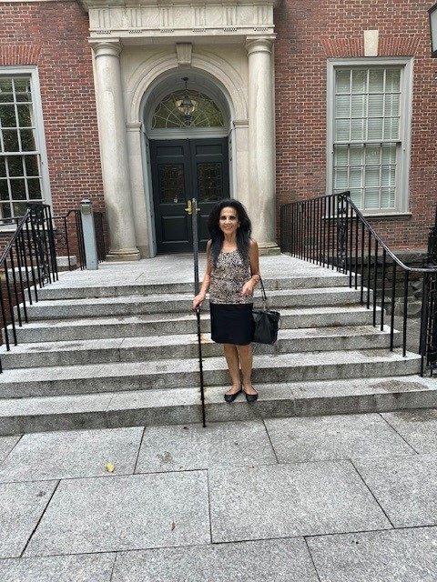
Did you know?
Distinguished Professor Audrey Latourette was appointed to the Summer Scholar in Residence Program at NYU's Washington Square campus in New York City.
Professor Latourette can be seen here at the courtyard entrance of NYU's School of Law where her research related to First Amendment rights of faculty was conducted.

Slide 7
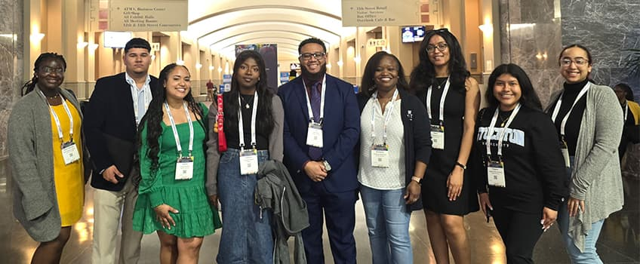
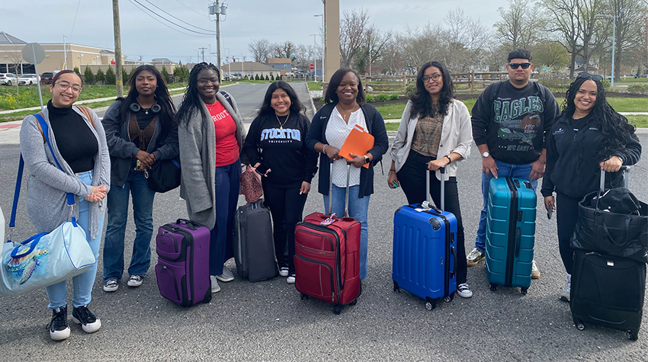
School of education
Future Educators of Color Find Inspiration at National Conference
7 Stockton students interested in becoming educators attended the American Educational Research Association’s (AERA) annual conference in Philadelphia from April 11-14.
Ian Bouie was inspired by what he saw at the American Educational Research Association’s (AERA) annual conference in Chicago last year. He decided to pay it forward and encourage future educators of color by taking 7 Stockton students to the same conference – this time in Philadelphia from April 11-14.

Slide 8
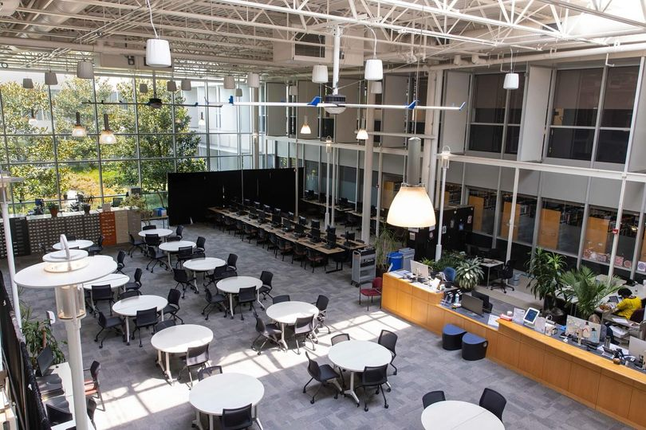
richard e. bjork library
Spotlight On: Library Learning Commons Renovation
As part of the NJ State Bond Solicitation 2022, Stockton University has been awarded $19.5m in funds to renovate the E-Wing Library into a state-of-the-art Library Learning Commons.
During the renovation, the Library is located at C/D Atrium.
Notes:
Welcomed Hughes Center and reinforced connections between policy-driven initiatives and academic experiences. Director of the Secret Service

Slide 9
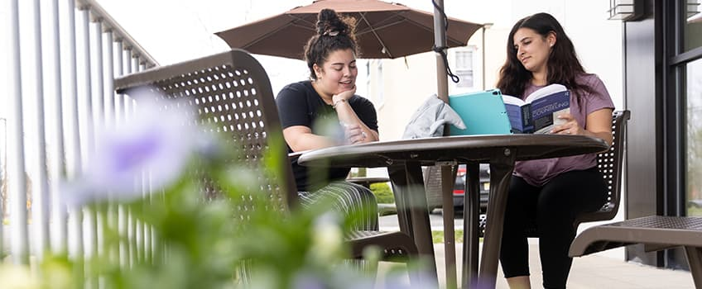
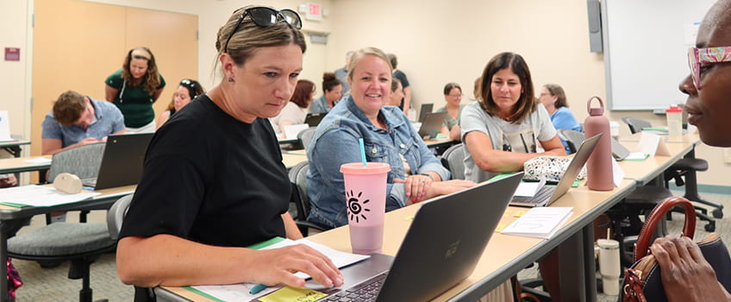
Did you know?
Stockton’s Master of Arts in Counseling Program has been granted Accreditation
Stockton University is the only college or university in southern New Jersey to receive a $650,000 state grant to promote K-12 Climate Change Education

Slide 10
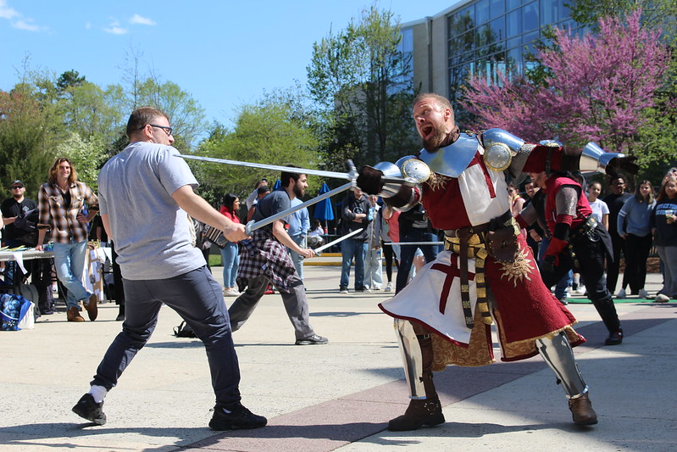
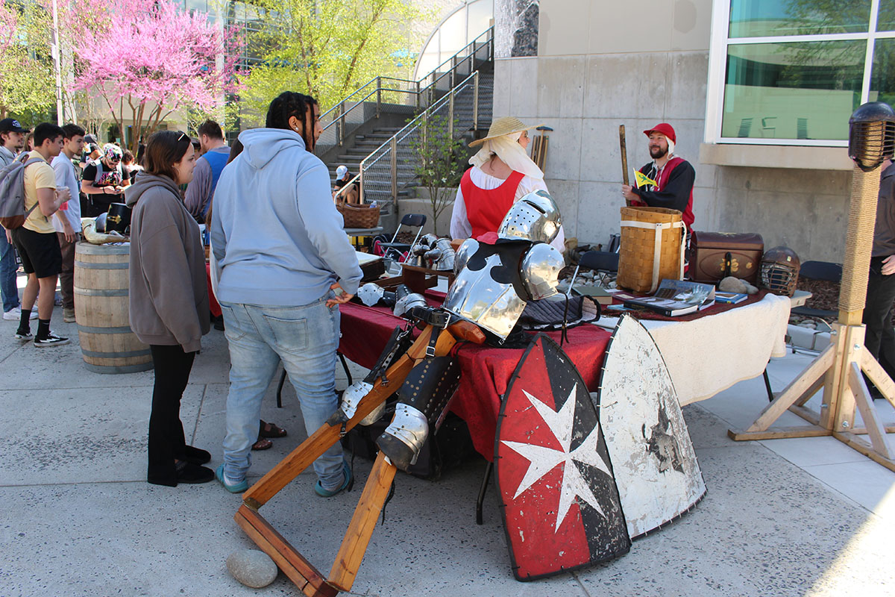
school of general studies and graduate education
Medieval Marketplace
Geoffrey Gust, Associate Professor of Critical Thinking & First Year Studies hosts the Medieval Marketplace to give students the opportunity to "connect with the past" by learning lessons in sword fighting and archery, present class projects, and see replicas of medieval armor and weapons.
Notes:
High School Dual Credit expands to increase diversity and preparedness of Stockton recruits.
Original work collectively designed & constructed by students of GMN2257 - The Art and Math of Origami taught in Spring 2022 by Dr. Norma Boakes

Slide 11
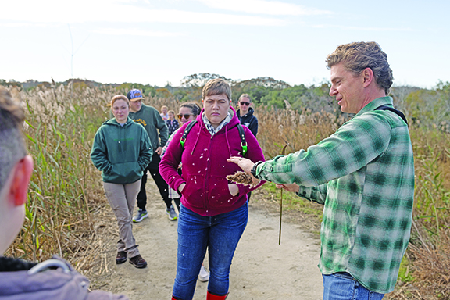
school of natural sciences and mathematics
Professor makes Higbee Beach living classroom
During fall migration, warblers, raptors and monarch butterflies traveling down the East Coast funnel through the Cape May peninsula.
Jason Kelsey and students in his Coastal Ecosystems class followed a sliver of their migratory route to learn more about habitats and differences in natural and developed coastlines.
With Cape May on National Geographic’s top 10 list of birding destinations in the world, students packed binoculars for the field trip.
The class, part of Stockton University’s Coastal Zone Management master’s degree program, met at Higbee Beach Wildlife Management Area to explore the natural bayshore and then took a short drive downtown to look at how beach engineering can reshape the coast.
Stockton University students get a lesson in local ecosystems on Cape May Canal

Slide 12
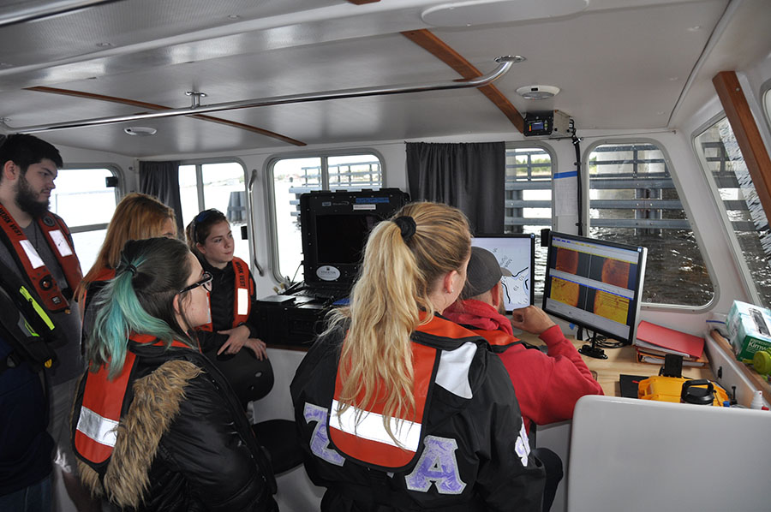
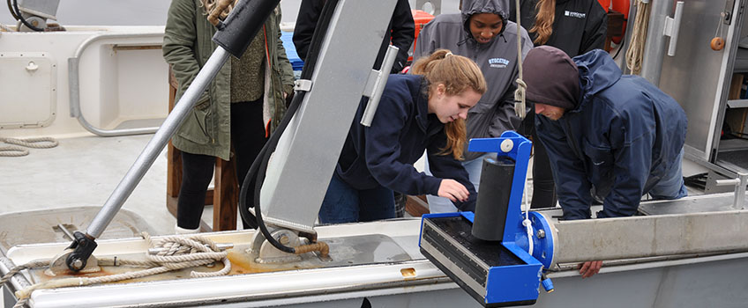
school of natural sciences and mathematics
The National Oceanic and Atmospheric Administration (NOAA) awarded Stockton with a $1.4 million grant (with $300,000 matching from Stockton)
The award — one of the largest awarded to Stockton’s Marine Field Station — has two major components:
  Expanding a program with local fishing industries to identify and remove lost fishing and aquaculture gear in South Jersey waterways
  Cataloging abandoned watercraft in New Jersey and removing 15-25 target vessels.

Slide 13
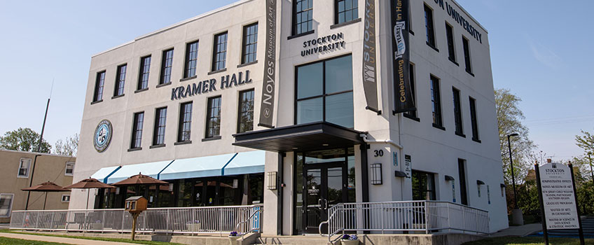
Hammonton – Kramer Hall
Stockton University in Hammonton at Kramer Hall
For the past 11 years Stockton's Hammonton Location, Kramer Hall has held over 200 courses with 4,000 enrollments. It hosts graduate programs such as Counseling and Data Science and Strategic Analytics and is home to the Noyes Museum of Art.

Slide 14
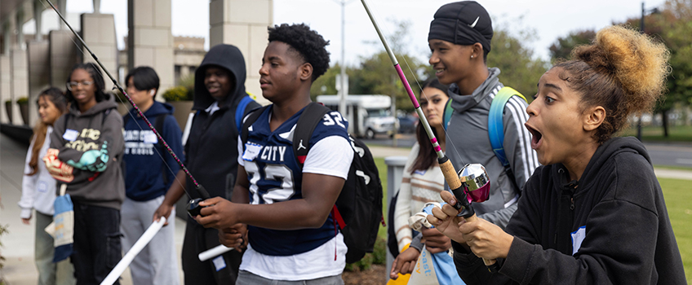
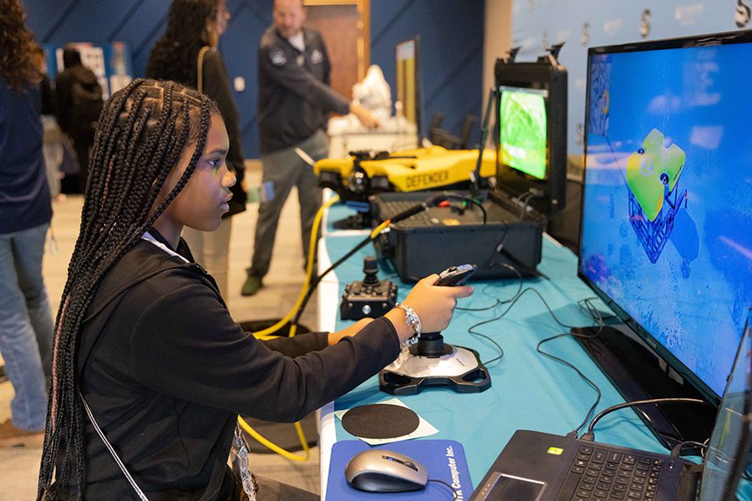
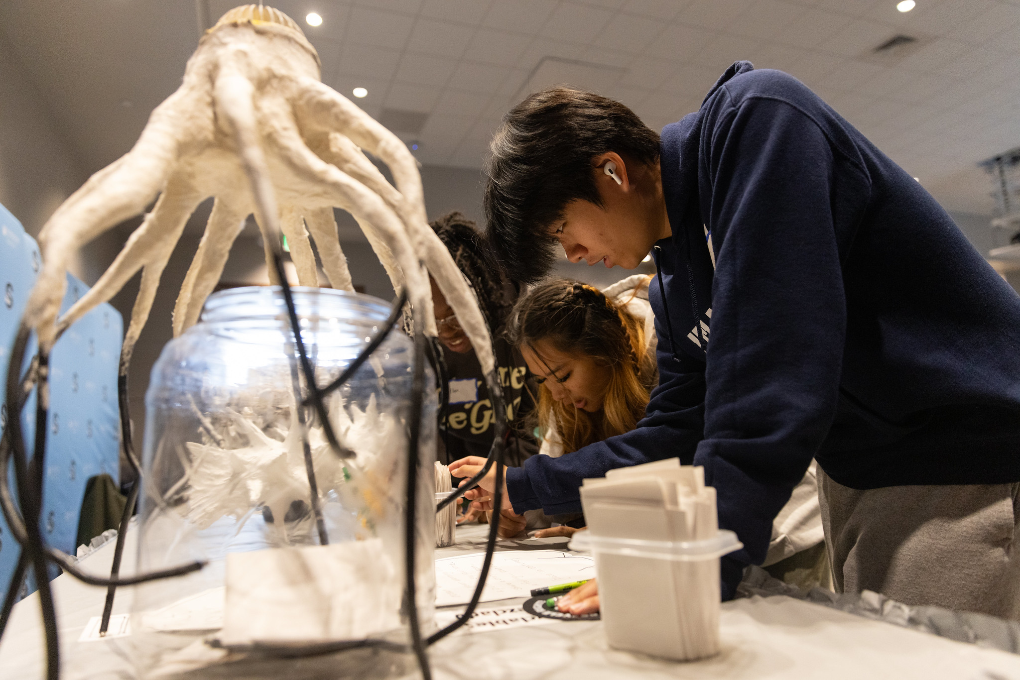
school of natural sciences and mathematics
Return of Coast Day Brings Lifelong Memories to Students
Several classmates spent a morning at Coast Day, an event coordinated by Susanne Moskalski, associate professor of Marine Science, and held at John F. Scarpa Academic Center. Students from Atlantic City and Egg Harbor Township high schools checked out a variety of displays and exhibitors focusing on the theme of coastal change, conservation and resilience. The students also listened to a lecture about sea level rise, had the opportunity to take part in a craft with shells and even learned how to cast a fishing rod.
Using Coast Day to share that knowledge in a fun and interesting way is very important, said Amanda Norvell, the dean of the School of Natural Sciences and Mathematics.

Slide 15
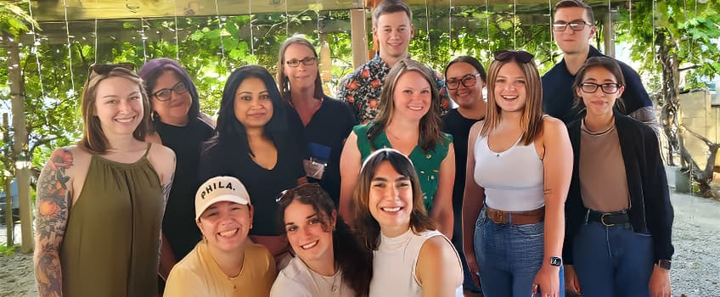
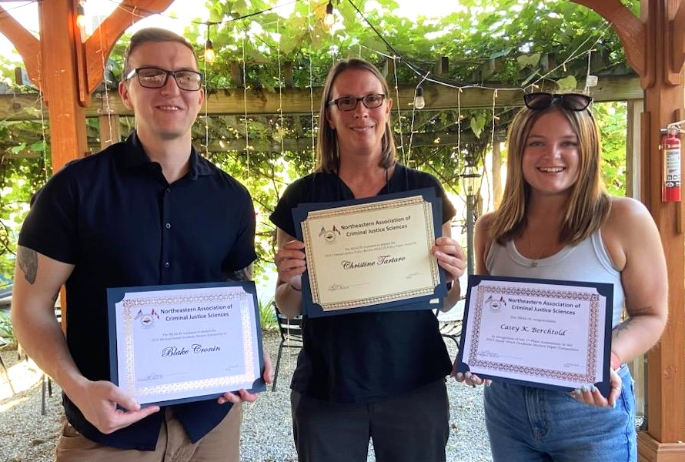
School of social and behavioral sciences
Criminal Justice Faculty & Students Present & Win Awards at The NEACJS Annual Conference
In June 2024, Criminal Justice faculty and their students attended the 2024 annual Northeastern Academy of Criminal Justice Sciences (NEACJS).
At the conference, Stockton's Criminal Justice Program students and faculty members received awards:
MACJ student, Blake Cronin, received the Michael Israel Graduate Student Scholarship
Recent MACJ graduate, Casey Berchhold, received the David Orrick Graduate Student Award for one of her final papers
Distinguished Professor Christine Tartaro, and Assistant Professor Ruibin Lu were awarded the Sage/CJPR-NEACJS Policy Paper Award.
Furthermore, other Criminal Justice faculty members and students presented their research.
Congratulations to all the award winners and presenters!
Notes:
Welcomed Hughes Center and reinforced connections between policy-driven initiatives and academic experiences. Director of the Secret Service

Slide 16
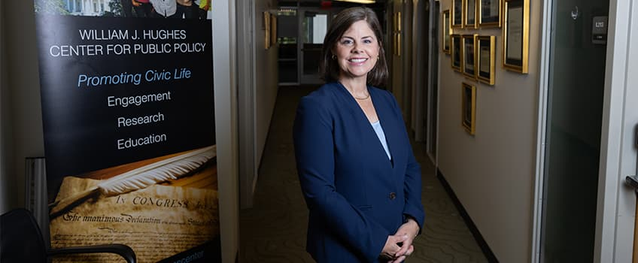
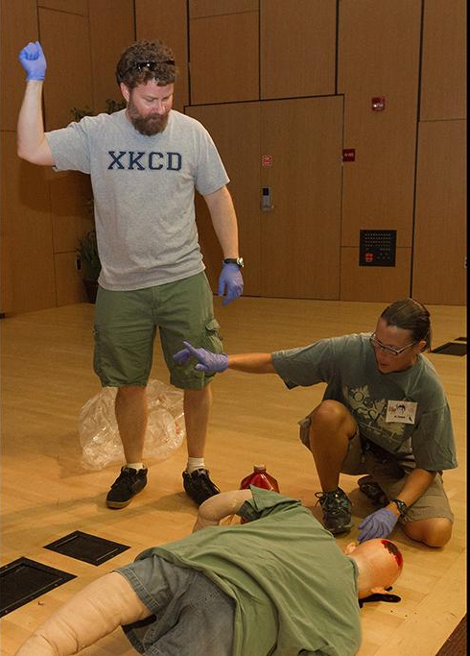
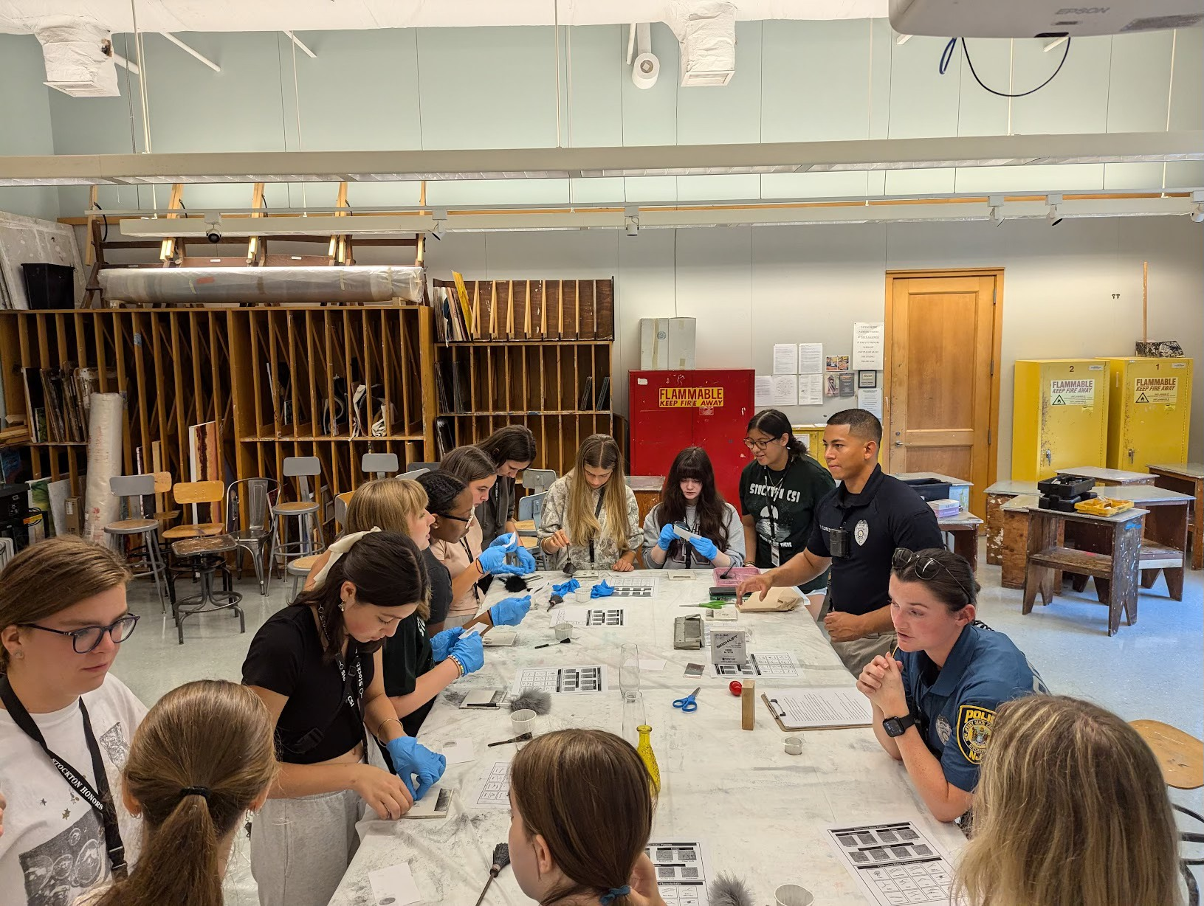
Did you know?
Tina Zappile, Associate Professor of Political Science, is the New Director of the William J. Hughes Center
This Summer 2024, Stockton CSI Summer Camp has entered its eighteenth year.
Notes:
Welcomed Hughes Center and reinforced connections between policy-driven initiatives and academic experiences. Director of the Secret Service

