Slide 1
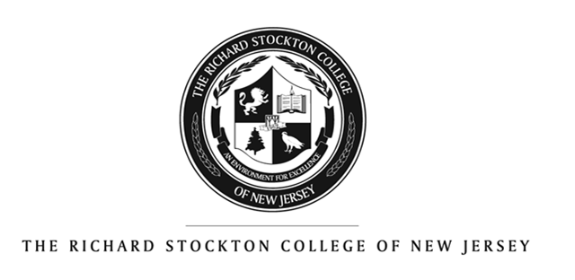
The Faculty Senate Task Force on University Status
2012-2013
Points of Information

Slide 2
Definitions of University
: an institution of higher learning providing facilities for teaching and research and authorized to grant academic degrees; specifically : one made up of an undergraduate division which confers bachelor's degrees and a graduate division which comprises a graduate school and professional schools each of which may confer master's degrees and doctorates (Merriam-Webster)
Institution of higher education, usually comprising a liberal arts and sciences college and graduate and professional schools that confer degrees in various fields. A university differs from a college in that it is usually larger, has a broader curriculum, and offers advanced degrees in addition to undergraduate degrees. The first true university was the University of Bologna, founded in the 11th century; the first in northern Europe was the University of Paris, which served as a model for the universities of Oxford, Cambridge, Heidelberg, and others. One of the first modern universities, in which secular objectivity and rationalism replaced religious orthodoxy, was the University of Halle (founded 1694 in Halle, Ger.). The liberalism of Halle was adopted by Göttingen, Berlin, and many other German universities. The German model of the university as a complex of schools and research institutes also exerted a worldwide influence. The growth of universities in the U.S., where most colleges had been established by religious denominations, was greatly spurred by the Morrill Act of 1862. (Concise Encyclopedia)

Slide 3
New Jersey Definition & Process
In New Jersey, an institution that offers graduate and undergraduate degrees in a variety of academic disciplines and professional fields may seek status as a comprehensive university. Such institutions emphasize teaching, and are distinct from the state's six research universities (see next slide), which place a heavier emphasis on basic and applied research and Ph.D. programs.
Being granted university status recognizes the level and diversity of programs that the institution already offers, and does not authorize the addition of doctoral programs or other new degrees.
From 1993, when the process for recognition as a comprehensive university was implemented, through 1998, six institutions had completed the designation: Montclair State, Rider, Monmouth, Rowan, William Paterson and Kean universities. Georgian Court and Jersey City completed the process subsequently; St. Peters did as recently as 2012.
To qualify for university status, an institution must meet national standards for inclusion as a master's college or university in the Carnegie Classification of Institutions of Higher Education and demonstrate that it has met New Jersey eligibility criteria (granting masters degrees) for at least five years.

Slide 4
Six New Jersey Research Universities
Private
Public
New Jersey Institute of Technology (NJIT)
Rutgers University
University of Medicine and Dentistry (UMDNJ)
Princeton University
Seton Hall University
Stevens Institute of Technology
Source: New Jersey Department of Higher Education List of Schools by Sector: http://www.nj.gov/highereducation/colleges/schools_sector.htm
Note: Carnegie Basic Classifications are all Research or Doctoral

Slide 5
Eleven New Jersey Comprehensive Universities
Private
Public
Drew University*
Fairleigh Dickinson University
Georgian Court University
Monmouth University
Rider University
Saint Peter’s University
Kean University
Montclair State University
New Jersey City University
Rowan University
William Paterson University
Source: http://www.nj.gov/highereducation/colleges/schools_sector.htm
Note: Carnegie Basic Classifications are all Masters Colleges and Universities except Drew, which remains listed as a Baccalaureate College by Carnegie

Slide 6
Nine New Jersey Colleges
Private
Public
Bloomfield College
Caldwell College
Centenary College
Felician College
College of St. Elizabeth
The College of New Jersey
Ramapo College
Richard Stockton College
Thomas Edison State College
Source: http://www.nj.gov/highereducation/colleges/schools_sector.htm
Note: Carnegie Basic Classifications are all Masters Colleges and Universities except Bloomfield, Felician and Thomas Edison, all of which are listed as Baccalaureate Colleges by Carnegie

Slide 7
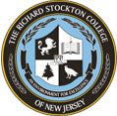
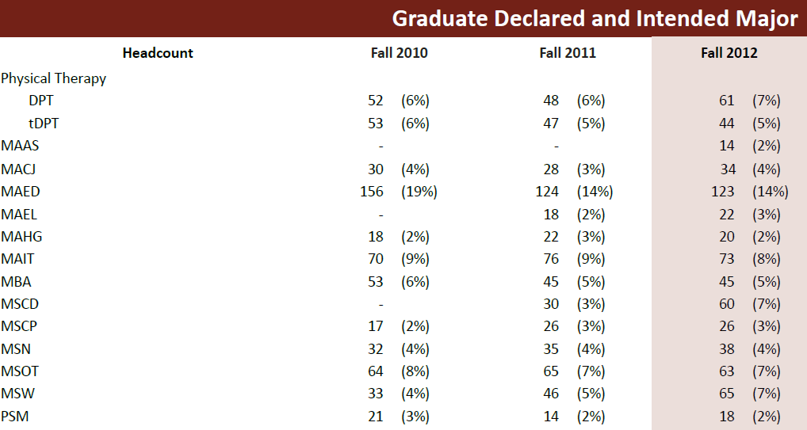
Key Dates and Current Stockton Graduate Program Enrollments
1997 NJ Commission granted permission for masters programs (Masters in Physical Therapy)
2006 NJ Commission granted permission for one doctoral program (Doctor of Physical Therapy)

Slide 8
In Summary
Research (Doctoral) Universities differ from Comprehensive (Masters) Universities
Renaming does not alter Carnegie Status
New Jersey allows colleges to change status and rename based on two criteria:
    Five+ years of granting masters degrees and
    Carnegie classification of Masters College/University
Stockton has met both criteria for comprehensive (teaching) university status since 2010

