Slide 1
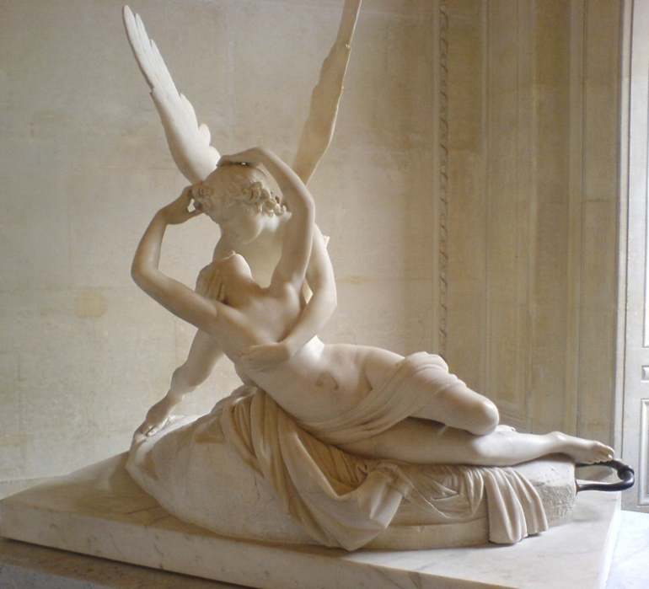
When Love Unites With The Soul
The Cupid and Psyche Story in Apuleius and C.S. Lewis
Classical Humanities Lecture Series
Richard Stockton College
Spring 2011
Prof. Katherine Panagakos

Slide 2
FREE SUMMER LANGUAGE CLASSES
Classes begin the week of May 16
Monday 6-7 pm: Free Modern Greek J-201
Tuesday 6-7 pm: Free Ancient Greek F-201/205
Wednesday 6-7 pm: Free Latin F-120/121/122
Not For Credit! Just For Fun!
For more information, please contact:
Modern Greek: George Plamantouras (ichs@stockton.edu 609.652.4433)
Ancient Greek: Jeff Cole (immortal_pride@hotmail.com 609.374.6801)
Latin: Prof. Katherine Panagakos (katherine.panagakos@stockton.edu)
Or see our website: www.stockton.edu/ichs

Slide 3
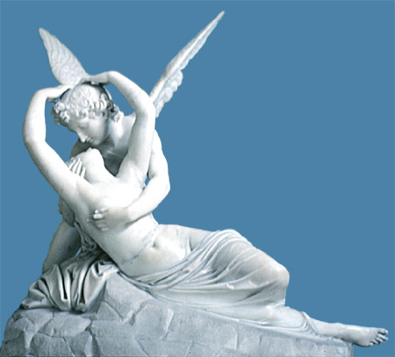
Cupid and Psyche in the Louvre
http://www.youtube.com/watch?v=Gm-nU05WZFc
Antonio Canova
Louvre, Marble, 1793
Psyché ranimée par le baiser de l'Amour (Psyche revived by the kiss of Love)

Slide 4
Apuleius’ World
Born c. AD125; Died c. AD180
From Madaura, a Roman colony in the North African province of Numidia
Educated first at Carthage then Athens
Pleaded cases in Rome
Spent most time in Carthage

Slide 5
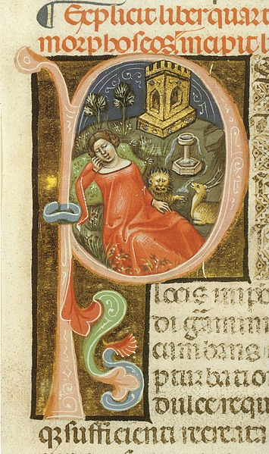
Apuleius’ Works
Metamorphoses (The Golden Ass)
Apologia (A Discourse on Magic)
Florida
De Platone et eius dogmate (On Plato and his Doctrine)
De Deo Socratis
(On the God of Socrates)
De Mundo (On the Universe)
Psyche in the Garden of Amor, illustration of Apuleius Metamorphoses
c. 24. Manuscript Vat. Lat. 2194 (1345) in the Biblioteca Apostolica Vaticana.

Slide 6
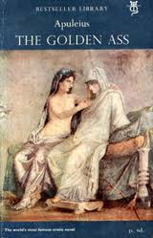
Apuleius’ Metamorphoses (The Golden Ass)
Only fully extant Latin novel
Prose fiction
Comic-realistic
The other is the fragmentary Satyricon of Petronius
Adventures of Lucius in 11 books

Slide 7
The Story of Lucius
Lucius
Thessaly and the Greco-Roman world
Stories within stories
Tales of magic and witchcraft
Adventures
Daily life
CURIOSITY!
Initiation into cult of Isis
Cupid & Psyche is the longest inserted tale (4.28-6.24)
Illustration of the Golden Ass by Jean de Bosschère (1947)

Slide 8
Old woman narrates the story of Cupid and Psyche to the kidnapped Charite
“But come, now let me take your mind off your troubles: here’s a pretty fairytale, an old woman’s story.”
(Plaque) by Pierre Courteys, c1520-before 1591 (1560)

Slide 9
The Tale of Cupid & Psyche
Early life of Psyche
Venus’ jealousy
Oracle of Delphi & exposure on the mountain
Life in the magical palace
Sister’s jealousy
Psyche’s tasks
Reunion & deification
Paul Alfred de Curzon, (c.1840-1859)

Slide 10
Early Life of Psyche
Hill Hall, 16th century Elizabethan mansion

Slide 11
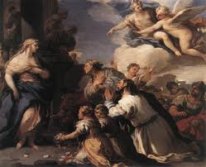
Psyche worshipped like Venus
Luca Giordano (1692-1702)

Slide 12
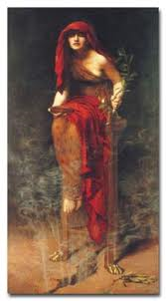
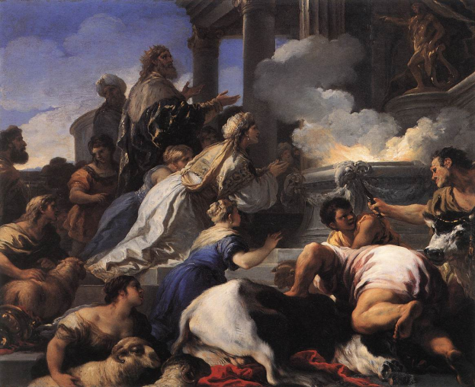
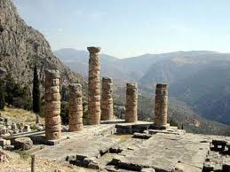
Oracle at Delphi
On mountain peak, O King, expose the maid
For funeral wedlock ritually arrayed.
No human son-in-law (hope not) is thine,
but something cruel and fierce and serpentine;
That plagues the world as, borne aloft on wings,
with fire and steed it persecutes all things;
That Jove himself, he whom the gods revere,
that Styx’s darkling stream regards with fear.
LUCA GIORDANO
(1692-1702)

Slide 13
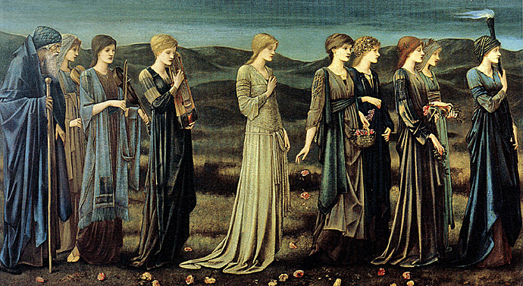
Psyche’s Wedding/Death
Edward Burne-Jones, The Wedding of Psyche (1865)

Slide 14
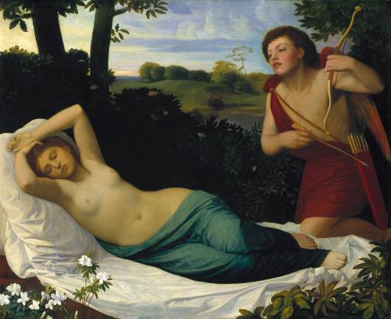
Cupid finds Psyche
Edward Burne-Jones
(1865-1887)

Slide 15
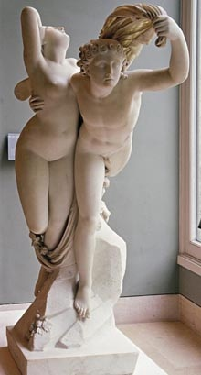
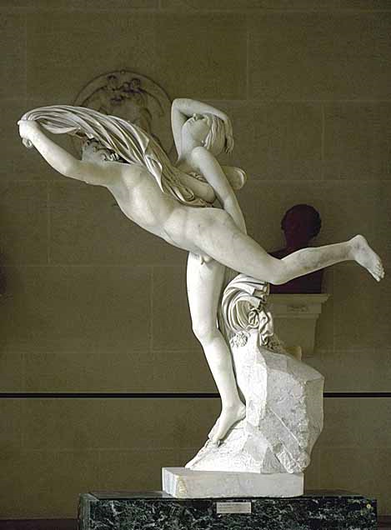
Zephyr carries Psyche to Cupid’s Palace
Zephyr and Psyche,
by Henri-Joseph Ruxthiel,
1775-1837 (1814)
John William Waterhouse,
Psyche entering Cupid’s Garden
(1901)

Slide 16
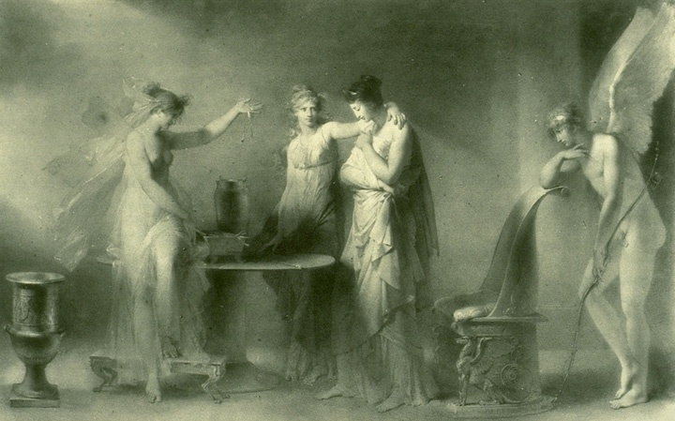
Jealousy of Psyche’s Sisters
A.E. Fragonard, 1780-1850 (1798)

Slide 17
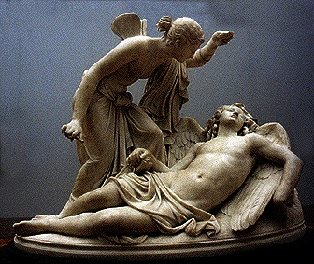
Psyche looks at her husband
“Not a Monster” by Lorian Kiesel
(c2000)
Psyche looking at Cupid
by Simon Vouet, 1590-1649
Notes:
Sculpture by unknown artist, 18th century

Slide 18
Cupid flees from Psyche
Psyche Abandoned
by Augustin Pajou (1790)
Dorothy Mullock (1914)

Slide 19
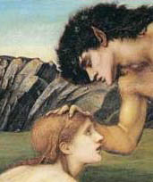
Pan and Psyche
Edward Burne-Jones (1872-74)

Slide 20
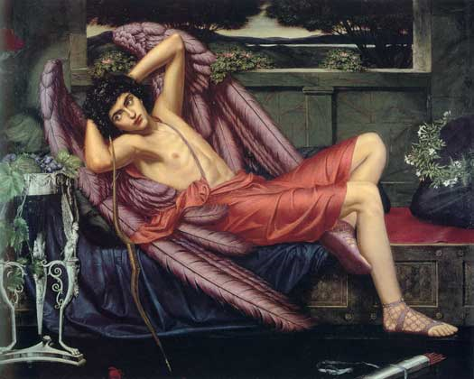
Death of Psyche’s Sisters
Sidney Harold Meteyard (1868-1947)

Slide 21
Venus and Psyche
Luca Giordano (1692-1702)
Psyche at the Throne of Venus
by Edward Matthew Hale (1883)

Slide 22
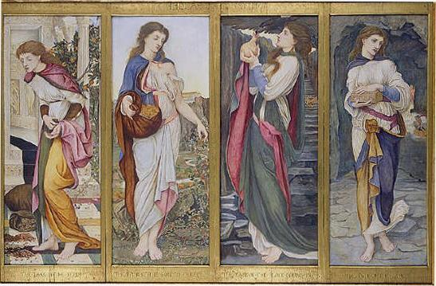
The Labours of Psyche
John Roddamn Spencer Stanhope, 1829-1908 (1873)

Slide 23
Persephone’s Box & Sleep
John William Waterhouse, c.1903.
Edward Burne-Jones (1865-1887)

Slide 24
Marriage of Cupid and Psyche
Guilio Romano (1527-1531)

Slide 25
Cupid and Psyche
Basil Rakoczi (1949)
Edvard Munch, Amor and Psyche
(1907)

Slide 26
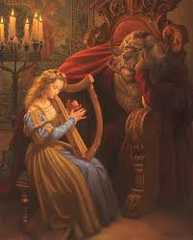
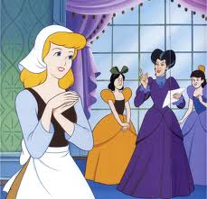
Fairytale Aspects of C&P

Slide 27
C.S. Lewis
1898-1963
English professor at Oxford
Good friends with J.R.R. Tolkien
“Inklings”
Avowed Atheist but influenced by his colleagues and friends-returned to Christianity
The Screwtape Letters (1942)
Chronicles of Narnia (1950-56)

Slide 28
Till We Have Faces: A Myth Retold
Set in Glome; a fictional kingdom outside the bounds of the Greek world.

Slide 29
Characters
Psyche/Istra
Orual (eldest sister)
Redival (middle sister)
Trom, father & king of Glome
The Fox (Greek tutor)
Ungit (= Venus)
Brute on the mountain (= Cupid)
Bardia, chief soldier and advisor
Unnamed Priest of Ungit
Arnom, (later) priest of Ungit

Slide 30
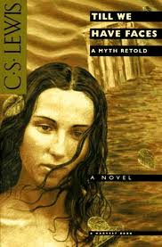
Orual/Mia
“I am old now and have not much to fear from the anger of the gods. I have no husband nor child, nor hardly a friend, through whom they can hurt me.”
“Being, for all these reasons, free from fear, I will write in this book what no one who has happiness would dare to write. I will accuse the gods, especially the god who lives on the Grey Mountain. That is, I will tell all he has done to me from the beginning, as if I were making my complaint of him before a judge. But there is no judge between gods and men, and the god of the mountain will not answer me. Terrors and plagues are not an answer. I write in Greek as my old master taught it to me. It may some day happen that a traveller from the Greeklands will again lodge in this palace and read the book. Then he will talk of it among the Greeks, where there is great freedom of speech even about the gods themselves. Perhaps their wise men will know whether my complaint is right or whether the god could have defended himself if he had made an answer.”
Part I: Chapters 1-21
Part II: Chapters 1-4

Slide 31
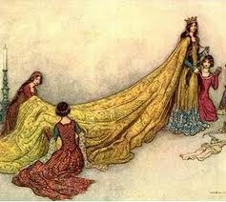
Queen Orual of Glome
Arnom writes of Queen Orual: “who was the most wise, just, valiant, fortunate and merciful of all the princes known in our parts of the world.”

Slide 32
Lewis’ changes
The central alteration in my own version consists in making Psyche’s palace invisible to normal, mortal eyes---if “making” is not a wrong word for something which forced itself upon me, almost at my first reading of the story, as the way the thing must have been. This change of course brings with it a more ambivalent motive and a different character for my heroine and finally modifies the whole quality of the tale.

Slide 33
Till We Have Faces
Alternate title: “Bareface”
Description of Ungit
Psyche = Orual
Psyche = Ungit
Ungit = Orual

Slide 34
The Four Loves
Natural Loves
Storge
Eros
Philia
Divine Love
Agape

Slide 35
The Myth of Cupid and Psyche

