Slide 1
RCC Partnership TEAM--- Making a Difference!
RCC IT TEAM---
Making a Difference!
RCC ADMIN TEAM---
Making a Difference!
RCC GEO TEAM--- Making a Difference!

Slide 2
The 2020 Census
Count everyone once, only once and in the right place.
Increasingly diverse and growing population
330 million people
Over 140 million housing units
Mandated by Article 1, Section 2 of the U.S. Constitution
Conducted every 10 years ending in zero since 1790
Representation and Funding
The Census is Safe, Easy, & Important!
Notes:
Let’s get started with the 2020 Census….
As I mentioned , the Census is mandated by the United States Constitution and has been around since 1790.
In 1790, Thomas Jefferson was director of the first census. Then In 1790, they only needed 650 enumerators to count 3.9 million residents in 13 states. At the time New York City was the largest urban place with 33 thousand people. In 2010, the Census Bureau needed about 635 thousand enumerators to count a population of about 308 million people
To give you an idea of the magnitude of conducting a Census, A Census is the largest U.S. peacetime mobilization and operation conducted.
In 2020 we will be attempting to count over an estimated 330 million people in 140 million households.
The law requires the Census Bureau to keep your information confidential. Your responses are only used to produce statistics
All Census Bureau workers take a legally binding, lifetime oath to protect your information. Anyone who violates that oath could face jail time, a $250,000 fine, or both.

Slide 3
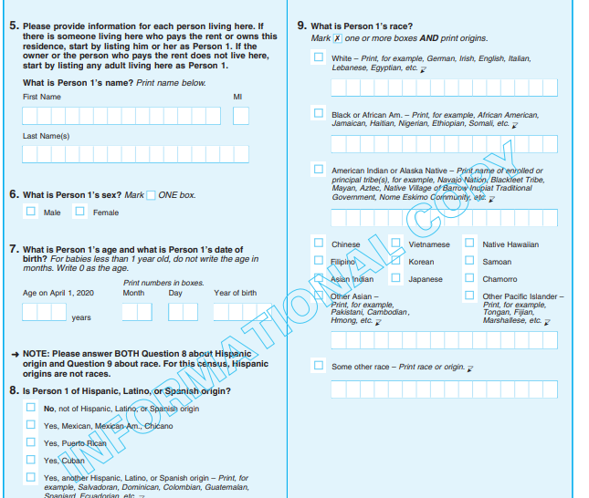
Responding to the 2020 Census
Four ways to respond in 2020
Online
Phone
Paper
Personal Visit by Census Employee
Name, age, DOB, race and origin, Hispanic origin, relationship, gender, tenure, operational questions (pop count, name, phone number, overcount, undercount)
We will never ask for:
Your social security number.
Money or donations.
Anything on behalf of a political party.
Your bank or credit card account numbers.
Click HERE---> 2020 Census Questionnaire

Slide 4
Language Support – Online at 2020Census.gov
LANGUAGE SUPPORT ONLINE, BY PHONE, BY MAIL, AS WELL AS ADVERTISING
12 languages
(in addition to English):
Spanish
Chinese
Vietnamese
Korean
Russian
Arabic
Tagalog
Polish
French
Haitian Creole
Portuguese
Japanese
99%
English plus these 12 languages cover 99% of all U.S. households.

Slide 5
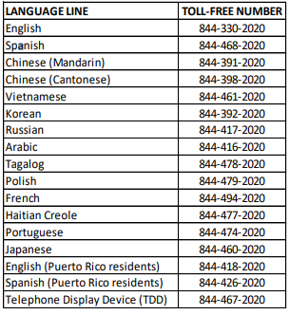
Completing the Census by Phone
Beginning March 1, 2020, the English and Spanish language lines will be available to provide general information about the 2020 Census, including answers to frequently asked questions (FAQs), via an automated Interactive Voice Response (IVR) system.
Callers to these lines will also be advised to call back starting March 9, 2020 to speak with a live customer service representative (CSR). Callers to all other language lines will hear the message to call back starting March 9, 2020, to speak with a live CSR.
Beginning March 9, 2020, all lines will begin live CSR support providing information about the 2020 Census and assistance with the questionnaire.
Callers to the English and Spanish language lines will be routed through the IVR system prior to being transferred to a CSR. Callers to all other language lines will be greeted in that language by a CSR.

Slide 6
Overview of Non-English Language Support
Language Guides (Video and Print)
Language Glossaries Language Identification Card
Paper Questionnaire
& Mailing Materials
59 Non-English Languages
Video and print language guides will be available online. Glossaries provide key terminology to bilingual staff. Language Identification Card expanded to 59 languages (50 in 2010). Language listed below are in order of need (top to bottom, left to right).
Spanish
Bilingual mailing materials and questionnaires will be sent to addresses in bilingual tracts.
Mailings will include instructions on responding via Internet or phone in 12 non-English languages.
To view the 2020Census.gov landing page in any of the non-English 59 languages click here.
Language Guides
https://www.census.gov/programs-surveys/decennial-census/2020-census/planning-management/language-resources/language-guides.html
Spanish | Italian | Khmer | Tamil | Croatian
Chinese | Farsi | Nepali | Navajo | Bulgarian
Vietnamese | German | Urdu | Hungarian | Twi
Korean | Armenian | Romanian | Hebrew | Lithuanian
Russian | Hindi | Telugu | Malayalam | Yoruba
Arabic | Ukrainian | Burmese | Swahili | Czech
Tagalog | Bengali | Punjabi | Yiddish | Igbo
Polish | Greek | Lao | Indonesian | Marathi
French | Amharic | Hmong | Serbian | Sinhala
Haitian Creole | Somali | Albanian | Tigrinya | Slovak
Portuguese | Thai | Turkish | Ilocano | American Sign Language
Japanese | Gujarati | Bosnian | Dutch
During Nonresponse Followup enumerators use:
A bilingual handheld instrument (English/Spanish)
Bilingual materials (English/Spanish)
Instructions to respond online or by phone in 12 non-English languages
Language Identification Card

Slide 7
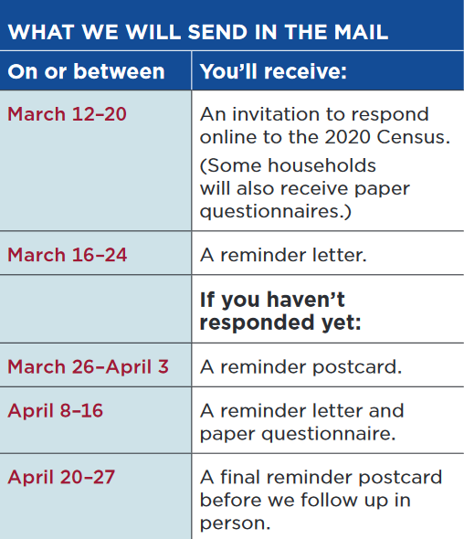
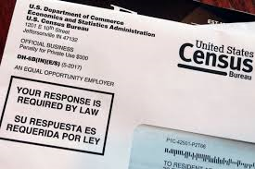
Every household will have the option of responding online, by phone, or by mail.
Every household that hasn’t already responded will receive reminders and a paper questionnaire.

Slide 8
HELPFUL LINKS
CONGRESSIONAL TOOLKIT:
https://2020census.gov/content/dam/2020census/materials/partners/2019-09/2020-census-congressional-toolkit.pdf
MOBILE QUESTIONNAIRE ASSISTANCE FACT SHEET:
https://2020census.gov/content/dam/2020census/materials/partners/2020-02/Mobile_Questionnaire_Assistance_Fact_Sheet.pdf
2020 CENSUS MAILINGS-VISUALS
https://www.census.gov/newsroom/press-kits/2020/2020-census-mailings.html
PARTNER GUIDELINES TO SUPPORTING SELF-RESPONSE:
https://2020census.gov/content/dam/2020census/materials/partners/2019-10/partners-self-response.pdf

Slide 9
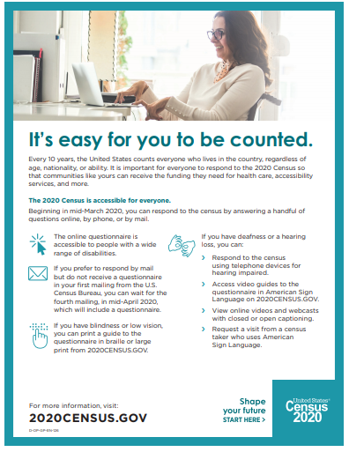
MORE HELPFUL LINKS
FACT SHEET ON ACCESSIBILITY OF THE 2020 CENSUS:
https://2020census.gov/content/dam/2020census/materials/partners/2019-11/Fact_Sheet_on_Accessibility2.pdf
FACT SHEET FOR RESPONDING THE CENSUS ONLINE:
https://2020census.gov/content/dam/2020census/materials/partners/2019-11/Fact_Sheet_Responding_Online.pdf
RESPONSE RATE MAP:
https://2020census.gov/en/response-rates.html
LANGUAGE SUPPORT:
https://2020census.gov/en/languages.html
INTERNET SELF-RESPONSE VIDEO GUIDE:
https://youtu.be/fXg1_1HHKzA

Slide 10
GEOGRAPHY- ADDRESS QUESTIONS
The Census Bureau relies on accurate mailing addresses and the U.S. Postal Service (USPS) to deliver the 2020 Census to most households in the county. A mailing address usually consists of a house number, street name, city, state, and zip code. A zip code is based on USPS delivery routes and often has a city/town name associated with it. The postal zip code geography and city/town may differ from the legal municipality the residence is located within. In addition to mailing addresses, the Census Bureau Master Address File contains a geographic location for the physical address structure. The geographic location can be in the form of a latitude and longitude coordinate, or a Census Tract and Block. The Census Bureau uses the physical location of a housing unit to assign it to the appropriate geographic area for data tabulation.
For an in-depth explanation of the differences between Postal and Census geography, please visit: https://www.census.gov/programs-surveys/geography/guidance/geo-areas/usps_census_city.html

Slide 11
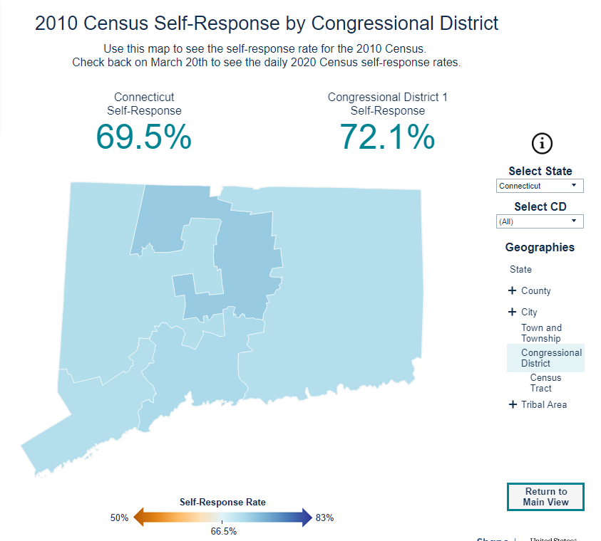
Self-Response Rate Map- Congressional Districts
CLICK HERE: 2020 Self-Response Rate Map

Slide 12
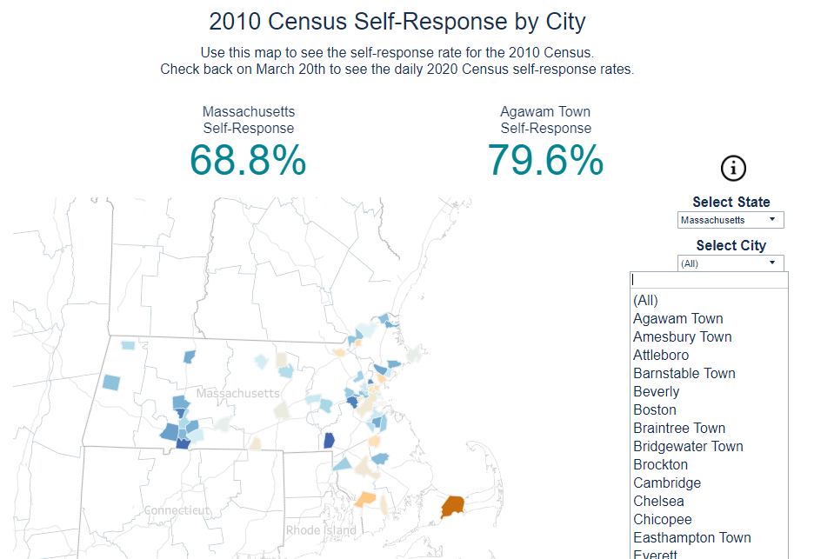
Self-Response Rate- Cities

Slide 13
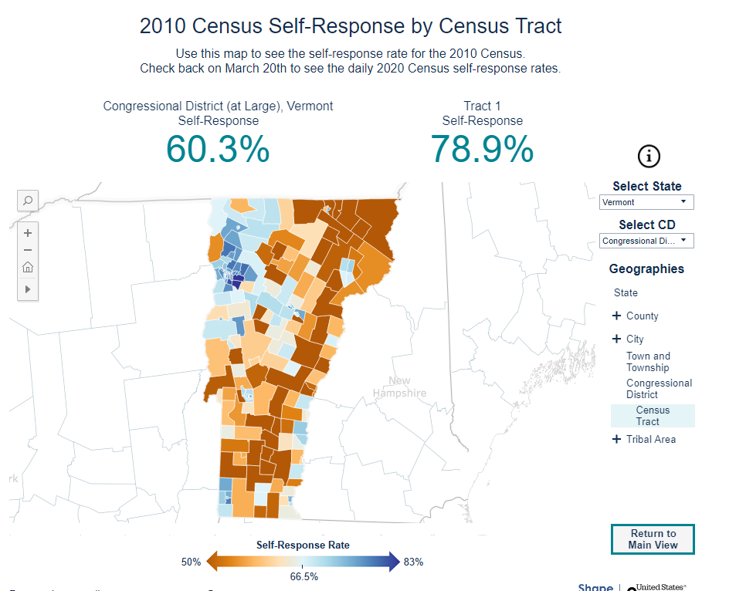
Self-Response Rate Map- Census Tracts
CLICK HERE: 2020 Self-Response Rate Map

Slide 14
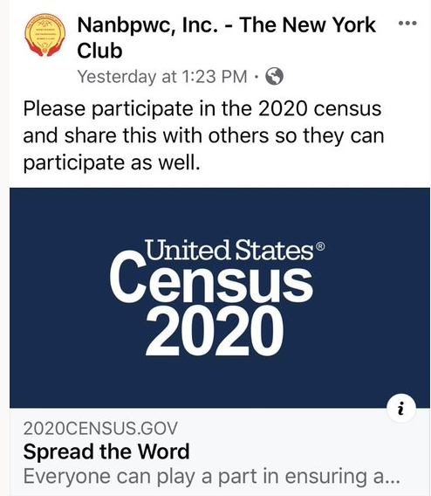
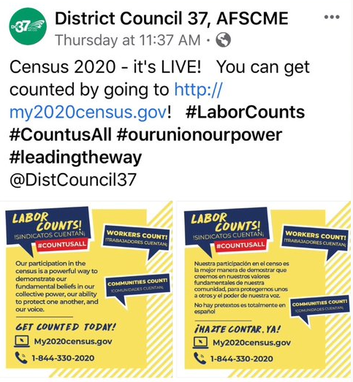
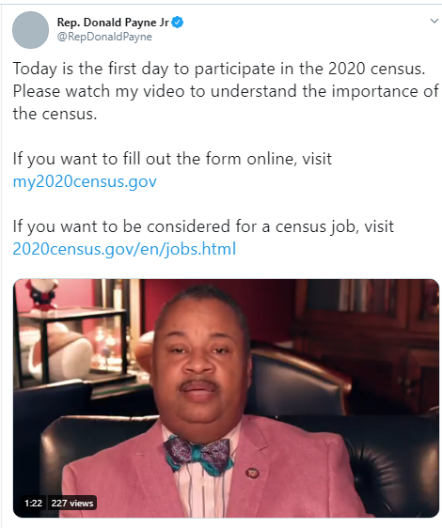
PROMOTE SOCIAL MEDIA

Slide 15
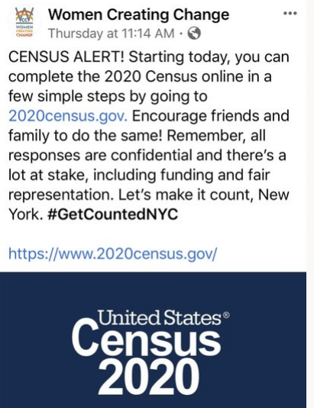
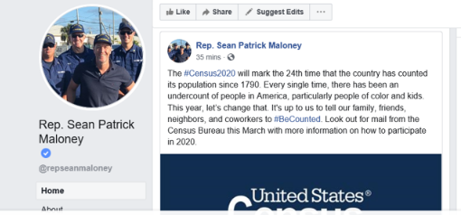

Slide 16
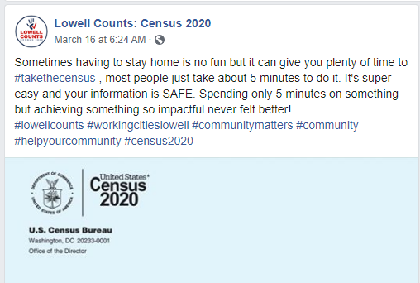
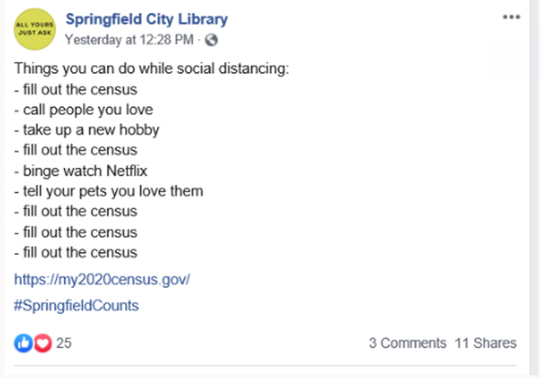
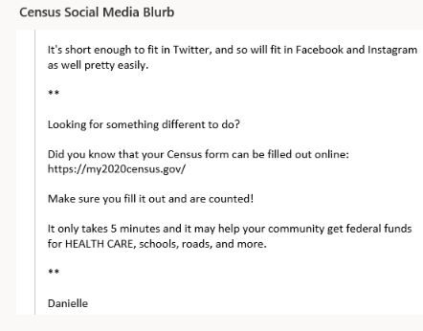

Slide 17
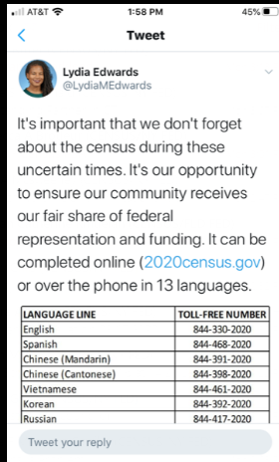
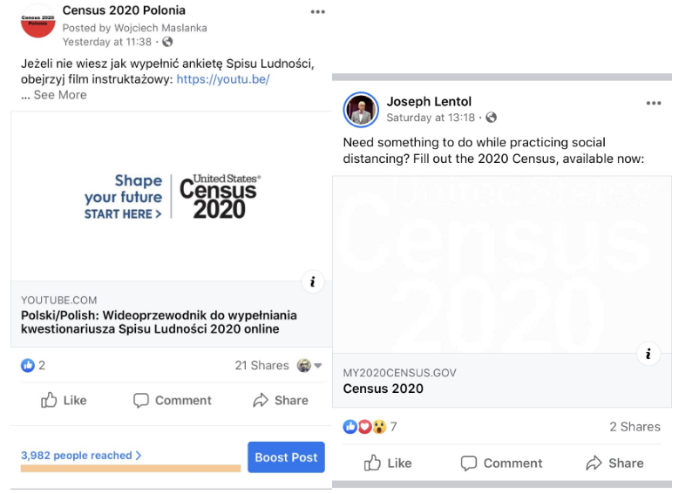

Slide 18
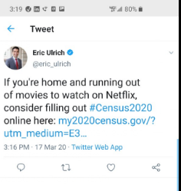
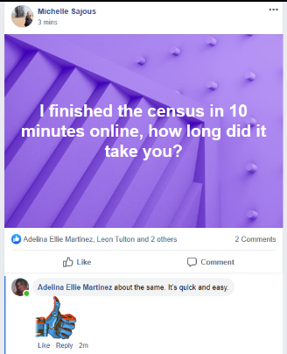
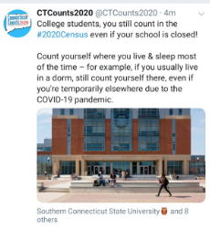

Slide 19
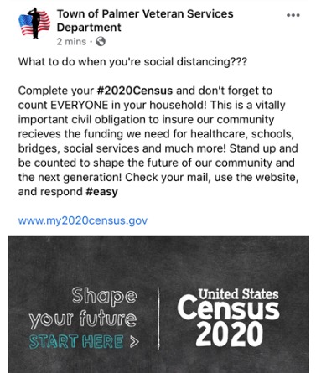
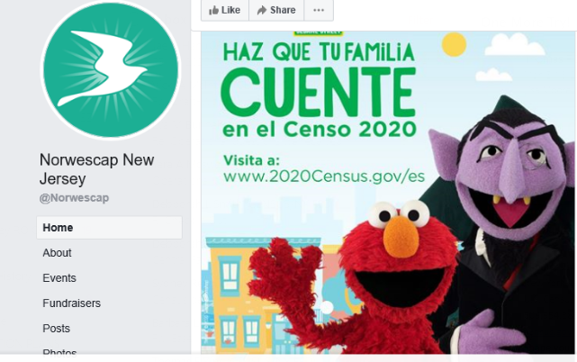
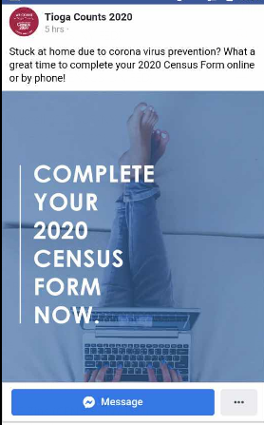

Slide 20
CT-
MA-
ME-
NH-
NJ-
NY-
NYC-
PR-
RI-
VT-

Slide 21
PSAs
https://www.waterfordct.org/home/news/everyone-counts-census-2020

