Slide 1
Symmetries of Julia Sets
Dr. Bradley Forrest
Stockton University – Day of Scholarship
April 8, 2021

Slide 2
Joint work with Dr. James Belk of the University of St. Andrews

Slide 3
Transformation

Slide 4
Transformation
The distance between the owl and elephant is unchanged after translation

Slide 5
Transformation
The distance between the owl and elephant is unchanged after rotation

Slide 6
Transformation
A rule that takes each point of the plane to a unique
corresponding point is called a transformation of the plane.
Translations and rotations are two types of transformations of the plane.

Slide 7
Transformation
Example Translation: f(x,y) = (x+1, y-2)
Moves points one unit right and two units down
Example Rotation: f(x,y) = (-y, x)
Rotates points 90 degrees counterclockwise about
the origin

Slide 8
Transformation
P = (x₁,y₁), Q = (x₂,y₂) - points on the plane
Distance
Between $=\sqrt{{(\text{x}\text{1}−\text{x}\text{2})}^{\text{2}}+{(\text{y}\text{1}−\text{y}\text{2})}^{\text{2}}}$ = d(P,Q)
P and Q
Transformations that preserve distance are called
isometries.
Translations and rotations preserve distance
If f is a translation or a rotation, then
d(P,Q) = d(f(P),f(Q))

Slide 9
Transformation

Slide 10
Transformation
The distance between the owl and elephant increased after dilation

Slide 11
Transformation
Contractions and dilations preserve the ratio of distances
If f is a contraction or a dilation, then
d(P,Q) = K d(f(P),f(Q))
where K is a fixed number for every pair of points P and Q.
Transformations that preserve the ratio of distances
are called similarities.
For any four distinct points P, Q, R, and S:
$$\frac{\text{d}\text{(}\text{P}\text{,}\text{Q}\text{)}}{\text{d}\text{(}\text{R}\text{,}\text{S}\text{)}}=\frac{\text{d}\text{(}\text{f}\text{(}\text{P}\text{),}\text{f}\text{(}\text{Q}\text{))}}{\text{d}\text{(}\text{f}\text{(}\text{R}\text{),}\text{f}\text{(}\text{S}\text{))}}$$

Slide 12
Transformations of Squares
Finite objects, like polygons, also have transformations.
The isometries of the square are made up of rotations and
reflections.

Slide 13
Transformations of Squares
Transformations do not have to have any specific effect on
the distances between points in the object. Transformations
can be flexible.

Slide 14
Transformations of Squares
Transformations do not have to have any specific effect on
the distances between points in the object. Transformations
can be flexible.

Slide 15
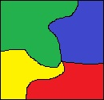
Transformations of Squares
Transformations do not have to have any specific effect on
the distances between points in the object. Transformations
can be flexible.
These flexible transformations are called homeomorphisms.

Slide 16
Transformations
More Rigid
More Flexible
isometries
similarities
homeomorphisms
Every isometry is a similarity and every similarity is a
homeomorphism. There are usually many more
homeomorphisms than isometries.

Slide 17
Fractals

Slide 18
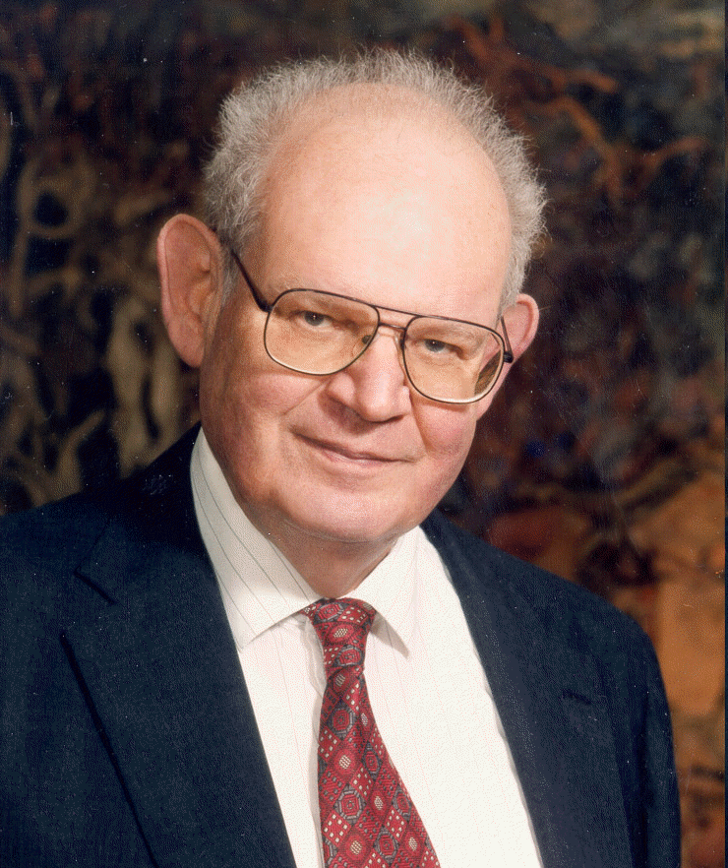
Fractals
Benoît Mandelbrot
1924 – 2010
Mandelbrot’s insight:
Complicated shapes are often self-similar.

Slide 19
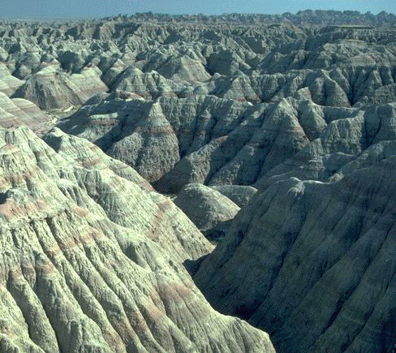
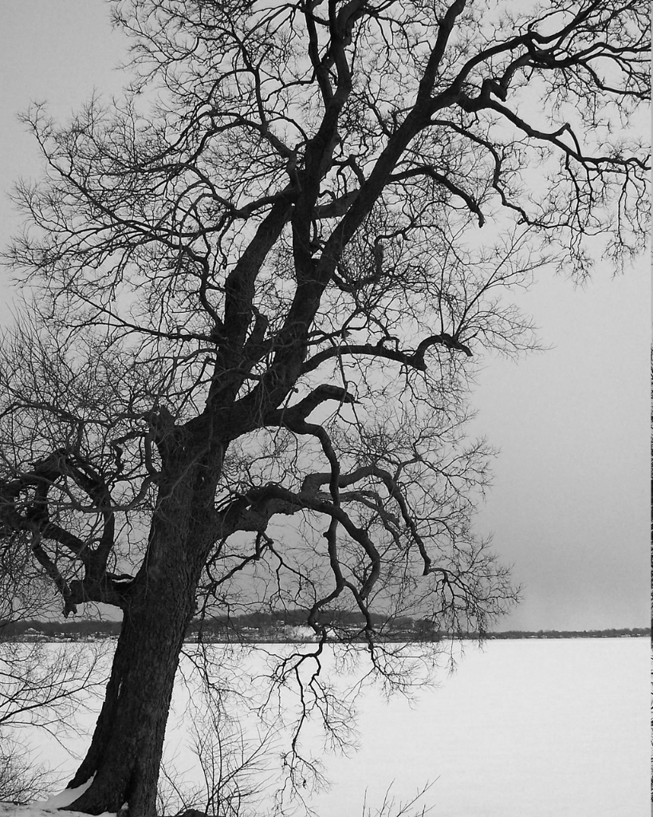
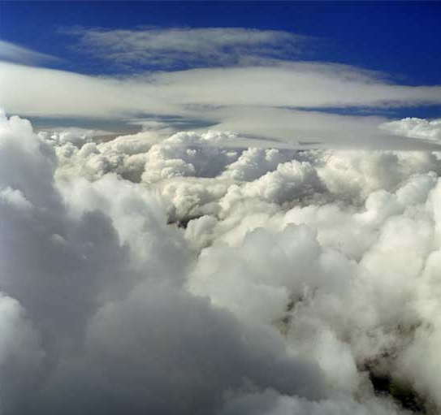
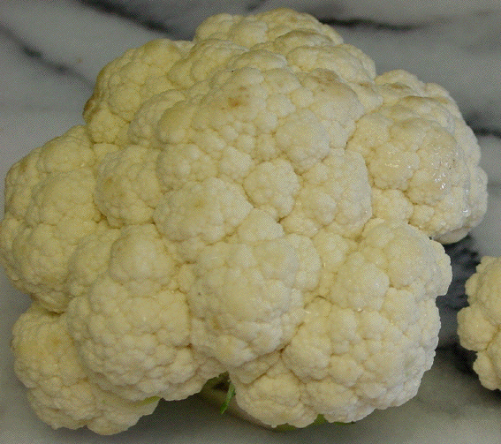
Fractals
One pattern repeats itself at many different size scales

Slide 20
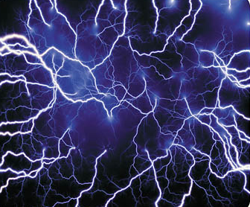
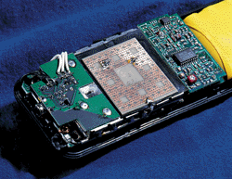
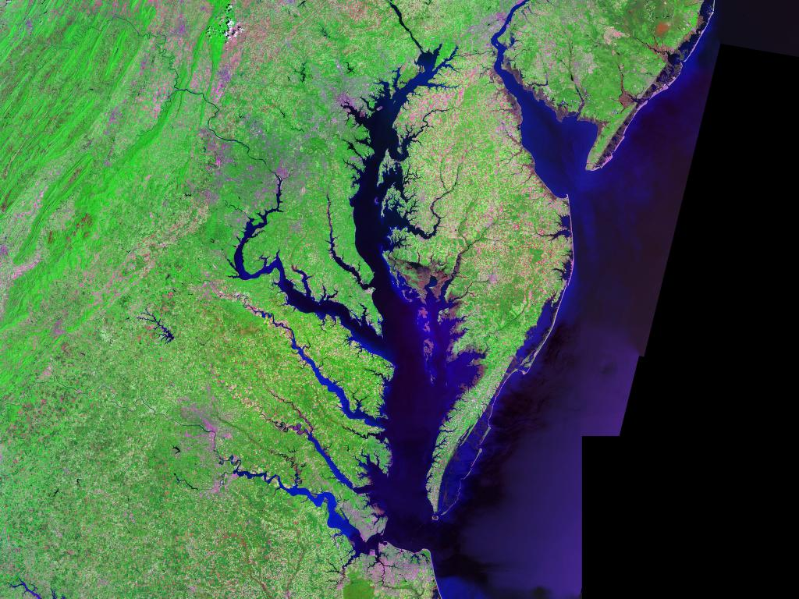
Fractals
Fractals are used throughout the sciences

Slide 21
Sierpiński Triangle

Slide 22
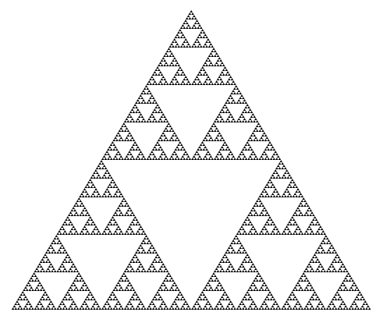
Sierpiński Triangle

Slide 23
Sierpiński Triangle
Red points are the only set
of three points that separate
the fractal into three pieces
Any transformation preserves
this set of three points

Slide 24
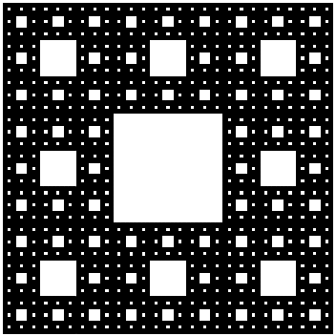
Sierpiński Carpet

Slide 25
Sierpiński Carpet
There are homeomorphisms of the Sierpiński Carpet that take any collection of empty squares to any other collection

Slide 26
Dynamics – Julia Sets

Slide 27
Dynamics
Dynamics is the branch of mathematics concerned with the results of applying sequences of operations

Slide 28
Dynamics
Example: Suppose we repeatedly square a positive number. What happens?
2 2²=4 4²=16 16² = 256 …
1 1²=1 1²=1 1² = 1 …
$\frac{\text{1}}{\text{2}}$ ($\frac{\text{1}}{\text{2}}$)²= $\frac{\text{1}}{\text{4}}$ ($\frac{\text{1}}{\text{4}}$)²= $\frac{\text{1}}{\text{16}}$ ($\frac{\text{1}}{\text{16}}$)²=$\frac{\text{1}}{\text{25}\text{6}}$ …

Slide 29
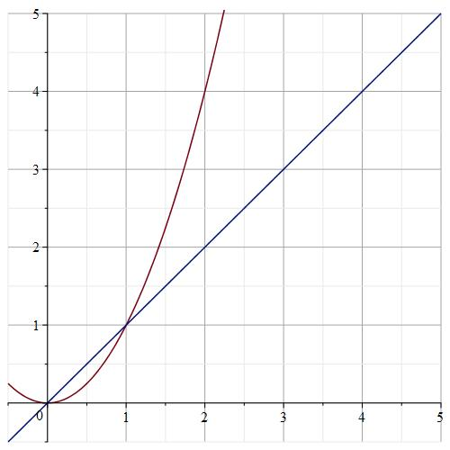
Dynamics

Slide 30
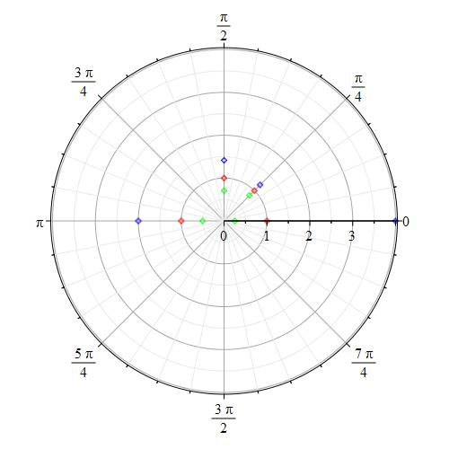
Dynamics
Example: Suppose we repeatedly square a complex number, x+yi = re^{iq}. What happens?
f(re^{iq}) = (re^{iq})² = r²e^{i2q}

Slide 32
Julia Sets
The Julia set of a complex polynomial is the boundary of set of points whose iterates remain bounded.
The Julia set of f(z) = z² is
the unit circle

Slide 33
Julia Sets
Julia set are often fractals – they form one of the best known
classes of fractals
The Basilica:
the Julia set of
f(z) = z² - 1

Slide 34
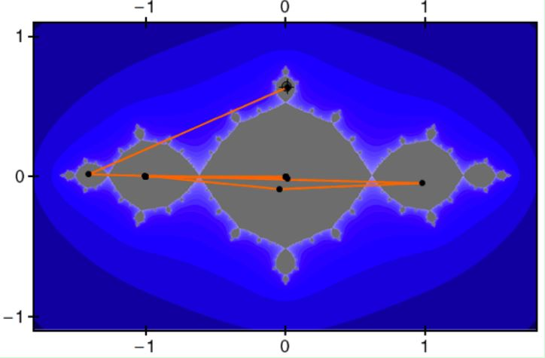
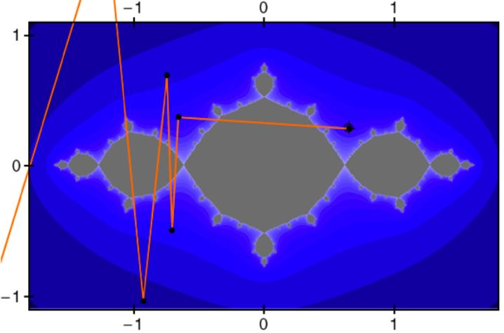

Slide 35
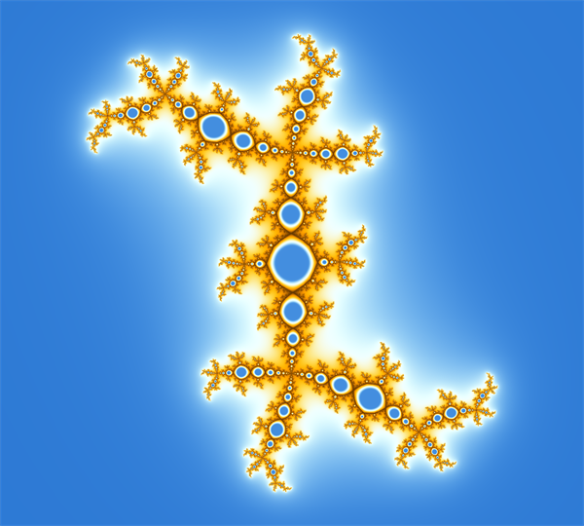
Julia Sets
f(z) = z² + 0.32 + 0.56i

Slide 36
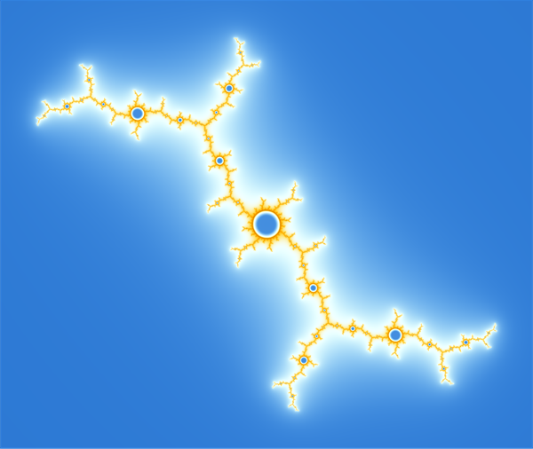
Julia Sets
f(z) = z² – 0.157 + 1.032i

Slide 37
Julia Sets
f(z) = z³ – 0.21 + 1.09i

Slide 38
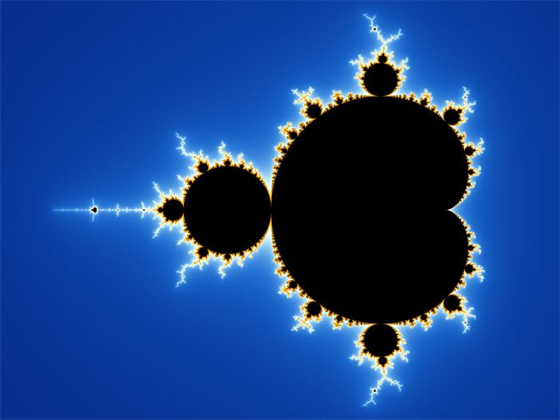
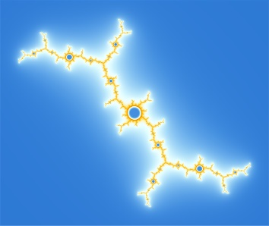
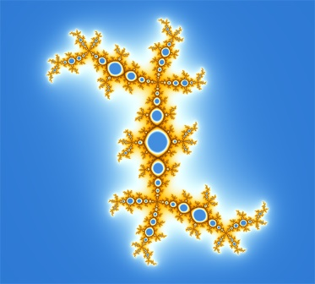
Mandelbrot Set
Unit circle
Values of c for which f(z) = z² + c has bounded iterates of 0

Slide 39
Transformations of Julia Sets

Slide 40
Transformations of Fractals
Belk, F: developed systematic methods to create transformations for the Basilica (2015) and many other fractals (2019).

Slide 41
Transformations of Fractals

Slide 42
Transformations of Fractals

Slide 43
Transformations of Fractals

Slide 44
Transformations of Fractals

Slide 45
Quasisymmetries
In 2018, Lyubich and Merenkov proved that these
transformations of the Basilica are quasisymmetries
A quasisymmetry is a transformation that, for some function
h, the following holds for any triple of points P, Q, and R
$\frac{\text{d}\text{(}\text{f}\text{(}\text{P}\text{)}\text{,}\text{f}\text{(}\text{Q}\text{)}\text{)}}{\text{d}\text{(}\text{f}\text{(}\text{P}\text{)}\text{,}\text{f}\text{(}\text{R}\text{))}}$ = h($\frac{\text{d}\text{(}\text{P}\text{,}\text{Q}\text{)}}{\text{d}\text{(}\text{P}\text{,}\text{R}\text{)}}$)

Slide 46
Quasisymmetries
A quasisymmetry is a transformation that, for some function
h, the following holds for any triple of points P, Q, and R
$\frac{\text{d}\text{(}\text{f}\text{(}\text{P}\text{)}\text{,}\text{f}\text{(}\text{Q}\text{)}\text{)}}{\text{d}\text{(}\text{f}\text{(}\text{P}\text{)}\text{,}\text{f}\text{(}\text{R}\text{))}}$ = h($\frac{\text{d}\text{(}\text{P}\text{,}\text{Q}\text{)}}{\text{d}\text{(}\text{P}\text{,}\text{R}\text{)}}$)
Quasisymmetries require that the ratios of slopes
centered at a point are related.

Slide 47
Quasisymmetries
More Rigid
More Flexible
isometries
similarities
quasisymmetries
homeomorphisms
Fractal | How Many Quasisymmetries? | When? | Who?
Sierpiński Triangle | 6 | ? | ?
Sierpiński Carpet | 8 | 2013 | Bonk, Merenkov
Basilica | Infinitely Many | 2018 | Lyubich, Merenkov
All Hyperbolic Quadratic Julia Sets | Infinitely Many | 2021 | Belk, F

Slide 48
Hyperbolic Julia Sets
A Julia set is hyperbolic if it has an attracting periodic cycle
It is conjectured that every interior region of the Mandelbrot set corresponds to a hyperbolic Julia set

Slide 49
Mandelbrot Set
Unit circle

Slide 50
Cubic Julia Sets
Belk, F – Conjecture: The Julia set of
f(z) = z³ – 0.21 + 1.09i
has finitely many homeomorphisms

Slide 51
Thank You!

