Slide 1
Grown or made? Children and adults' use of function to categorize familiar and unfamiliar foods as compared to non-foods
Isabella Gural, Veronica Campbell, Tania Gafanha, Reem Naber, and Dr. Helana Girgis

Slide 2
Outline of Presentation
Categorization by origins
Categorization of foods
Hypothesis
Methods
Participants
Stimuli
Procedure
Results
Discussion & Conclusions
Future directions

Slide 3
Categorization
Process by which we identify everything in our world and allows us to maneuver through it
Previous research shows that we categorize differently based upon an item’s origin
Notes:
For example, this is how we will always know what a desk is. We do not have to figure out what it is every time we walk into a classroom. We don’t have to figure out if it something you are supposed to sit on, etc. we know it is something for us to take notes on.

Slide 4
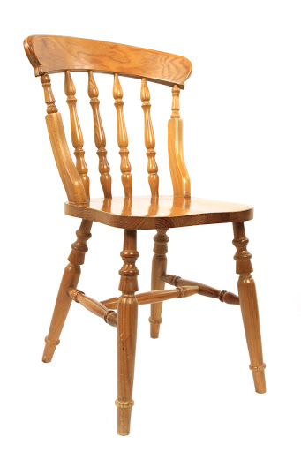
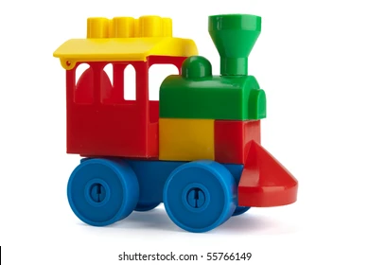
Categorization of Non-Foods
Artifacts
Past research has indicated that children categorize:
Artifacts based upon their intended function, and not upon their external properties
Kemler Nelson, et al. (2000), German & Johnson (2002), Bloom (1998)
Notes:
For example, artifacts are made by people and intended for use by people (toys, furniture, computers). Decades of research has shown that people typically categorize an artifact by its intended function, and do not use the artifact’s external properties. So, they categorize them by their intended use.

Slide 5
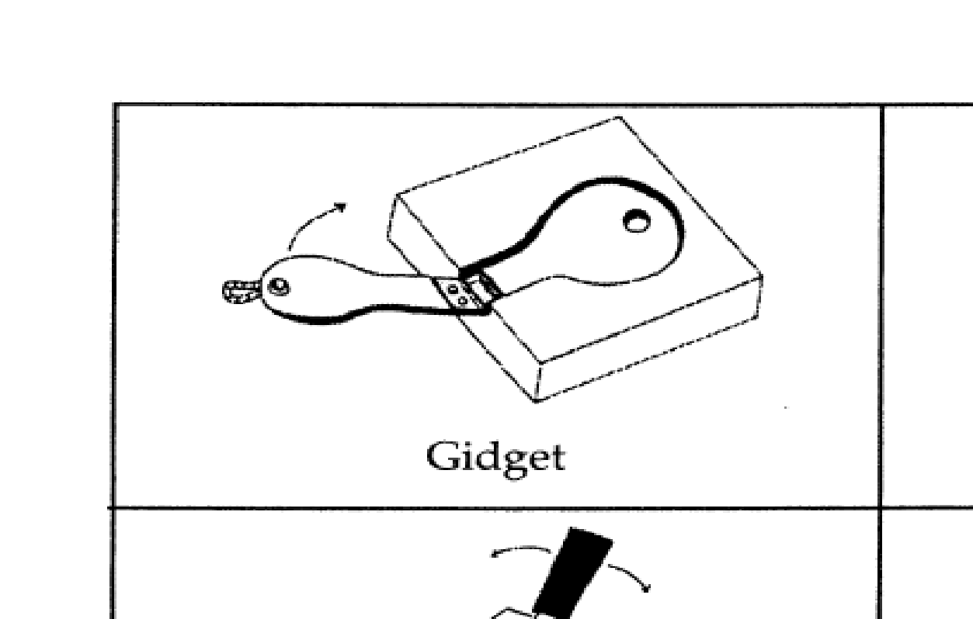
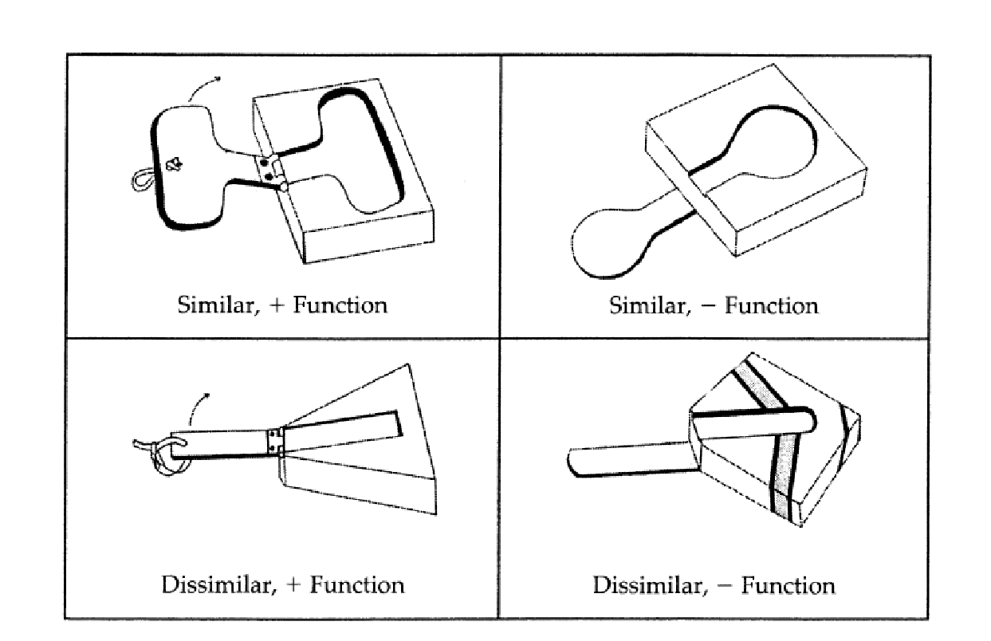
Kemler Nelson et al. (2000)
Notes:
Kemler presented a new toy to children and called it a gidget. She then presented four pictures of different toys (one toy looked similar and functioned the same was as the gidget, one toy looked similar to the gidget but did not function the same, the third toy did not look like the gidget but it functioned like it, and the fourth toy both did not look like and did not function like the gidget). She asked the children which toy was the most similar to the gidget, and they were more likely to choose the toy that was closer in similarity of function to the gidget, and were less likely to take into account the physical appearance.

Slide 6
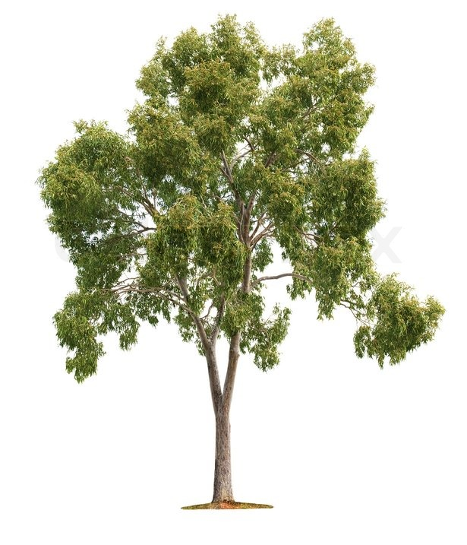
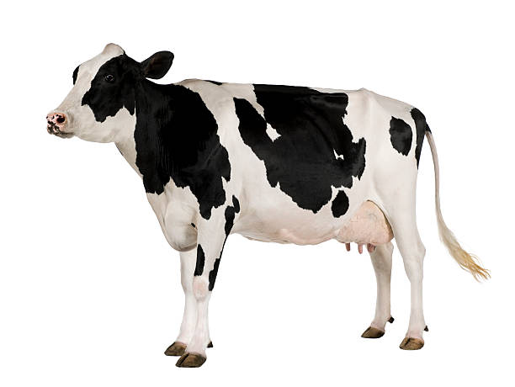
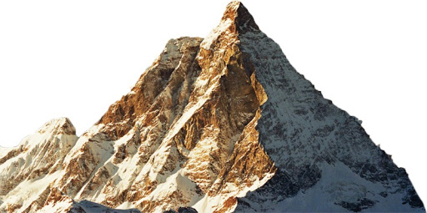
Categorization of Non-Foods
Natural Kinds
Past research has indicated that children categorize:
Natural kinds based upon their internal properties, and not upon their external properties
Keil (1992), Gelman (2004), Ahn (1998)
Notes:
But not all things are human made, some are natural. We label these as “natural kinds”, and these are things such as plants, minerals, and animals. Children categorize them by their internal properties and also do not use their external properties.

Slide 7
Keil (1992)
Notes:
An example of this is Keil’s study in 1992. He presented pictures of a raccoon to children. He then said that he would shave a strip down the raccoon’s back, paint it white, and surgically attach a stink sac to it. Keil then asked the children “What is this, a raccoon or a skunk?”. We know that this is still a raccoon because although he changed what it looked like, its internal properties still remain a raccoon.

Slide 8
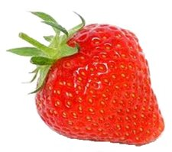
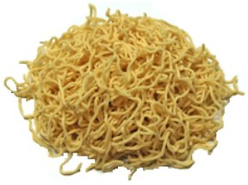
Categorization of Foods
Most categorization research on food has focused on
Classification of foods as healthy and unhealthy
Food selection decisions
Properties of Food
Edibility
Natural and processed
Notes:
Most categorization research has focused on when and under what circumstances children classify foods as healthy and unhealthy and how this may affect their food selection decisions
But there is little research on how children are categorizing the foods themselves, This is surprising because 1.) foods are all around us every day, and 2.) there are pretty significant consequences for making poor food choices (poisonous foods, unhealthy foods). There is no real, one way to identify poisonous vs. non poisonous, healthy vs. unhealthy (from an evolutionary perspective, not built with this system) so understanding how people categorize these things becomes important 3.) Children rely heavily on external informants for information about foods.
In addition, food is so different from non-foods because foods are the only thing in our world that is edible, meaning that it has a completely different function than anything else. To make things more interesting, there are two origins under the same domain because foods can be both natural and human made.
It’s because of these reasons that some researchers believe that we have a separate reasoning system for foods. However, to date, there is not enough empirical to evidence to say one way or the other.

Slide 9
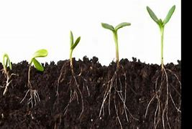
Children’s Knowledge of the Biological World
4-year-olds categorize plants and natural foods as natural kinds, applying biological processes of growth and death
(Girgis & Nguyen, 2018; Ingaki & Hatano, 2002; Springer & Keil, 1991)
Four-year-olds apply causal explanations to how plants grow and identify the order in which plant growth occurs, e.g., seed, plant, flower, fruit
(Hickling & Gelman, 1995)
Based on the previous research, it may be that children use internal properties to identify the origins of natural foods, but need experience with processed foods to identify its origins.
Notes:
Young children have fairly sophisticated knowledge of the biological world.

Slide 10
In this research we examined children’s knowledge of origins for familiar and unfamiliar natural foods, processed foods, non-food natural kinds, and artifacts.
Notes:
DR. G: here explain what is meant by this – what kind of answers would we see if children categorize foods by its function or by its origins? Bring up the reasons that we are comparing foods to non-foods, e.g., separate reasoning system for foods given how important it is or not?

Slide 11
Hypothesis
For children, we expect greater accuracy in identifying the origins of natural foods as compared to processed foods.
For children, we expect greater accuracy in identifying the origins of non-food items as compared to foods.
Accuracy in identifying the origins of familiar and unfamiliar foods and non-foods develop with age

Slide 12
Methods
Participants
Age Groups | n | M_{age} | Females
3-year-olds | 27 | 3.57 | 14
4-year-olds | 25 | 4.48 | 16
Adults | 28 | 20.01 | 18

Slide 13
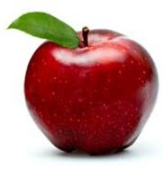
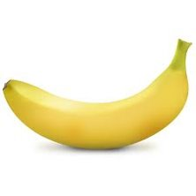
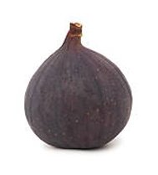
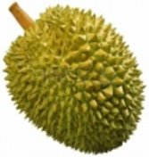
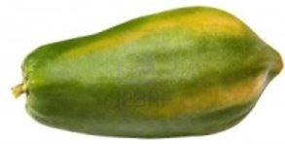
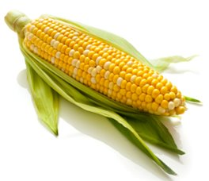
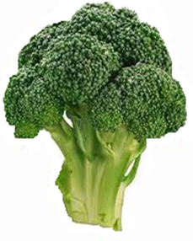
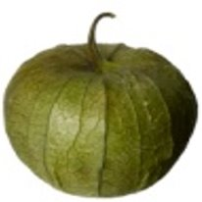
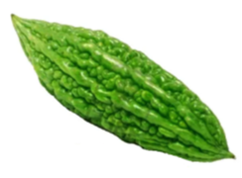
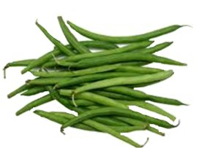
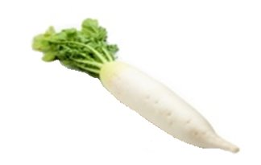
Methods Materials
Familiar Natural Foods
Unfamiliar Natural Foods
Notes:
Please note that we got familiarity ratings which guided our stimuli selection.

Slide 14
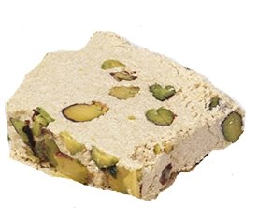
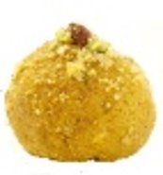
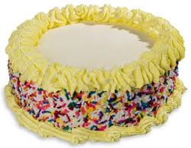
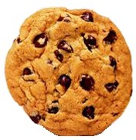
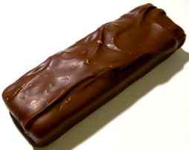
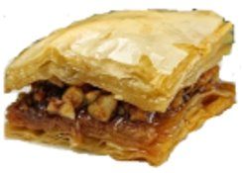
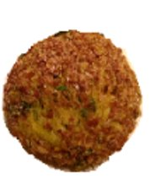
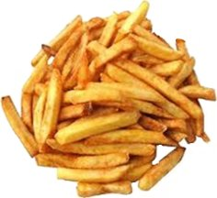
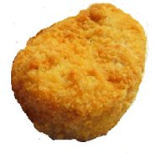
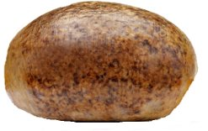
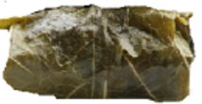
Methods Materials
Familiar Processed Foods
Unfamiliar Processed Foods
Notes:
DR. G: put the pictures of the garden and factory and describe them
Then have a slide with the stimuli we used for each – so one slide with pics of familiar and unfamiliar natural foods, one slide with pics of familiar and unfamiliar processed foods, one slide with pics of familiar and unfamiliar non-food natural kinds and one slide with pics of familiar and unfamiliar artifacts
Too much detail on the material slides you have – no need to describe demographics

Slide 15
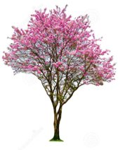
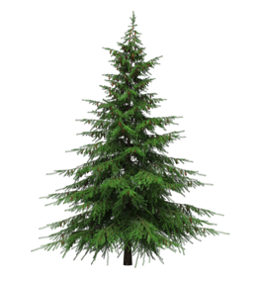
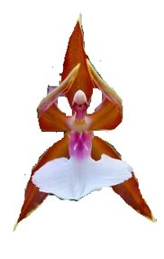
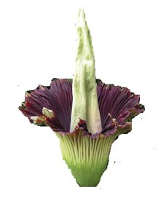
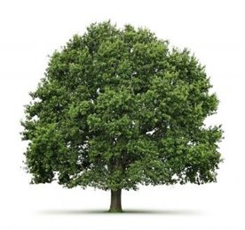
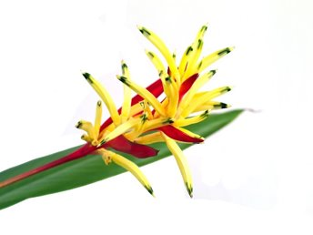
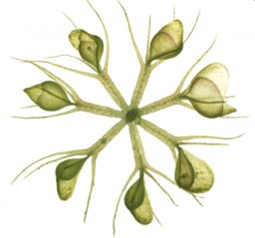
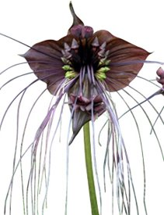
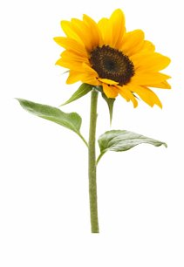
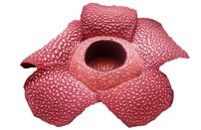
Methods Materials
Familiar Non-Food Natural Kinds
Unfamiliar Non-Food Natural Kinds
Notes:
DR. G: put the pictures of the garden and factory and describe them
Then have a slide with the stimuli we used for each – so one slide with pics of familiar and unfamiliar natural foods, one slide with pics of familiar and unfamiliar processed foods, one slide with pics of familiar and unfamiliar non-food natural kinds and one slide with pics of familiar and unfamiliar artifacts
Too much detail on the material slides you have – no need to describe demographics

Slide 16
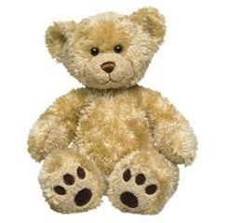
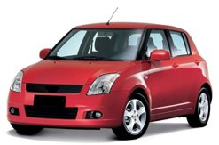
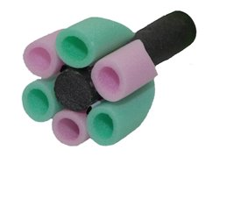
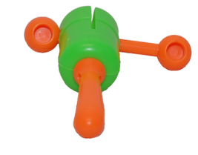
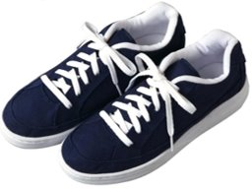
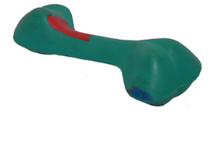
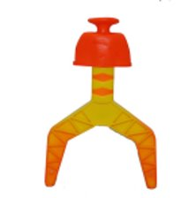
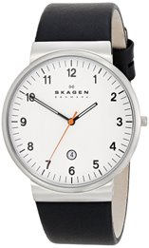
Methods Materials
Familiar Artifacts
Unfamiliar Artifacts
Notes:
DR. G: put the pictures of the garden and factory and describe them
Then have a slide with the stimuli we used for each – so one slide with pics of familiar and unfamiliar natural foods, one slide with pics of familiar and unfamiliar processed foods, one slide with pics of familiar and unfamiliar non-food natural kinds and one slide with pics of familiar and unfamiliar artifacts
Too much detail on the material slides you have – no need to describe demographics

Slide 17
Methods Materials
Notes:
These are the photos we used for a garden and a factory. We presented both of these photos along with pictures of familiar and unfamiliar foods and non-foods (one by one), and asked whether the item was grown in a garden or made in a factory.

Slide 18
Methods Procedure
Notes:
Children were tested via zoom by a researcher and adults did the study online through Qualtrics. We told children that some things grow in a garden, and somethings are made in a factory, and showed them pictures of each. They were then told they would see multiple pictures and they were to decide if the item was either grown in a garden or made in a factory. The photos were shown in a randomized order.
This slide is an example of what the participant saw. See this, this is a banana, is this banana grown in a garden or made in a factory

Slide 19
Results
Dependent Variable: Correct identification of origins
Natural foods and non-food natural kinds grown in a garden
Processed foods and artifacts made in a factory
3 (Age: 3-years, 4-years, adults) x 2 (Familiarity: familiar, unfamiliar) x 4 (Item: natural foods, processed foods, non-natural kinds, artifacts) repeated measures ANOVA

Slide 20
Age x Familiarity x Item Interaction F(6, 231) = 5.14, p < .001
Type of Item
Notes:
Main effects for age, item, and familiarity, but qualified with a 3-way interaction
Age x Familiarity x Item interaction
F(6, 231) = 5.14, p < .001
Follow up analyses revealed – more accurate responses with each older age group.
For all three age groups, no differences in accuracy for familiar and unfamiliar natural foods
Differences between familiarity for other items
Bonferonni corrected – 4s are better at identifying origins of familiar non-foods as compared to foods
Unfamiliar natural foods > non-foods > processed foods
For adults, we find less accuracy in unfamiliar processed foods as compared to all other items, and less accuracy in origins of unfamiliar nonfoods as compared to natural foods, but no differences between the non-foods themselves.
Unfamiliar natural foods > non-foods > processed foods
No differences for 3s in accuracy by item unfamiliar
We find much less accuracy for all age groups with unfamiliar processed foods as compared to other unfamiliar items.

Slide 21
Discussion & Conclusions
Support for hypothesis
Natural foods vs. Processed foods
Non-foods vs. Foods
Experience matters
Properties associated with natural foods that allow for better responses
May have a separate developmental timeline for knowledge of foods vs. knowledge of non-foods
Notes:
There were no differences found between participants’ knowledge of non-foods, but all age groups were better at identifying the origins of natural foods. This shows that there is something special about natural foods that allows children to identify its origin, even for novel natural foods, whereas there was a harder time with unfamiliar processed foods. This could be due to how many different ways processed foods can be created (so many ingredients).
We did find support for our hypotheses based upon our results. Children were better able to identify natural foods vs. processed foods, which can be further supported by the low rate of accuracy found for processed foods. As hypothesized, they also had greater accuracy of identifying the origins of non-food items as compared to foods. We also found support for our hypothesis that greater accuracy of identifying the origins of familiar and unfamiliar foods and non-foods develop with age, with the exception of unfamiliar processed foods.

Slide 22
Future Directions
Role of healthfulness
Natural vs. processed foods
Notes:
Does healthfulness (so healthy or unhealthy) play a role when considering a foods origins
How are we thinking about natural foods vs. processed foods, when does a natural food become a processed food? Is it on a continuum? Or are they two separate categories?

Slide 23
Thank you!
Notes:
We would like to thank all co-authors of this research, all research assistants in the Children’s Learning Lab, and participating parents and families. Thank you!

Slide 24
Questions?

