Slide 1

Getting Researchers Started with Cayuse Human Ethics
Notes:
Welcome to Getting Researchers Started with Cayuse Human Ethics. This training is intended to introduce researchers to all the basics and necessary information have success in making submissions with this new IRB submission platform.

Slide 2

What is Cayuse Human Ethics?
Online submission platform
Smart forms with branching logic
Promotes review efficiency
Eases collaboration efforts
Notes:
What is Cayuse Human Ethics? This is an online submission platform that utilizes smart form logic to provide consistency in information requests and reviews of all study protocols submitted. Through integrated mechanisms on the administrative and reviewer end, this program allows for review efficiency, eases collaboration efforts, and provides more standardized reviews that our current submission portal.

Slide 3
Overview
Accessing Cayuse
Initiating a submission
Login credentials
Creating Submissions
Resources
Account activation
Guest accounts
Access URLs
Find people feature
Cayuse Icons
Internal resources
In-system resources (help center and “hover help”)
Contact information
Cayuse Platform Home and Accessing Human Ethics Product
NOTE: This training is targeted towards users with the Researcher role submitting protocols. Subsequent training will be made available to IRB members and other users with the Analyst role.
Notes:
This is an overview of what will be covered in this presentation. How to access Cayuse Human Ethics, information needed for profile creation, how to create a submission and features and icons to be aware of, and additional resources to ease the submission project and support project development will all be included in this presentation.

Slide 4
Single Sign On
SSO credentials will be used to login to Cayuse
If you receive an error code after logging in your account may need to be activated, contact your IRB administrator at IRB@stockton.edu and provide your first name, last name, Z-number, and GOPortal username.
If you need an external Co-I to access a project email IRB@stockton.edu with their first name, last name, and email.
Notes:
SSO credentials will be used for Stockton affiliates to access Cayuse. In the event of you receiving an error code when logging in, your account most likely has not been activated. Contact irb@stockton.edu and provide your name, z-number, and goportal user. If an external Co-I must access a project, email irb@stockton.edu with their first name, last name, and email. As they are unaffiliated with Stockton they will receive an automated email from Cayuse with a personalized access URL that does not require SSO.

Slide 5
URL : https://stockton.app.cayuse.com/
Bookmark this page for easy access
If there’s a blank screen when the website loads, clear cache and browsing history and reload or if you view a ‘Forbidden’ page, contact your IRB Administrator at irb@stockton.edu
Please note that guest users (external co-investigators or unaffiliated research team members) will have an access URL unique to them provided via email
Notes:
The URL to access cayuse is found here, I would recommend bookmarking this page for ease of access. If you have difficulty accessing the program I recommend clearing your browsing history and refresh the page, or contact your IRB admin at irb@stockton.edu for further assistance. This URL is already linked on the IRB webpage as well.

Slide 6
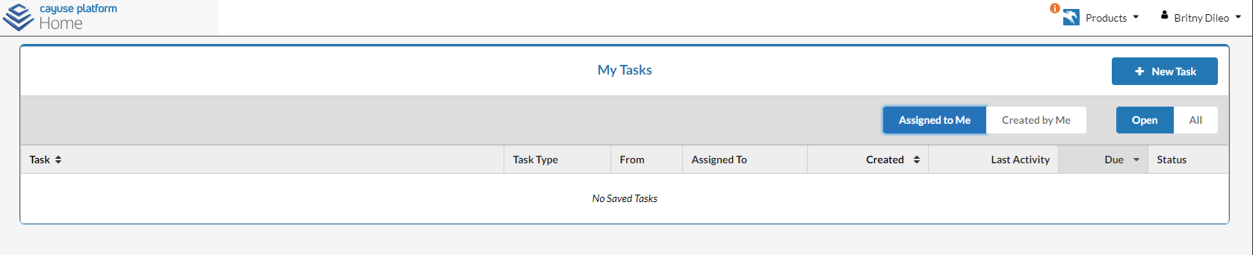
Cayuse Platform Home
Cayuse Platform Home will load first
This page can be used as a To-Do list of tasks assigned by the IRB Administrator or members of your research team
Select New Task to assign a task to yourself, or others
These features can be toggled
Notes:
This is what the Cayuse Platform homepage looks like. One key thing to know is the task feature, here you can assign tasks to your team or to myself as the administrator, simply click the New Task button, look up the person the task is relevant to, provide a due date and description of what is needed. This feature is not necessary to use, but may be helpful for project management.

Slide 7
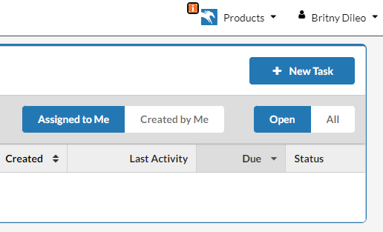
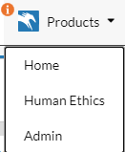
Selecting the Human Ethics Product
Click the product selector drop down
Select Human Ethics
This is the area of most confusion.
You must remember to use the product selector to access the Human Ethics page.
Without doing so, you will be unable to start submissions, access your history of submissions, see comments and modifications, or complete any meaningful task for the protocol submission process.
Notes:
The drop down menu in the top right is the Product Selector, when clicked, you can access a drop down of Cayuse products available. For IRB submission, the Human Ethics product will be utilized. Without selecting the human ethics product no meaningful tasks related to IRB submissions can be performed. We are in the process of setting up grant management software through Cayuse, so other products like that, would also be found in this drop down menu.

Slide 8
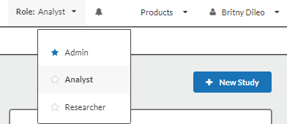
Role Selection
Ensure the Role drop down accurately reflects your role in this submission.
Researcher*indicates you are submitting a protocol to the IRB for review. IRB members will also utilize the Researcher tab for reviewing materials.
Analyst indicates you are IRB staff, such as the IRB Administrator. This role is also assigned to the Chair in the event of an administrator’s absence.
Admin indicates you are able to register new users, update templates, and update form contents.
*In most cases, this will be the only role assigned
If you have multiple roles, the blue star icon indicates what role you will automatically sign into when you enter the Cayuse Human Ethics product.
Drop down menu is unavailable if you only have one role.
Notes:
If you have multiple roles, ensure the Role drop down menu accurately reflects your role in this submission. This role selector is most relevant for individuals with dual roles, in particular the IRB Chair. In most cases the only role assigned will be researcher. In the event you have multiple roles, use the star icon to indicate what role you will automatically sign into if you have a preference.

Slide 9
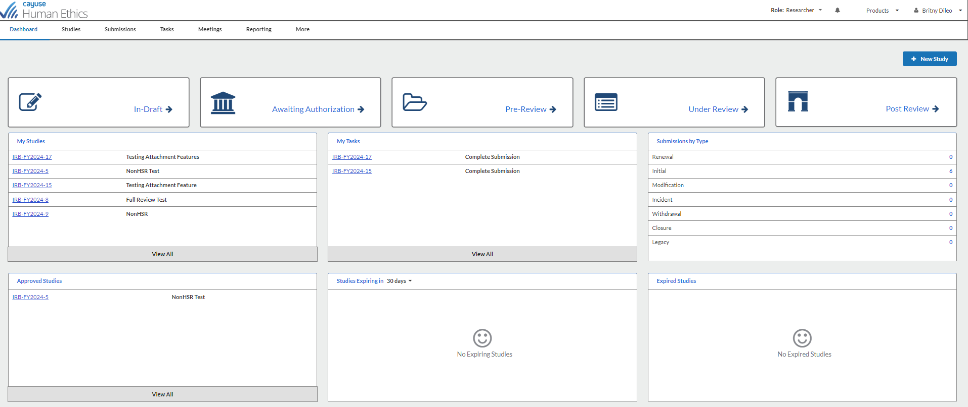
Cayuse Dashboard
Notes:
This is a preview of the Cayuse Human Ethics Dashboard. The content conveyed in this homepage is specific to you and your role. In the following slides I will cover what the major parts of this page mean.

Slide 10
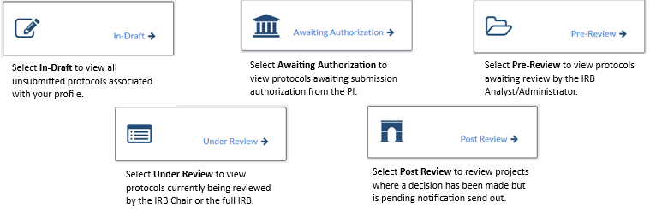
Dashboard Functionality
Notes:
In-Draft items are as implied, protocols that have yet to be submitted. It is important to note that IRB administrators and staff can still see the progress of your submission in real time, which is useful if you need assistance. Awaiting authorization means that the submission still needs a certification from the PI to route to the IRB admin, if you are the only research team member, you can self-certify your submissions. Pre-Review notifies you of what submissions of yours are pending review by the Administrator. The administrator may get back to you with revisions or move the submission along to an IRB chair to determine category of review and if full review is needed. If pushed along, the submission then goes into the Under Review status. Post review means a decision has been made by the IRB, in most cases this will be a status for full review items and is pending decision notification to be sent. Sometimes decision notifications may not be immediate if the IRB admin is summarizing revisions requested by the full IRB at the most recent convened meeting.

Slide 11
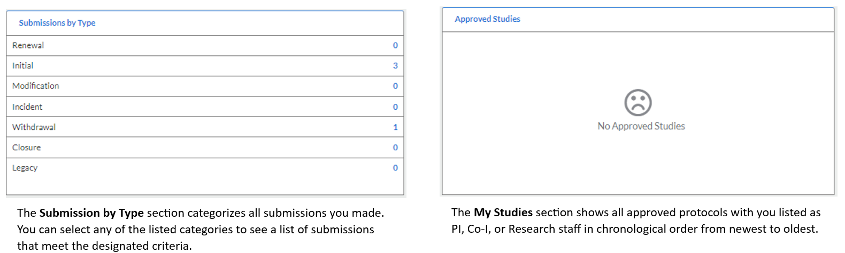
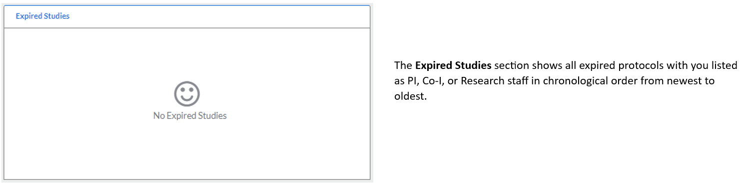
Dashboard Functionality
Notes:
These are sections at the bottom of the Cayuse Human Ethics homepage. Your studies are categorized by type, all approved studies are listed with hyperlinks for ease of access, and if a study expires they will be listed as well. Not shown here, there is a section of studies expiring within the next 30, 60, and 90 days so you can get a head start on your renewal submissions.

Slide 12
Select “+ New Study” to begin your submission.
Notes:
To begin a new submission, select the + sign in the top right

Slide 13
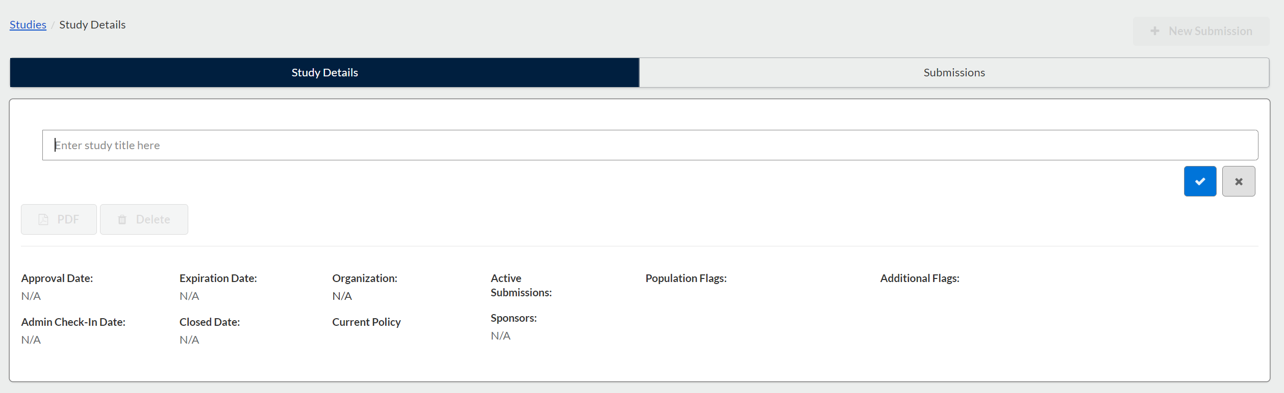
Creating a New Submission
Enter study title here.
Protocol number will be automatically assigned.
Use the blue check mark to confirm the study title.
Once the blue check mark is selected, the repository for this study is created.

Slide 14
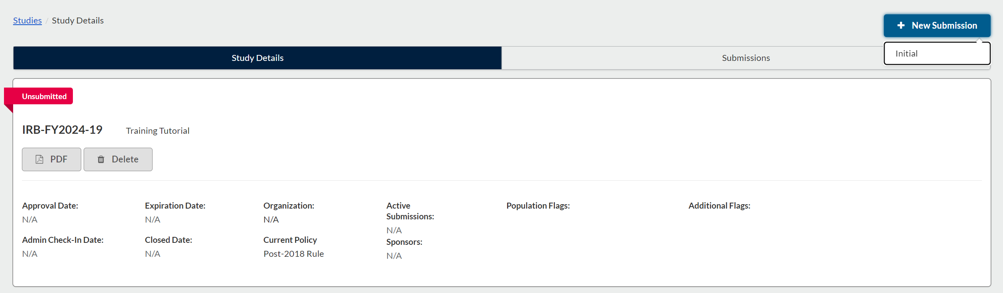
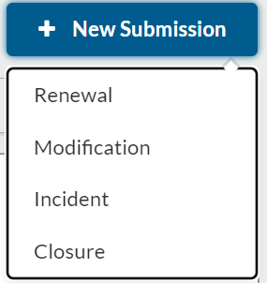
The delete study option is only available prior to beginning a submission.
Select “+ New Submission,” to access a drop-down menu with potential submissions to make.
With new studies, only initial submissions can be created. Once reviewed and approved by the IRB other submission options will be made available through this same drop-down menu.
The red “unsubmitted” flag signifies this study has yet to undergo IRB review. It will change to a green “approved” flag once reviewed and approved.

Slide 15
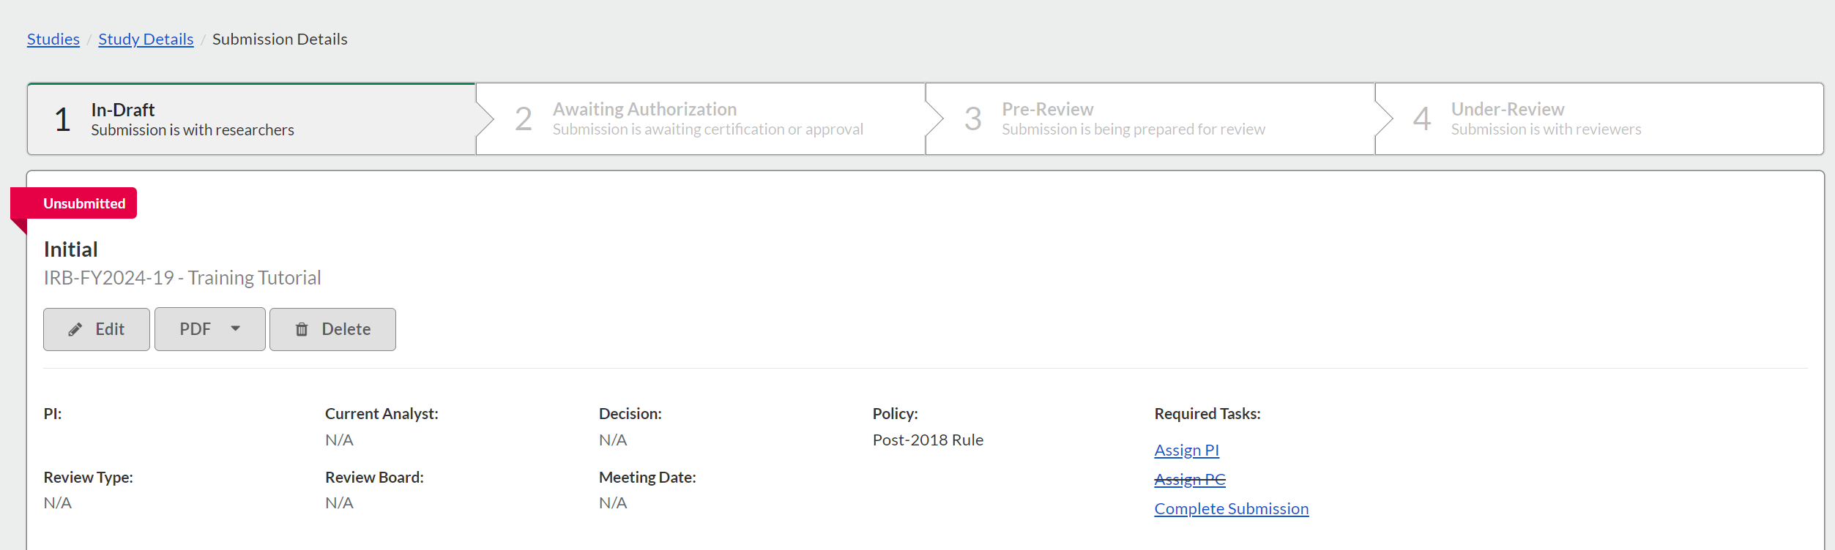
Select Edit to begin the submission process

Slide 16
Initial Submission
Cayuse Human Ethics utilizes SmartForm logic
Ensure you read questions carefully and answer as accurately as possible
Your responses may trigger subsequent fields, attachments, and other prompts to appear and require attention
This is to ensure that submissions catered to the type of protocol being proposed and to minimize requests for additional information.

Slide 17


Cayuse Icons
White check marks to the right of each section indicate that all required fields have been filled out. All sections must have white check marks prior to submitting for review.
Red asterisks indicate required fields.
The “Save” button can be found on the top right to manually save, however whenever you move onto another section the submission contents will auto-save.
Black question marks found on the far right of questions are customized help text. Click the question mark to access information such as definitions, federal guidelines, and other relevant information that may assist you.

Slide 18
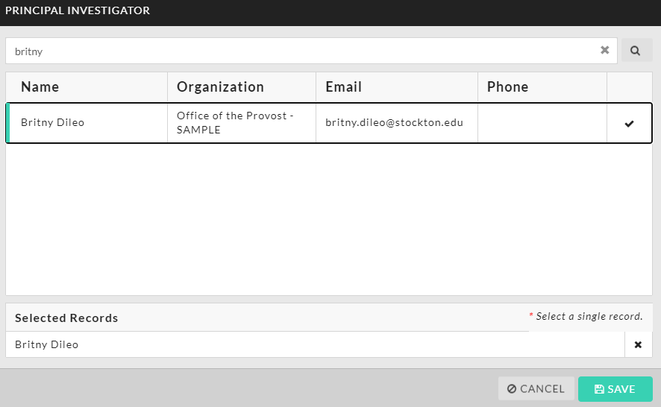
Find People Feature
Selecting the “Find People” button will prompt to this screen.
Any question in your submission with the find people feature will note whether you can select multiple records in the bottom right.

Slide 19
Major Differences Between Systems
Internal IRB System | Cayuse Human Ethics
Summarize changes made when a Change in Research request is made | All changes are tracked; no summaries needed
Students cannot create submissions; faculty sponsor must transcribe students’ work for dissertation or thesis | Students can be the PI on a submission. Faculty sponsor is assigned to the study, has full edit access and certify submissions of students before reaching the IRB.
Inability for Co-Is (internal and external) to have real time access to IRB submissions they’re associated with. | Co-Is have full edit access so long as you certify and sign off on their submissions. Useful for incident reports due to need for timeliness in reporting.
CITI training must be manually loaded | Cayuse is synced with CITI, if your affiliated email is used for your CITI account, all training records can be accessed on Cayuse.
Pretty broad information requests. No clarity on potential documentation needed. | Smart Form logic will auto prompt for various documents you may need.
Issue with sign offs, require waiting on IT or revising submission. | Administrative certification option available.

Slide 20
Resources
In-System
  Hover Help – If you see a black question mark on the far right of any given question, click it for more details. This is customized help text created by the IRB to support your submission and may contain details on definitions, appropriate timelines, federal guidelines, and even links to help answer your question
  Resource Center – In the bottom right of any given page on Cayuse there is a blue circle with a white question mark. This grants access to the resource center. Here you can access Cayuse articles relevant to the current page you’re on or you can search for more specific assistance
Internal
  Templates are available on the Stockton University IRB webpage. Templates include but are not limited to informed consent, child assent, parental permission, letters of support, and recruitment
  Schedule a one-on-one meeting with your IRB administrator who can review your submissions in real time even if they’re in draft status to provide support

