Slide 1
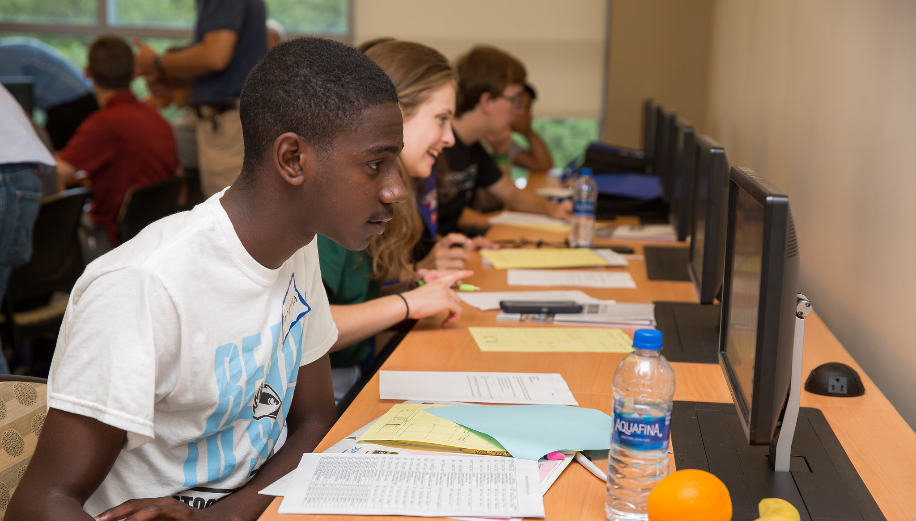
New Student Orientation at Stockton University
Science, Math, Pre-Professional,
and Undecided Majors
https://stockton.edu/sciences-math
/

Slide 2
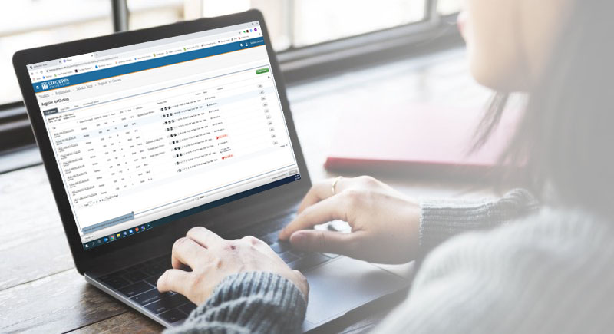
Registering for Classes
After online orientation training modules are complete, the following curriculum guidelines will help choose your courses
nams-registration@stockton.edu

Slide 3
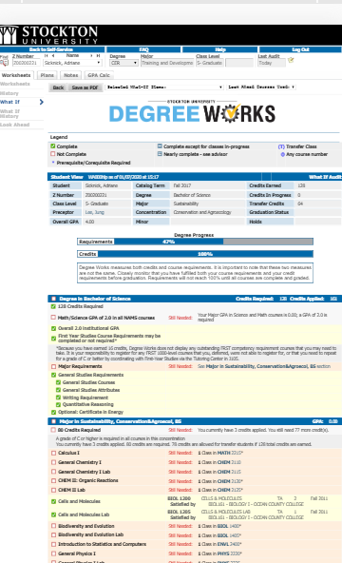
Degree Requirements
Earn 128 credits for either B.A. or B.S.
Earn at least 32 of the final 48 credits at Stockton
Meet all general studies, at some distance (ASD) and program/major requirements
Earn at least a 2.0 cumulative GPA for all courses taken at Stockton
Earn at least a 2.0 cumulative GPA for all science and math courses taken at Stockton

Slide 4
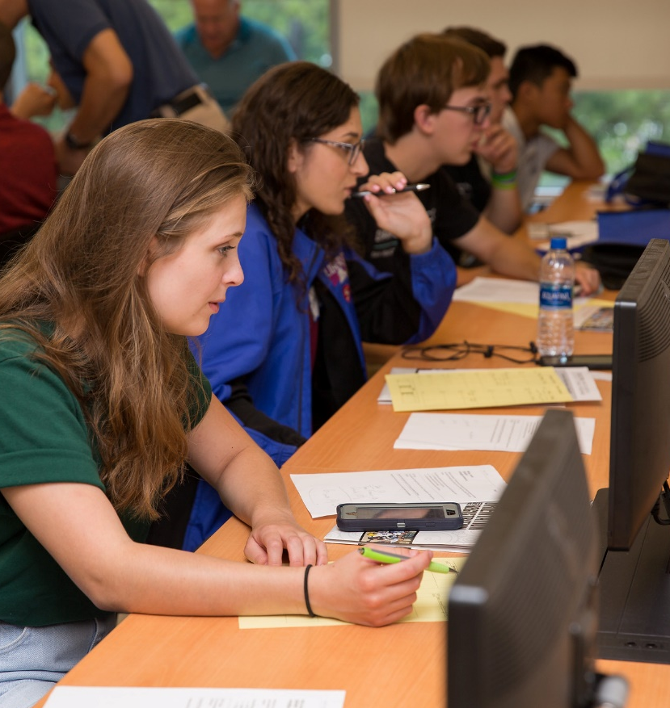
What Classes Should I Register For?
FRST 1000 level/Developmental - dependent on your placement testing or SAT/ACT scores
Freshman seminar (GXX 10XX) or transfer seminar (GXX 20XX) - list available
General Studies G-distribution courses – some taught by NAMS faculty
At some distance courses
Major-related courses
Writing (W) and Quantitative Reasoning (Q) courses
AHVI attributes : Arts, Historical Consciousness, Values/Ethics, International/Multicultural )

Slide 5



Math Requirements and Course Placement:
Stockton Is Test Optional
However, science majors must be “pre-calc ready”
Intermediate Algebra (GNM 1126) OR
Algebraic Problem Solving (FRST/GNM 2310)
  SAT Below 570
  ACT Below 24
  Accuplacer QAS 256
Precalculus (MATH 1100)
  SAT 570 – 610
  ACT 24 – 27
  Accuplacer APAA 245 – 275
Calculus (MATH 2215)
  SAT 620 and above
  ACT 28 and above
  Accuplacer APAA 276 and above

Slide 6

Writing and Quantitative Reasoning Requirement
W1
W1/W2
W1/2
W1/W2
3000 or above
Q1
Q2
Q1/Q2
Q courses – NAMS curriculum will handle this requirement
Freshmen:
Take one Q1 course Freshman year and Take one W1 course Freshman year (no need to take both in the same semester)
Transfer Students:
Two W1 & Q1 courses may be transferred in
W2 & Q2 courses MUST be taken at Stockton

Slide 7
Important Curriculum Rules
  25% of all the courses taken at Stockton must be General Studies courses – transfer student and freshman admits
For Students transferring 64 credits or more
  General Studies requirement is lowered to 16 credits.
  The ASD increases from 32 - 48 credits for BA | from 16 to 32 credits for BS
  -Beneficial to students with many transfer credits that will not fulfill program requirements, but can fulfill ASD requirement
  -A BA is more flexible for these students than a BS
  16 General Studies credits - no requirement to maintain G-course distribution ratios
  -However MUST take one, 4-credit GIS course as a junior or seniors

Slide 8
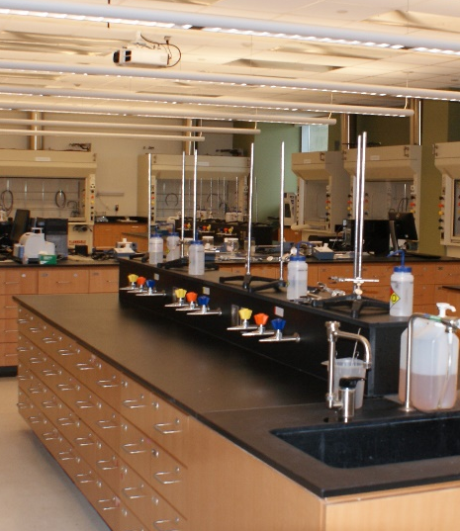
Courses with Labs
Labs sometimes count for one credit and meet about 2 ½ hours per week
These courses require a lab that is scheduled independently (corequisite or co-req)
  Students wanting to register for closed sections of courses with co-requisite lab should add themselves to the waitlist for the desired LAB section. If you get a lab seat, you will be given a lecture seat. No waitlist on lecture.
Some labs are scheduled with the course
Physics I, II and III meet 4 times a week
Calculus I, II and III meet 4 times a week
NAMS freshmen may generally take their first semester:
Math course (4 credits)
Science course with lab (4-5 credits)
Second science course with lab (4-5 credits)
Freshman seminar or writing course (4 credits)
Some labs are
1 Credit
Most courses are
4 Credit Courses

Slide 9

vs.
Corequisite
(Co-Req)
Prerequisite
(Pre-Req)
Course or other requirement that a student must take at the same time as another course or requirement
Course requirement that a student must take before another course
Prerequisites ARE NOT listed in Degree Works. It is your responsible to read course descriptions and ascertain what course requirements are before registering.

Slide 10
Common issues with registration:
Error message and can’t resolve – contact the NAMS office with the error message details, (co-req, pre-req etc.)
On a waitlist for lab and receive notification of eligibility to register
[48 hours until drop/add, then 24 hours] for the lab. If lecture is full, contact NAMS office for an override
If need permission of instructor (POI), contact the professor directly -
Overrides: Contact Amanda Allen 609.652.4546 or use the override form -
Stockton/sciences-math/contact-us

Slide 11

Learning Management System - Blackboard
Syllabus, content, assignments, course announcements, assignment grades etc.
Blackboard is a tool that is utilized differently for each of your classes.
Student tutorials [https://stockton.edu/blackboard-tutorial/student-tutorials/index.html] are accessible 24/7 through the Stockton website.

Slide 12
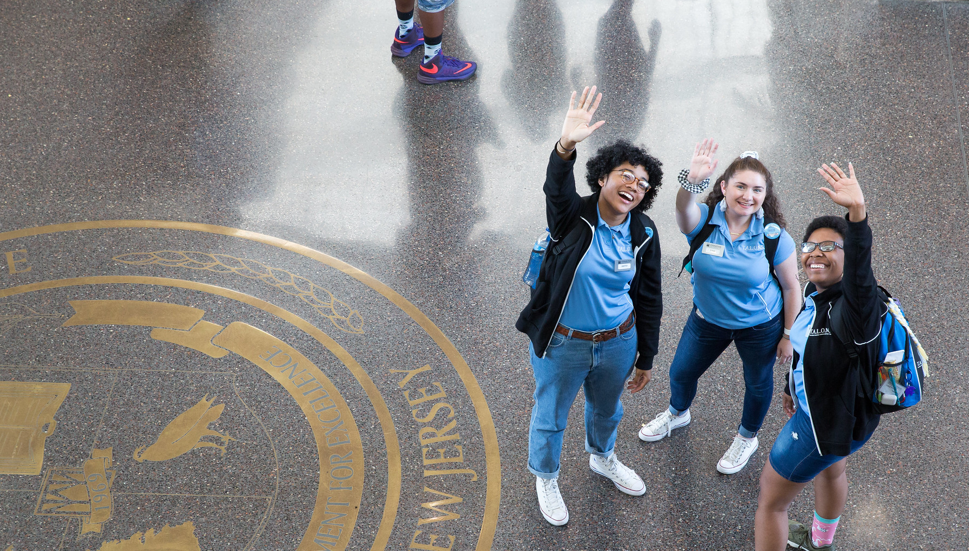
All orientation modules need to be completed before your assigned registration day. If you have not completed, please go back and finish.
Welcome to Stockton!

