Slide 1



Teach people your main takeaway on the first slide.
Include your own imagery too.

Slide 2
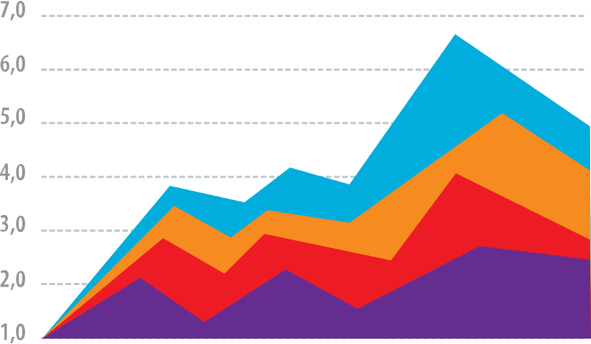

Now add a key figure and explain what it shows.

Slide 3
(Give them a couple slides to process figures)

Slide 4
Who cares? Explain why your finding matters.

Slide 5
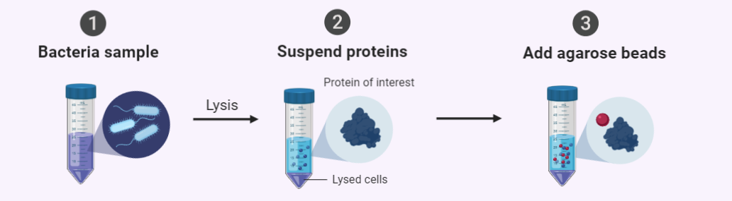
Teach your methods in steps
1
Bacterial Sample

Slide 6
Teach your methods in steps
1
2
Bacterial Sample
Suspend Proteins

Slide 7
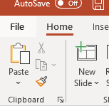
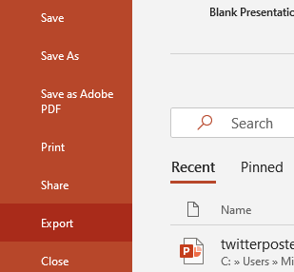

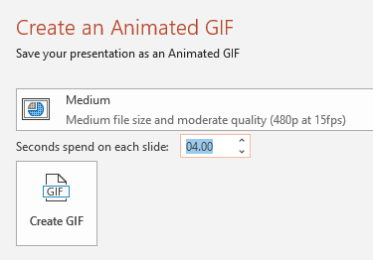
All done? Save as an animated GIF:
1. File
2. Export
3. Create Animated GIF
4. Set Quality to Medium and Seconds to ~4-5

Slide 8
Extras.
Delete these slides when you’re ready to save.

Slide 9
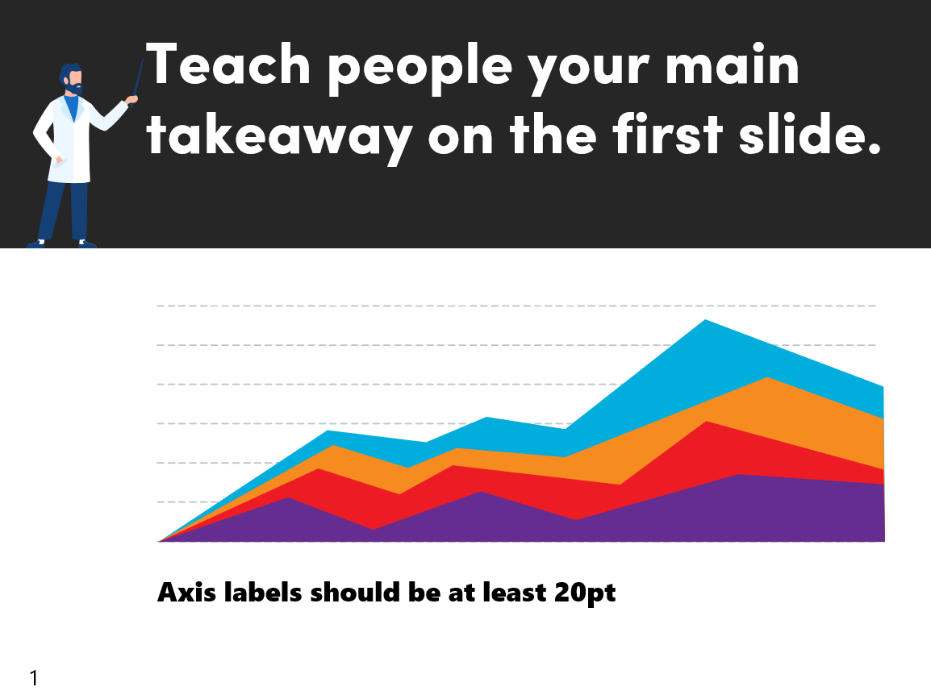







Choose a timer graphic
(Copy-paste onto your slides)
FOR LIGHT BACKGROUNDS
FOR DARK BACKGROUNDS
5 seconds
4 seconds
3 seconds
5 seconds
4 seconds
3 seconds
FOR ANY BACKGROUND
4 seconds
8 seconds
8 seconds
4 seconds

Slide 10
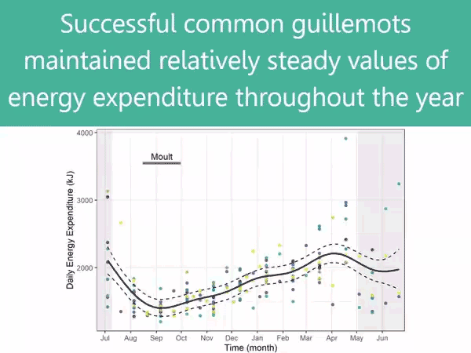



Examples (play this slide)
Donated by Ruth Dunn
Donated by Mike Morrison

